Slide 1
Teacher survey and interviews
Heleen Hofmeyr & Irene Pampallis

Slide 2
Goal: Understanding teacher motivation and incentives

Slide 3
Why motivation?
Teachers’ motivations determines how long they will stay in the profession and their commitment to their jobs (Sinclair, 2008).
It also determines which incentives they will respond to i.t.o. being willing to teach in certain schools.

Slide 4
What do we know?
Findings from TALIS 2018:
80% of teachers report being satisfied with their jobs.
A high proportion (45%) of teachers want to change schools.
A quarter of teachers under 50 want to leave the profession in the next 5 years.
1 in 5 teachers regret becoming a teacher.
2. Provinces struggle to place teachers in rural schools.

Slide 5
What do we know? (cont.)
3. Many ITE graduates don’t become teachers.
4. Many teachers leave the profession.

Slide 6
What don’t we know?
The why behind the above, e.g.:
What is it that makes rural schools unattractive?
Is it simply that they don’t want to live in a rural area?
Working conditions/school infrastructure?
Why do some ITE graduates not become teachers?
Did they never intend to become teachers?
Did their studies and practicals put them off the profession?
Notes:
These are the things we hope to understand better with the survey and interviews.

Slide 7
What don’t we know? (cont.)
Who is most likely to teach in certain areas or respond to certain incentives?
Are younger teachers more willing to take up jobs in rural areas? How much does personal background affect where we are willing to teach?
The extent of the problem of staffing rural schools
What proportion of young teachers are willing to work in these schools?
Notes:
These are the things we hope to understand better with the survey and interviews.

Slide 8
Motivations for becoming a teacher
Overview of the survey
Job satisfaction
Geographic preferences

Slide 9
Who are we surveying?
Teachers in government schools
Teaching 5 years or less
Aiming for representation from:
All 9 provinces
Schools in rural areas, small towns, big towns, cities
High schools & primary schools
Notes:
Teaching 5 years or less: volatile time (important to find out what motivates these teachers - to keep them in the profession - training efficiency and chance to develop as a teacher.

Slide 10
Timeline
May 2023
June 2023
October 2023
August 2023
December 2023
Survey piloted with teachers
Instruments finalised
Survey data analysed
Jan | Feb | Mar | Apr | May | Jun | Jul | Aug | Sept | Oct | Nov | Dec
Survey distributed to teachers
Report released

Slide 11
We need your input!
We want our survey to answer questions that are relevant to your needs.
*What are the most important issues i.t.o. recruiting teachers?
*Are there important questions we aren’t asking?
*Do some of our questions miss the mark?
Notes:
E.g. If there is an incentive programme that you are currently using/thinking of using to attract teachers to your area, you might want to check that incentive’s attractiveness.
E.g. If you know that young teachers struggle with a lack of support from older colleagues, or certain areas are hard to staff because of a high prevalence of malaria, and that doesn’t appear in the survey…
E.g. If there is something you really want to know about the teachers in your province

Slide 12
Group 1
Teacher characteristics
(Sections 1 & 2)
Group 2
Becoming a teacher
(Sections 3 & 4)
Group 3
Where to teach?
(Section 5)
Group 4
Job satisfaction & inclination to leave teaching
(Section 6)
Read through the questions in your section of the survey
Discuss whether you think they are useful. Would you change them?
Write comments on the paper surveys.
Write suggested questions on post-it notes.
If you finish with your section, feel free to comment on another section!
Notes:
In a moment I’ll ask you to choose a group
(Brief description of each group)
Raportteur for each group - nominate someone to give feedback at the end

Slide 13
Where is the survey?
Paper copies of the draft will be given to each group.
If you want to view it on your device:
https://tinyurl.com/5erberdh
Notes:
E.g. If there is an incentive programme that you are currently using/thinking of using to attract teachers to your area, you might want to check that incentive’s attractiveness.
E.g. If you know that young teachers struggle with a lack of support from older colleagues, or certain areas are hard to staff because of a high prevalence of malaria, and that doesn’t appear in the survey…
E.g. If there is something you really want to know about the teachers in your province

Slide 14
Any other thoughts?
Anything else that came from the group discussions?
Something raised by another group?
Any points that haven’t been raised?
Notes:
E.g. If there is an incentive programme that you are currently using/thinking of using to attract teachers to your area, you might want to check that incentive’s attractiveness.
E.g. If you know that young teachers struggle with a lack of support from older colleagues, or certain areas are hard to staff because of a high prevalence of malaria, and that doesn’t appear in the survey…
E.g. If there is something you really want to know about the teachers in your province

Slide 15
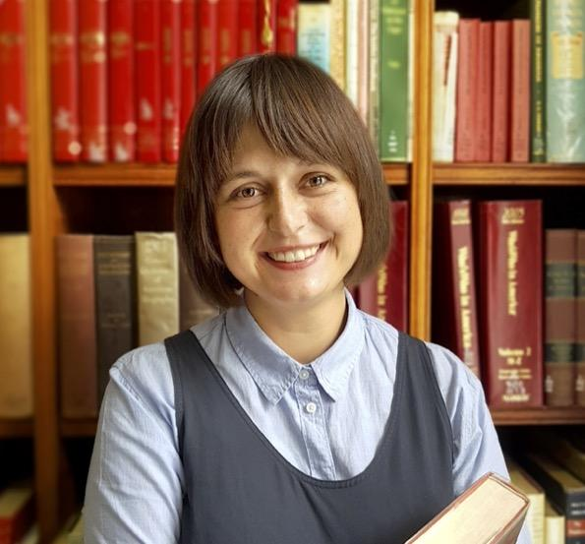
Contact us
Heleen Hofmeyr
Irene Pampallis
heleenhofmeyr@gmail.com
irene.pampallis@gmail.com

