Slide 1
Provincial Spotlight Series
TDD Provincial Spotlight Dialogue
25 May 2023

Slide 2
Overview
Provincial engagements in June/July and November 2023
Key Aim: Narrow the distance between research, policy and planning
Inform
Consult
Involve
Colloborate
Empower
One-way information flow
Information exchange
Source: adapted International Association for Public Participation (2000)

Slide 3
Targeted Stakeholders
Head of Departments (HoDs),
Deputy Director-Generals (DDGs),
Directors,
Provincial Treasury Officials,
District Directors,
Planners at the provincial level;
HEDCOM Sub-Committees (Planning, Monitoring & Evaluation and Human Resource Matters and Initial Teacher Education )

Slide 4
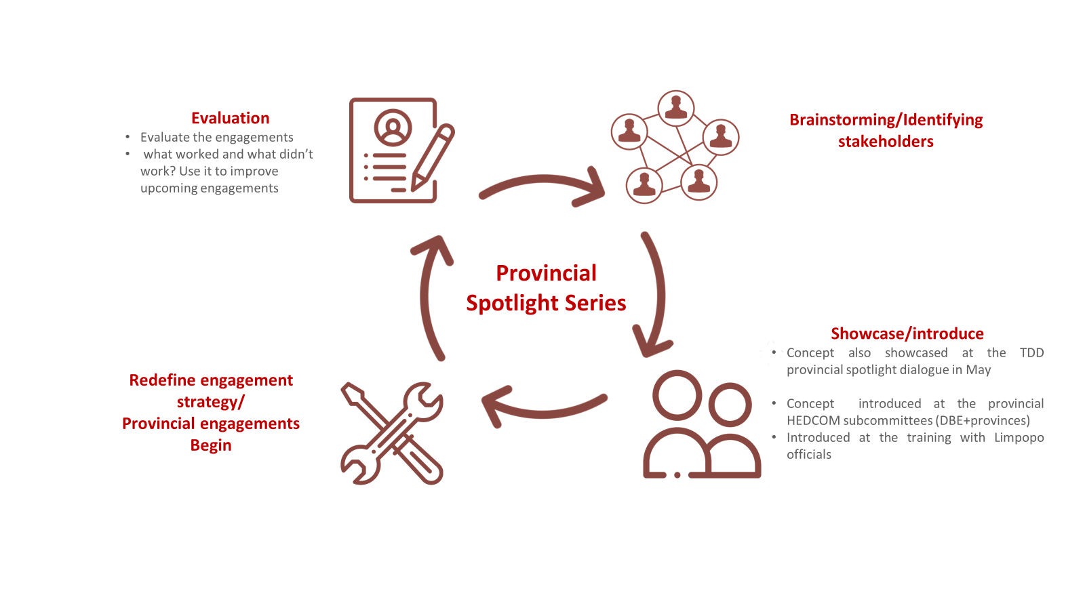
Engagement Process

Slide 5
Thank you.
email: ppntaka@gmail.com

