Slide 1
25 May 2023
Provincial Educator Demand 2021 – 2030
TDD Provincial Spotlight Dialogue

Slide 2
Background and context
Provincial Educator Demand Background
National projections on educator supply and demand were produced last year (Gustafsson, 2022)
Selected findings now broken down by province
Focus on province-specific projected educator demand, less emphasis on supply
Provincial Spotlight Series
First event of this series is this workshop
Cascade to provinces - Meeting with HODs, DDGs, District directors, HEDCOM sub-committees
Timeline: Jun to Jul 2023 and later in the year around Nov 2023
Report [Forthcoming]

Slide 3
Provincial demand presentation summary
1
Age distribution of educators
→ Indicator of likely increase in age-related retirement rates
Projected resignations and retirements to 2030
→ Indication of joiners needed to replace retirees & resignations
Historical and projected enrolment and population growth
→ Likely change in overall demand for the total number of educators
Historical school and educator growth
→ Indication of changes in educator ranks and independent school trends
Appointment and class size implications of educators, enrolment and school trends
→ Potential effects of responses to educator and enrolment projections
Projected educator cost trends
→ Financial implications of the change in age distribution
Educator movements between provinces and schools
→ Potential to reallocate teachers between schools or provinces
2
3
4
5
6
7

Slide 4
Age distributions and projected retirements and resignations
1
2

Slide 5
Educator age distribution (2021)
1
Age: 53
Source: Anonymised PERSAL data from 2021, only educators (Rank 60 000 – 69 999) are considered. ECD practitioners, TVET lecturers and ABET teachers were removed.

Slide 6
Educator age distribution (2021)
1
Higher peak
Average peak
Lower peak
Most affected
Least affected
Source: Anonymised PERSAL data from 2021, only educators (Rank 60 000 – 69 999) are considered. ECD practitioners, TVET lecturers and ABET teachers were removed.

Slide 7
Older teacher proportions for non-teacher and primary schools educators
1
 |  | Percentage of educators aged 50+ in 2021
Province |  | All educators |  | Non-teachers (HOD, Dep.- principals, Principals & Other) |  | Primary school educators
EC |  | 51% |  | 71% |  | 58%
FS |  | 43% |  | 65% |  | 49%
GP |  | 41% |  | 65% |  | 42%
KN |  | 39% |  | 65% |  | 44%
LP |  | 58% |  | 81% |  | 63%
MP |  | 50% |  | 73% |  | 55%
NC |  | 43% |  | 69% |  | 44%
NW |  | 47% |  | 70% |  | 52%
WC |  | 42% |  | 73% |  | 40%
Source: Anonymised PERSAL data from 2021, only educators (Rank 60 000 – 69 999) are considered. ECD practitioners, TVET lecturers and ABET teachers were removed. The 2021 rankclass file was expanded to include ranks found only in years prior to 2021, used to classify educators by rank. Primary school only includes all educators that are in a component that is classified as a Primary school.

Slide 8
Educator age distribution (weighted in 2021)
1
Source: Anonymised PERSAL data from 2021, only educators (Rank 60 000 – 69 999) are considered. ECD practitioners, TVET lecturers and ABET teachers were removed.

Slide 9
Educator age distribution in 2021 & 2030
1
Assume constant 2021 educator numbers
Source: Anonymised PERSAL data from 2021, only educators (Rank 60 000 – 69 999) are considered. ECD practitioners, TVET lecturers and ABET teachers were removed. Estimates to 2035 derived from the National and provincial models – assumption of no growth in educator numbers.

Slide 10
Educator age distribution in 2021 & 2030
1
Assume constant 2021 educator numbers
A much flatter age distribution is expected in 2030
2021
2030
Source: Anonymised PERSAL data from 2021, only educators (Rank 60 000 – 69 999) are considered. ECD practitioners, TVET lecturers and ABET teachers were removed. Estimates to 2035 derived from the National and provincial teacher supply and demand models – assumption of no growth in educator numbers.

Slide 11
Educator age distribution expected in 2030
1
Assume constant 2021 educator numbers
2021
2030 projected
Same flatter distribution in 2030, seen for all provinces
% of educators at this age
Source: Anonymised PERSAL data from 2021, only educators (Rank 60 000 – 69 999) are considered. ECD practitioners, TVET lecturers and ABET teachers were removed. Estimates to 2035 derived from the National and provincial teacher supply and demand models – assumption of no growth in educator numbers.

Slide 12
Projected resignation & retirements (LP)
Provincial example
2
Assume constant 2021 educator numbers
Proportion of Educators
The majority of educators that exit PERSAL in Limpopo are retirees (ages 56 to 65)
The resignation rate in Limpopo is low. Very few educators opt to leave teaching before retirement
The number of young teachers (ages 21-30) resigning is projected to increase as the number of newly hired young teachers increases.
All educators that leave PERSAL or change to something that is not an educator are classified as having either:
Resigned: Ages 21-55
Retired: Ages 56+
Projected
Source: Anonymised PERSAL data from 2021, only educators (Rank 60 000 – 69 999) are considered. ECD practitioners, TVET lecturers and ABET teachers were removed. Estimates to 2035 derived from the National and provincial teacher supply and demand models – assumption of no growth in educator numbers. Note: Retirements refer to all educators, aged 56 to 65, that leave PERSAL, whilst resignations refer to all educators aged 55 and below that leave PERSAL (as educators) for any reason.

Slide 13
Projected resignation & retirements (LP)
Provincial example
2
Assume constant 2021 educator numbers
Retirement headcount
The number of retirements is projected to increase, peaking in ~2028 and then declining again
The number of retirements is projected to increase from about 2,000 in 2022 to about 3,000 in 2028, an increase of about 1,000 retirements annually
Projected
Number of retirements
Source: Anonymised PERSAL data from 2021, only educators (Rank 60 000 – 69 999) are considered. ECD practitioners, TVET lecturers and ABET teachers were removed. Estimates to 2035 derived from the National and provincial teacher supply and demand models – assumption of no growth in educator numbers. Note: Retirements refer to all educators, aged 56 to 65, that leave PERSAL, whilst resignations refer to all educators aged 55 and below that leave PERSAL (as educators) for any reason.

Slide 14
Projected resignation & retirements (GP)
Provincial example
2
Assume constant 2021 educator numbers
Proportion of Educators
The majority of educators that exit PERSAL in Gauteng are resigning (ages 55 or below)
The retirement number rises and peaks in 2030 and 2031, but remains smaller than resignations
The number of young teachers (ages 21-30) resigning is projected to increase as the number of newly hired young teachers increases.
Projected
Source: Anonymised PERSAL data from 2021, only educators (Rank 60 000 – 69 999) are considered. ECD practitioners, TVET lecturers and ABET teachers were removed. Estimates to 2035 derived from the National and provincial teacher supply and demand models – assumption of no growth in educator numbers. Note: Retirements refer to all educators, aged 56 to 65, that leave PERSAL, whilst resignations refer to all educators aged 55 and below that leave PERSAL (as educators) for any reason.

Slide 15
Projected resignation & retirements (GP)
Provincial example
2
Assume constant 2021 educator numbers
Retirement headcount
The number of retirements is projected to increase, peaking in ~2030 & 2031 and then declining again
The number of retirements is projected to increase from just under 2,000 in 2022 to just under 3,000 in 2031, an increase of about 1,000 retirements annually
Projected
Number of retirements
Source: Anonymised PERSAL data from 2021, only educators (Rank 60 000 – 69 999) are considered. ECD practitioners, TVET lecturers and ABET teachers were removed. Estimates to 2035 derived from the National and provincial teacher supply and demand models – assumption of no growth in educator numbers. Note: Retirements refer to all educators, aged 56 to 65, that leave PERSAL, whilst resignations refer to all educators aged 55 and below that leave PERSAL (as educators) for any reason.

Slide 16
Projected retirements to 2035
2
Assume constant 2021 educator numbers
Projected cumulative retirements as a proportion of total educators in 2021
A year later, EC at about a half (2032)
By 2031, about half of LP educators from 2021 will have retired
About ~220K
educators estimated to retire by 2035
(just over half of 2021 educators)
50%
Source: Anonymised PERSAL data from 2021, only educators (Rank 60 000 – 69 999) are considered. ECD practitioners, TVET lecturers and ABET teachers were removed. Estimates to 2035 derived from the National and provincial teacher supply and demand models – assumption of no growth in educator numbers. Note: Retirements refer to all educators, aged 56 to 65, that leave PERSAL, whilst resignations refer to all educators aged 55 and below that leave PERSAL (as educators) for any reason.

Slide 17
Provincial population and enrolment trends
3

Slide 18
Provincial enrolment trends (2012–2021)
3
High growth
Moderate growth
Stable
Decline
Source: Enrolment numbers taken from School Realities-EMIS (2012 – 2021) released by the DBE, using total numbers for ordinary public and independent schools.

Slide 19
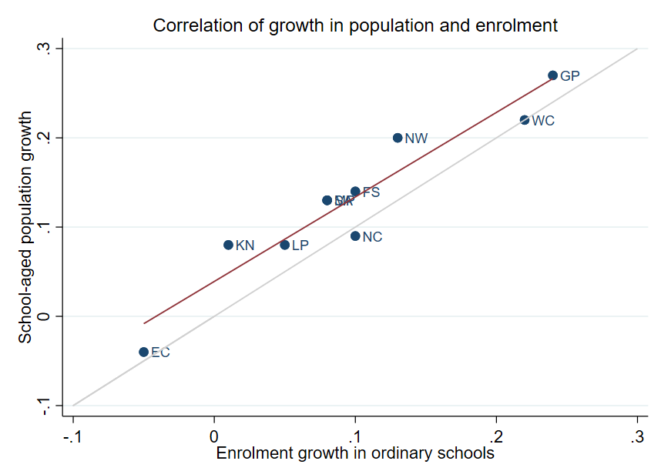
Correlation between population and enrolment growth (2012-2021)
3
R² = 0.9025
Strong positive correlation between population and enrolment growth between 2012 and 2021
45˚
Source: Thembisa age specific data V4.5 for school-aged population (Ages 7-18) estimates and enrolment taken from School Realities-EMIS (2012 – 2021) released by the DBE, for numbers on ordinary public and independent schools (Statistical Publications (education.gov.za))

Slide 20
Projected growth in school-aged population
3
Projected population growth of children aged 7–18 between 2021 and 2030
Decline
High growth
Note: Period 2021 – 2030 is the same timeframe, nine years, as 2012 – 2021.
Source: Thembisa age-specific estimates from the model V4.5 for children aged 7-18 by province

Slide 21
School-aged population estimates to 2030
3
63%
of all provincial population headcount growth is projected to take place in Gauteng
(in-migration)
Change in number of school-aged children
(in thousands of children)
Note: Period 2021 – 2030 is the same timeframe, nine years, as 2012 – 2021.
Source: Thembisa age-specific estimates from the model V4.5 for children aged 7-18 by province

Slide 22
School-aged population estimates to 2030
3
 | Number of children (Aged 7–18) |  |  |  | Growth '12–'21 | Growth '21–'30
Province | 2012 | 2021E | 2030E |  | Growth '12-21 | Growth '21-30
EC | 1 657 202 | 1 598 475 | 1 361 637 |  | -4% | -15%
FS | 592 445 | 676 489 | 650 820 |  | 14% | -4%
GP | 1 962 793 | 2 498 533 | 3 180 884 |  | 27% | 27%
KN | 2 485 822 | 2 690 378 | 2 657 716 |  | 8% | -1%
LP | 1 395 864 | 1 507 386 | 1 612 125 |  | 8% | 7%
MP | 977 749 | 1 100 594 | 1 165 728 |  | 13% | 6%
NC | 254 075 | 277 560 | 281 208 |  | 9% | 1%
NW | 742 943 | 893 530 | 930 323 |  | 20% | 4%
WC | 1 068 009 | 1 298 801 | 1 496 731 |  | 22% | 15%
Total | 11 136 902 | 12 541 746 | 13 337 172 |  | 13% | 6%
All provincial growth rates are estimated to be lower or about the same for 2021-2030 compared to 2021-2021
EC, FS and NW are projected have much lower growth (10ppt lower)
Note: Period 2021 -2030 is the same timeframe, nine years, as 2012 – 2021.
Source: Thembisa age-specific estimates from the model V4.5 for children aged 7-18

Slide 23
School and educator growth
4

Slide 24
Educator, school and enrolment growth
4
 | % growth from 2012 to 2021
Province | Number of educators | Number of teachers |  | Number of public ordinary schools | Enrolment in public ordinary schools | Enrolment in ordinary schools |  | Est. school-aged population
EC | -17% | -20% |  | -8% | -6% | -5% |  | -4%
FS | -13% | -13% |  | -27% | 9% | 10% |  | 14%
GP | 21% | 28% |  | 1% | 20% | 24% |  | 27%
KN | -5% | -3% |  | -3% | 1% | 1% |  | 8%
LP | -8% | -2% |  | -7% | 4% | 5% |  | 8%
MP | 3% | 7% |  | -8% | 7% | 8% |  | 13%
NC | 6% | 9% |  | -3% | 9% | 10% |  | 9%
NW | 2% | 4% |  | -9% | 12% | 13% |  | 20%
WC | 12% | 22% |  | 0% | 21% | 22% |  | 22%
SA | -1% | 2% |  | -6% | 7% | 8% |  | 13%
Source: Educator numbers from anonymised PERSAL data from 2012 and 2021, only educators (Rank 60 000 – 69 999) are considered. Thembisa age specific data V4.5 for school-aged population (Ages 7-18) estimates and enrolment and school numbers taken from School Realities-EMIS (2012 – 2021) released by the DBE, for numbers on ordinary public and independent schools (Statistical Publications (education.gov.za))
Notes:
Public vs. Independent – Public budget (when we say demand we mean public demand
Overall – linked to population growth and supply (still need to be producing enough teachers for the whole country)

Slide 25
Educator, school and enrolment growth
4
 | % growth from 2012 to 2021
Province | Number of educators | Number of teachers |  | Number of public ordinary schools | Enrolment in public ordinary schools | Enrolment in ordinary schools |  | Est. school-aged population
EC | -17% | -20% |  | -8% | -6% | -5% |  | -4%
FS | -13% | -13% |  | -27% | 9% | 10% |  | 14%
GP | 21% | 28% |  | 1% | 20% | 24% |  | 27%
KN | -5% | -3% |  | -3% | 1% | 1% |  | 8%
LP | -8% | -2% |  | -7% | 4% | 5% |  | 8%
MP | 3% | 7% |  | -8% | 7% | 8% |  | 13%
NC | 6% | 9% |  | -3% | 9% | 10% |  | 9%
NW | 2% | 4% |  | -9% | 12% | 13% |  | 20%
WC | 12% | 22% |  | 0% | 21% | 22% |  | 22%
SA | -1% | 2% |  | -6% | 7% | 8% |  | 13%
Source: Educator numbers from anonymised PERSAL data from 2012 and 2021, only educators (Rank 60 000 – 69 999) are considered. Thembisa age specific data V4.5 for school-aged population (Ages 7-18) estimates and enrolment and school numbers taken from School Realities-EMIS (2012 – 2021) released by the DBE, for numbers on ordinary public and independent schools (Statistical Publications (education.gov.za))
Notes:
Public vs. Independent – Public budget (when we say demand we mean public demand
Overall – linked to population growth and supply (still need to be producing enough teachers for the whole country)

Slide 26
Educator, school and enrolment growth
4
 | % growth from 2012 to 2021
Province | Number of educators | Number of teachers |  | Number of public ordinary schools | Enrolment in public ordinary schools | Enrolment in ordinary schools |  | Est. school-aged population
EC | -17% | -20% |  | -8% | -6% | -5% |  | -4%
FS | -13% | -13% |  | -27% | 9% | 10% |  | 14%
GP | 21% | 28% |  | 1% | 20% | 24% |  | 27%
KN | -5% | -3% |  | -3% | 1% | 1% |  | 8%
LP | -8% | -2% |  | -7% | 4% | 5% |  | 8%
MP | 3% | 7% |  | -8% | 7% | 8% |  | 13%
NC | 6% | 9% |  | -3% | 9% | 10% |  | 9%
NW | 2% | 4% |  | -9% | 12% | 13% |  | 20%
WC | 12% | 22% |  | 0% | 21% | 22% |  | 22%
SA | -1% | 2% |  | -6% | 7% | 8% |  | 13%
Source: Educator numbers from anonymised PERSAL data from 2012 and 2021, only educators (Rank 60 000 – 69 999) are considered. Thembisa age specific data V4.5 for school-aged population (Ages 7-18) estimates and enrolment and school numbers taken from School Realities-EMIS (2012 – 2021) released by the DBE, for numbers on ordinary public and independent schools (Statistical Publications (education.gov.za))
Notes:
Public vs. Independent – Public budget (when we say demand we mean public demand
Overall – linked to population growth and supply (still need to be producing enough teachers for the whole country)

Slide 27
School growth from 2012 to 2021
4
School growth was driven by independent school growth (+37%) from 2012 to 2021. In contrast, the number of public schools in SA decreased (-6%)
EC | FS | GP | KN | LP | MP | NC | NW | WC | SA
% independent schools (2021)
4%
8%
30%
4%
5%
7%
7%
6%
17%
30%
17%
9%
Source: School numbers taken from School Realities-EMIS (2012 – 2021) released by the DBE, for numbers on ordinary public and independent schools (Statistical Publications (education.gov.za))

Slide 28
Changes in teacher and SMT numbers
4
 |  | Teacher |  |  |  |  | HOD |  |  |  |  | Deputy-Principal |  |  |  |  | Principal
Province |  | 2012 | 2021 | Diff | % change |  | 2012 | 2021 | Diff | % change |  | 2012 | 2021 | Diff | % change |  | 2012 | 2021 | Diff | % change
EC |  | 50 295 | 40 115 | -10 180 | -20% |  | 5 870 | 6 196 | 326 | 6% |  | 1 342 | 1 453 | 111 | 8% |  | 5 294 | 4 755 | - 539 | -10%
FS |  | 20 148 | 17 561 | -2 587 | -13% |  | 2 685 | 2 470 | - 215 | -8% |  | 852 | 768 | - 84 | -10% |  | 1 224 | 892 | - 332 | -27%
GP |  | 47 233 | 60 677 | 13 444 | 28% |  | 8 708 | 9 209 | 501 | 6% |  | 2 565 | 2 850 | 285 | 11% |  | 2 162 | 1 959 | - 203 | -9%
KN |  | 73 050 | 71 000 | -2 050 | -3% |  | 11 289 | 10 330 | - 959 | -8% |  | 2 642 | 2 342 | - 300 | -11% |  | 5 584 | 5 055 | - 529 | -9%
LP |  | 44 998 | 44 317 | - 681 | -2% |  | 6 090 | 3 762 | -2 328 | -38% |  | 1 562 | 778 | - 784 | -50% |  | 3 510 | 3 316 | - 194 | -6%
MP |  | 26 127 | 27 857 | 1 730 | 7% |  | 4 047 | 4 055 | 8 | 0% |  | 1 108 | 1 114 | 6 | 1% |  | 1 790 | 1 450 | - 340 | -19%
NC |  | 7 257 | 7 929 | 672 | 9% |  | 1 034 | 1 094 | 60 | 6% |  | 294 | 365 | 71 | 24% |  | 587 | 488 | - 99 | -17%
NW |  | 21 305 | 22 261 | 956 | 4% |  | 2 994 | 3 023 | 29 | 1% |  | 902 | 1 041 | 139 | 15% |  | 1 698 | 1 338 | - 360 | -21%
WC |  | 23 579 | 28 665 | 5 086 | 22% |  | 4 065 | 3 700 | - 365 | -9% |  | 1 334 | 1 297 | - 37 | -3% |  | 1 531 | 1 339 | - 192 | -13%
SA |  | 313 992 | 320 382 | 6 390 | 2% |  | 46 782 | 43 839 | -2 943 | -6% |  | 12 601 | 12 008 | - 593 | -5% |  | 23 380 | 20 592 | -2 788 | -12%
Source: Anonymised PERSAL data from 2012 and 2021, only educators (Rank 60 000 – 69 999) are considered. ECD practitioners, TVET lecturers, and ABET teachers were removed. The 2021 rankclass file was expanded to include ranks found only in years prior to 2021.

Slide 29
Changes in teacher and SMT numbers
4
 |  | Teacher |  |  |  |  | HOD |  |  |  |  | Deputy-Principal |  |  |  |  | Principal
Province |  | 2012 | 2021 | Diff | % change |  | 2012 | 2021 | Diff | % change |  | 2012 | 2021 | Diff | % change |  | 2012 | 2021 | Diff | % change
EC |  | 50 295 | 40 115 | -10 180 | -20% |  | 5 870 | 6 196 | 326 | 6% |  | 1 342 | 1 453 | 111 | 8% |  | 5 294 | 4 755 | - 539 | -10%
FS |  | 20 148 | 17 561 | -2 587 | -13% |  | 2 685 | 2 470 | - 215 | -8% |  | 852 | 768 | - 84 | -10% |  | 1 224 | 892 | - 332 | -27%
GP |  | 47 233 | 60 677 | 13 444 | 28% |  | 8 708 | 9 209 | 501 | 6% |  | 2 565 | 2 850 | 285 | 11% |  | 2 162 | 1 959 | - 203 | -9%
KN |  | 73 050 | 71 000 | -2 050 | -3% |  | 11 289 | 10 330 | - 959 | -8% |  | 2 642 | 2 342 | - 300 | -11% |  | 5 584 | 5 055 | - 529 | -9%
LP |  | 44 998 | 44 317 | - 681 | -2% |  | 6 090 | 3 762 | -2 328 | -38% |  | 1 562 | 778 | - 784 | -50% |  | 3 510 | 3 316 | - 194 | -6%
MP |  | 26 127 | 27 857 | 1 730 | 7% |  | 4 047 | 4 055 | 8 | 0% |  | 1 108 | 1 114 | 6 | 1% |  | 1 790 | 1 450 | - 340 | -19%
NC |  | 7 257 | 7 929 | 672 | 9% |  | 1 034 | 1 094 | 60 | 6% |  | 294 | 365 | 71 | 24% |  | 587 | 488 | - 99 | -17%
NW |  | 21 305 | 22 261 | 956 | 4% |  | 2 994 | 3 023 | 29 | 1% |  | 902 | 1 041 | 139 | 15% |  | 1 698 | 1 338 | - 360 | -21%
WC |  | 23 579 | 28 665 | 5 086 | 22% |  | 4 065 | 3 700 | - 365 | -9% |  | 1 334 | 1 297 | - 37 | -3% |  | 1 531 | 1 339 | - 192 | -13%
SA |  | 313 992 | 320 382 | 6 390 | 2% |  | 46 782 | 43 839 | -2 943 | -6% |  | 12 601 | 12 008 | - 593 | -5% |  | 23 380 | 20 592 | -2 788 | -12%
Decreases in number of educators in SMT positions from 2012 to 2021
Source: Anonymised PERSAL data from 2012 and 2021, only educators (Rank 60 000 – 69 999) are considered. ECD practitioners, TVET lecturers, and ABET teachers were removed. The 2021 rankclass file was expanded to include ranks found only in years prior to 2021.

Slide 30
Changes in teacher and SMT numbers
4
 |  | Teacher |  |  |  |  | HOD |  |  |  |  | Deputy-Principal |  |  |  |  | Principal
Province |  | 2012 | 2021 | Diff | % change |  | 2012 | 2021 | Diff | % change |  | 2012 | 2021 | Diff | % change |  | 2012 | 2021 | Diff | % change
EC |  | 50 295 | 40 115 | -10 180 | -20% |  | 5 870 | 6 196 | 326 | 6% |  | 1 342 | 1 453 | 111 | 8% |  | 5 294 | 4 755 | - 539 | -10%
FS |  | 20 148 | 17 561 | -2 587 | -13% |  | 2 685 | 2 470 | - 215 | -8% |  | 852 | 768 | - 84 | -10% |  | 1 224 | 892 | - 332 | -27%
GP |  | 47 233 | 60 677 | 13 444 | 28% |  | 8 708 | 9 209 | 501 | 6% |  | 2 565 | 2 850 | 285 | 11% |  | 2 162 | 1 959 | - 203 | -9%
KN |  | 73 050 | 71 000 | -2 050 | -3% |  | 11 289 | 10 330 | - 959 | -8% |  | 2 642 | 2 342 | - 300 | -11% |  | 5 584 | 5 055 | - 529 | -9%
LP |  | 44 998 | 44 317 | - 681 | -2% |  | 6 090 | 3 762 | -2 328 | -38% |  | 1 562 | 778 | - 784 | -50% |  | 3 510 | 3 316 | - 194 | -6%
MP |  | 26 127 | 27 857 | 1 730 | 7% |  | 4 047 | 4 055 | 8 | 0% |  | 1 108 | 1 114 | 6 | 1% |  | 1 790 | 1 450 | - 340 | -19%
NC |  | 7 257 | 7 929 | 672 | 9% |  | 1 034 | 1 094 | 60 | 6% |  | 294 | 365 | 71 | 24% |  | 587 | 488 | - 99 | -17%
NW |  | 21 305 | 22 261 | 956 | 4% |  | 2 994 | 3 023 | 29 | 1% |  | 902 | 1 041 | 139 | 15% |  | 1 698 | 1 338 | - 360 | -21%
WC |  | 23 579 | 28 665 | 5 086 | 22% |  | 4 065 | 3 700 | - 365 | -9% |  | 1 334 | 1 297 | - 37 | -3% |  | 1 531 | 1 339 | - 192 | -13%
SA |  | 313 992 | 320 382 | 6 390 | 2% |  | 46 782 | 43 839 | -2 943 | -6% |  | 12 601 | 12 008 | - 593 | -5% |  | 23 380 | 20 592 | -2 788 | -12%
Higher then decrease in number of public schools (-6%)
Acting position – appointments still in progress
Source: Anonymised PERSAL data from 2012 and 2021, only educators (Rank 60 000 – 69 999) are considered. ECD practitioners, TVET lecturers, and ABET teachers were removed. The 2021 rankclass file was expanded to include ranks found only in years prior to 2021.

Slide 31
Changes in teacher and SMT numbers
4
 |  | Teacher |  |  |  |  | HOD |  |  |  |  | Deputy-Principal |  |  |  |  | Principal
Province |  | 2012 | 2021 | Diff | % change |  | 2012 | 2021 | Diff | % change |  | 2012 | 2021 | Diff | % change |  | 2012 | 2021 | Diff | % change
EC |  | 50 295 | 40 115 | -10 180 | -20% |  | 5 870 | 6 196 | 326 | 6% |  | 1 342 | 1 453 | 111 | 8% |  | 5 294 | 4 755 | - 539 | -10%
FS |  | 20 148 | 17 561 | -2 587 | -13% |  | 2 685 | 2 470 | - 215 | -8% |  | 852 | 768 | - 84 | -10% |  | 1 224 | 892 | - 332 | -27%
GP |  | 47 233 | 60 677 | 13 444 | 28% |  | 8 708 | 9 209 | 501 | 6% |  | 2 565 | 2 850 | 285 | 11% |  | 2 162 | 1 959 | - 203 | -9%
KN |  | 73 050 | 71 000 | -2 050 | -3% |  | 11 289 | 10 330 | - 959 | -8% |  | 2 642 | 2 342 | - 300 | -11% |  | 5 584 | 5 055 | - 529 | -9%
LP |  | 44 998 | 44 317 | - 681 | -2% |  | 6 090 | 3 762 | -2 328 | -38% |  | 1 562 | 778 | - 784 | -50% |  | 3 510 | 3 316 | - 194 | -6%
MP |  | 26 127 | 27 857 | 1 730 | 7% |  | 4 047 | 4 055 | 8 | 0% |  | 1 108 | 1 114 | 6 | 1% |  | 1 790 | 1 450 | - 340 | -19%
NC |  | 7 257 | 7 929 | 672 | 9% |  | 1 034 | 1 094 | 60 | 6% |  | 294 | 365 | 71 | 24% |  | 587 | 488 | - 99 | -17%
NW |  | 21 305 | 22 261 | 956 | 4% |  | 2 994 | 3 023 | 29 | 1% |  | 902 | 1 041 | 139 | 15% |  | 1 698 | 1 338 | - 360 | -21%
WC |  | 23 579 | 28 665 | 5 086 | 22% |  | 4 065 | 3 700 | - 365 | -9% |  | 1 334 | 1 297 | - 37 | -3% |  | 1 531 | 1 339 | - 192 | -13%
SA |  | 313 992 | 320 382 | 6 390 | 2% |  | 46 782 | 43 839 | -2 943 | -6% |  | 12 601 | 12 008 | - 593 | -5% |  | 23 380 | 20 592 | -2 788 | -12%
Hollowing out of middle management
Source: Anonymised PERSAL data from 2012 and 2021, only educators (Rank 60 000 – 69 999) are considered. ECD practitioners, TVET lecturers, and ABET teachers were removed. The 2021 rankclass file was expanded to include ranks found only in years prior to 2021.

Slide 32
Changes in teacher and SMT numbers
4
 |  | Teacher |  |  |  |  | HOD |  |  |  |  | Deputy-Principal |  |  |  |  | Principal
Province |  | 2012 | 2021 | Diff | % change |  | 2012 | 2021 | Diff | % change |  | 2012 | 2021 | Diff | % change |  | 2012 | 2021 | Diff | % change
EC |  | 50 295 | 40 115 | -10 180 | -20% |  | 5 870 | 6 196 | 326 | 6% |  | 1 342 | 1 453 | 111 | 8% |  | 5 294 | 4 755 | - 539 | -10%
FS |  | 20 148 | 17 561 | -2 587 | -13% |  | 2 685 | 2 470 | - 215 | -8% |  | 852 | 768 | - 84 | -10% |  | 1 224 | 892 | - 332 | -27%
GP |  | 47 233 | 60 677 | 13 444 | 28% |  | 8 708 | 9 209 | 501 | 6% |  | 2 565 | 2 850 | 285 | 11% |  | 2 162 | 1 959 | - 203 | -9%
KN |  | 73 050 | 71 000 | -2 050 | -3% |  | 11 289 | 10 330 | - 959 | -8% |  | 2 642 | 2 342 | - 300 | -11% |  | 5 584 | 5 055 | - 529 | -9%
LP |  | 44 998 | 44 317 | - 681 | -2% |  | 6 090 | 3 762 | -2 328 | -38% |  | 1 562 | 778 | - 784 | -50% |  | 3 510 | 3 316 | - 194 | -6%
MP |  | 26 127 | 27 857 | 1 730 | 7% |  | 4 047 | 4 055 | 8 | 0% |  | 1 108 | 1 114 | 6 | 1% |  | 1 790 | 1 450 | - 340 | -19%
NC |  | 7 257 | 7 929 | 672 | 9% |  | 1 034 | 1 094 | 60 | 6% |  | 294 | 365 | 71 | 24% |  | 587 | 488 | - 99 | -17%
NW |  | 21 305 | 22 261 | 956 | 4% |  | 2 994 | 3 023 | 29 | 1% |  | 902 | 1 041 | 139 | 15% |  | 1 698 | 1 338 | - 360 | -21%
WC |  | 23 579 | 28 665 | 5 086 | 22% |  | 4 065 | 3 700 | - 365 | -9% |  | 1 334 | 1 297 | - 37 | -3% |  | 1 531 | 1 339 | - 192 | -13%
SA |  | 313 992 | 320 382 | 6 390 | 2% |  | 46 782 | 43 839 | -2 943 | -6% |  | 12 601 | 12 008 | - 593 | -5% |  | 23 380 | 20 592 | -2 788 | -12%
Hollowing out of middle management
Source: Anonymised PERSAL data from 2012 and 2021, only educators (Rank 60 000 – 69 999) are considered. ECD practitioners, TVET lecturers, and ABET teachers were removed. The 2021 rankclass file was expanded to include ranks found only in years prior to 2021.

Slide 33
Proportional split by educator rank
4
 | All Educators |  |  | Teacher |  |  | HOD |  |  | Dep.-Principal |  |  | Principal |  |  | Other
 | 2012 | 2021 |  | 2012 | 2021 |  | 2012 | 2021 |  | 2012 | 2021 |  | 2012 | 2021 |  | 2012 | 2021
EC | 100% | 100% |  | 78% | 75% |  | 9% | 12% |  | 2.1% | 2.7% |  | 8.2% | 8.8% |  | 2.5% | 2.4%
FS | 100% | 100% |  | 78% | 78% |  | 10% | 11% |  | 3.3% | 3.4% |  | 4.7% | 4.0% |  | 3.7% | 3.3%
GP | 100% | 100% |  | 74% | 79% |  | 14% | 12% |  | 4.0% | 3.7% |  | 3.4% | 2.6% |  | 4.4% | 2.7%
KN | 100% | 100% |  | 77% | 79% |  | 12% | 11% |  | 2.8% | 2.6% |  | 5.9% | 5.6% |  | 2.1% | 1.3%
LP | 100% | 100% |  | 78% | 84% |  | 11% | 7% |  | 2.7% | 1.5% |  | 6.1% | 6.3% |  | 2.1% | 1.5%
MP | 100% | 100% |  | 76% | 79% |  | 12% | 12% |  | 3.2% | 3.2% |  | 5.2% | 4.1% |  | 3.2% | 1.8%
NC | 100% | 100% |  | 75% | 77% |  | 11% | 11% |  | 3.0% | 3.6% |  | 6.1% | 4.8% |  | 5.1% | 3.9%
NW | 100% | 100% |  | 76% | 78% |  | 11% | 11% |  | 3.2% | 3.7% |  | 6.1% | 4.7% |  | 3.7% | 2.6%
WC | 100% | 100% |  | 74% | 80% |  | 13% | 10% |  | 4.2% | 3.6% |  | 4.8% | 3.7% |  | 4.1% | 2.1%
SA | 100% | 100% |  | 77% | 79% |  | 11% | 11% |  | 3.1% | 3.0% |  | 5.7% | 5.1% |  | 3.1% | 2.1%
Source: Anonymised PERSAL data from 2012 and 2021, only educators (Rank 60 000 – 69 999) are considered. ECD practitioners, TVET lecturers, and ABET teachers were removed. The 2021 rankclass file was expanded to include ranks found only in years prior to 2021. The percentage within each rank is calculated taking the total number of educator in that year for that rank over the total number of educators in that year.

Slide 34
Proportional split by educator rank
4
 | All Educators |  |  | Teacher |  |  | HOD |  |  | Dep.-Principal |  |  | Principal |  |  | Other
 | 2012 | 2021 |  | 2012 | 2021 |  | 2012 | 2021 |  | 2012 | 2021 |  | 2012 | 2021 |  | 2012 | 2021
EC | 100% | 100% |  | 78% | 75% |  | 9% | 12% |  | 2.1% | 2.7% |  | 8.2% | 8.8% |  | 2.5% | 2.4%
FS | 100% | 100% |  | 78% | 78% |  | 10% | 11% |  | 3.3% | 3.4% |  | 4.7% | 4.0% |  | 3.7% | 3.3%
GP | 100% | 100% |  | 74% | 79% |  | 14% | 12% |  | 4.0% | 3.7% |  | 3.4% | 2.6% |  | 4.4% | 2.7%
KN | 100% | 100% |  | 77% | 79% |  | 12% | 11% |  | 2.8% | 2.6% |  | 5.9% | 5.6% |  | 2.1% | 1.3%
LP | 100% | 100% |  | 78% | 84% |  | 11% | 7% |  | 2.7% | 1.5% |  | 6.1% | 6.3% |  | 2.1% | 1.5%
MP | 100% | 100% |  | 76% | 79% |  | 12% | 12% |  | 3.2% | 3.2% |  | 5.2% | 4.1% |  | 3.2% | 1.8%
NC | 100% | 100% |  | 75% | 77% |  | 11% | 11% |  | 3.0% | 3.6% |  | 6.1% | 4.8% |  | 5.1% | 3.9%
NW | 100% | 100% |  | 76% | 78% |  | 11% | 11% |  | 3.2% | 3.7% |  | 6.1% | 4.7% |  | 3.7% | 2.6%
WC | 100% | 100% |  | 74% | 80% |  | 13% | 10% |  | 4.2% | 3.6% |  | 4.8% | 3.7% |  | 4.1% | 2.1%
SA | 100% | 100% |  | 77% | 79% |  | 11% | 11% |  | 3.1% | 3.0% |  | 5.7% | 5.1% |  | 3.1% | 2.1%
Source: Anonymised PERSAL data from 2012 and 2021, only educators (Rank 60 000 – 69 999) are considered. ECD practitioners, TVET lecturers, and ABET teachers were removed. The 2021 rankclass file was expanded to include ranks found only in years prior to 2021. The percentage within each rank is calculated taking the total number of educator in that year for that rank over the total number of educators in that year.

Slide 35
What are the implications on class sizes and appointments
5

Slide 36
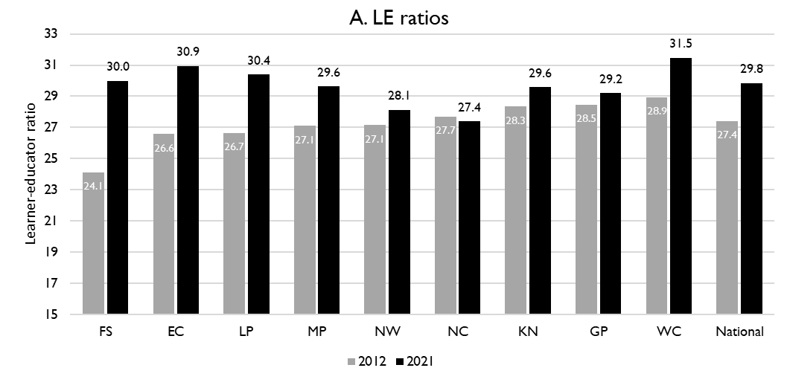
Lerner-Educator Ratios in 2012 and 2021
5
National and provincial learner-to-public-educator ratios in 2012 and 2021, grades 1 to 12 in public ordinary schools in South Africa
LE ratio rose from 27.4 to 29.8 learners per educator from 2012 to 2021
Deterioration (increase) in all provinces except NC
Large increases in FS, EC, LP and MP off a low base and in the WC off a higher base
Source: Figure 1 in South African teacher shortages as revealed through class sizes and learner-educator ratios: An exploratory analysis by Gabrielle Wills (2023)

Slide 37
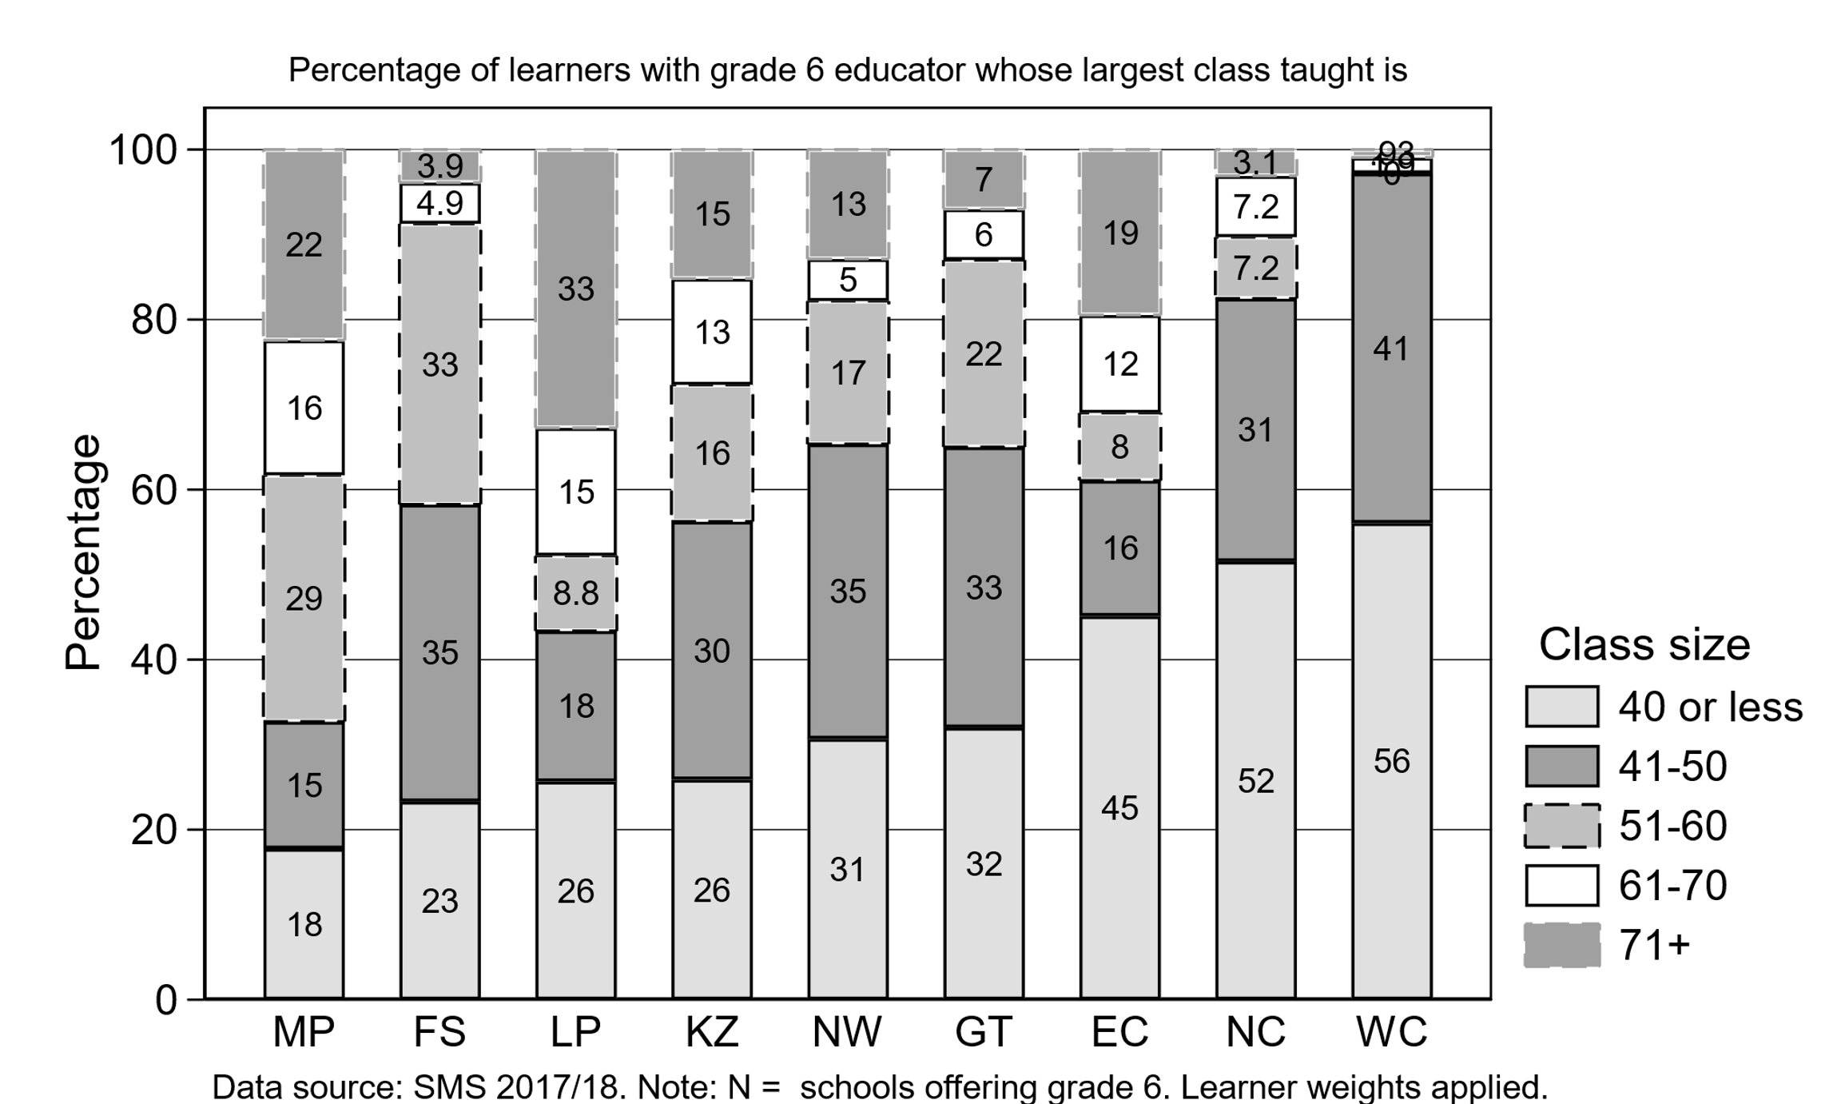
LE ratios and class sizes
5
Limpopo (~48%), Mpumalanga (~38%) and Eastern Cape (~31%) have the highest proportion of Gr 6 classes with more the 61 learners in a class
Increasing learner-educator ratios will drive up class sizes further
Limpopo (~48%), Mpumalanga (~38%) and Eastern Cape (~31%) have the highest proportion of Gr 6 classes with more the 61 learners in a class
Class sizes are determined by factors other than LE ratio (eg. WC or GP)
Percentage of grade 6 learners in schools with an educator reporting that their largest class is in the following class size category (SMS 2017/18)
MP | FS | LP | KN | NW | GP | EC | NC | WC
Source: Figure 8 in South African teacher shortages as revealed through class sizes and learner-educator ratios: An exploratory analysis by Gabrielle Wills (2023)

Slide 38
LE ratios and class sizes
5
Class sizes are determined by factors other than LE ratio (eg. WC or GP)
Other factors that also need to be managed, including scheduling, grade combinations, classrooms, subject-teacher mix, and educator absenteeism, among others
Percentage of grade 6 learners in schools with an educator reporting that their largest class is in the following class size category (SMS 2017/18)
Class size 51+
67% | 42% | 57% | 44% | 35% | 35% | 39% | 17% | 3%
MP | FS | LP | KN | NW | GP | EC | NC | WC
Source: Figure 8 in South African teacher shortages as revealed through class sizes and learner-educator ratios: An exploratory analysis by Gabrielle Wills (2023)

Slide 39
Projected increase in appointments
5
Sourcing
Alternatives may need to be considered eg. teachers that would usually have applied in other provinces, movement between schools
Sustained increase in projected annual appointments
(period of about 2026 – 2034)
Sourcing, appointment and promotion processes will need to be strengthened
Appointment
Departments need to be prepared to appoint about 20-40% more than the average number of annual hires over the last decade
Promotions
Deliberate, careful succession planning will be needed along with resources and processes to make and implement promotion decisions

Slide 40
What are the expected financial implications to 2030?

Slide 41
Budget Review 2023 COE baseline
Budget Review 2023 Estimates of Basic Education Compensation of Employees and CPI
 | 2021/22 | 2022/23 | 2023/24 | 2024/25 | 2025/26
Provincial Compensation of Employees (R mil) | 215 776 | 222 925 | 230 758 | 239 041 | 249 471
Growth in Compensation of Employees (%) |  | 3.3 | 3.5 | 3.6 | 4.4
CPI estimate (%) | 5.1 | 7.1 | 4.9 | 4.8 | 4.7
Conservative budget growth – with forecast growth in COE below CPI
Source: National Budget Review 2023. Basic Education Provincial Compensation of employees from Table 5.6 (p. 61) and CPI from Figure 3.1 (p. 28). The 2021/22 COE figure is taken from Table 5.6 (pg. 59) in the 2022 Budget Review Growth in COE shows the increase over the previous year.

Slide 42
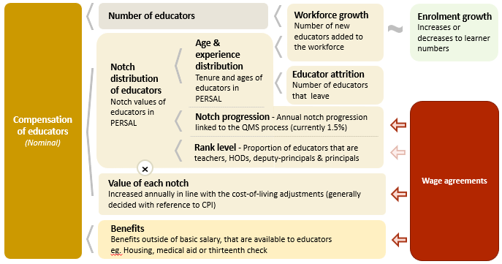
Compensation of educators cost drivers
6

Slide 43
Real and nominal costs
6
Examples:
In 2022 CPI was 7.2%
If nominal wages increase by 7.2%, then real wages increase by 0%
If nominal wages increase by 9%, then real wages increase by 1.8%
If nominal wages increase by 5%, then real wages decrease by 2.2%
A real increase in wages takes place when wages increase above the rate of inflation
Changes to real wages are an indicator of purchasing power

Slide 44
Projected unit costs trends| All educators
6
In constant 2021 rands
5%
Note: Scale not from zero
Source: Own calculations, using the anonymised PERSAL data from 2021, only educators are considered. ECD practitioners and examination reviewers removed. Estimates to 2030 derived from the national and provincial TSD models. Assumption of no growth in educator numbers.

Slide 45
Adjusted projections| GP, WC, EC & LP
Back-up slide
The simplest assumption used in the forecasting model is one of no change in educator numbers (constant educators)
In a few cases, this is too far from what we realistically expect of the future. We make 4 exceptions:
Growth in educator numbers
Gauteng → Assume 20% growth in educator numbers
Western Cape → Assume 10% growth in educator numbers
Decline in educator numbers
Eastern Cape → Assume a 10% decline in educator numbers
Change in the proportion of teachers to non-teachers
Limpopo → Assume teacher proportion of educators returns to 79%

Slide 46
Projected unit costs trends| All educators
6
In constant 2021 rands
Note: Scale not from zero
GP, WC and EC growth and LP ranks adjusted
Source: Own calculations, using the anonymised PERSAL data from 2021, only educators are considered. ECD practitioners and examination reviewers removed. Estimates to 2030 derived from the national and provincial TSD models. Assumption of no growth in educator numbers for FS, KN, LP, MP, NC, NW and SA. Assume 20% educator growth for GP, 10% for WC and a decline in 10% of educators in the EC. In LP assume that the proportion of non-teachers grows from 16% in 2021 to 21% in 2030.

Slide 47
Indexed unit costs trends| All educators
6
In constant 2021 rands
GP: 1% increase
Educator unit cost
(Index in 2022 = 100%)
LP: 1.5% decrease
Note: Scale not from zero
GP, WC and EC growth and LP ranks adjusted
Source: Own calculations, using the anonymised PERSAL data from 2021, only educators are considered. ECD practitioners and examination reviewers removed. Estimates to 2030 derived from the national and provincial TSD models. Assumption of no growth in educator numbers for FS, KN, LP, MP, NC, NW and SA. Assume 20% educator growth for GP, 10% for WC and a decline in 10% of educators in the EC. In LP assume that the proportion of non-teachers grows from 16% in 2021 to 21% in 2030.

Slide 48
Projected unit costs trends| All educators
6
In constant 2021 rands
Teachers
(School based teachers)
Non-teachers
(HODs, Deputy’s, Principals & Other)
-4%
Average annual unit cost
(In 2021 Rands)
+1%
Note: Scale not from zero
GP, WC and EC growth and LP ranks adjusted
Source: Own calculations, using the anonymised PERSAL data from 2021, only educators are considered. ECD practitioners and examination reviewers removed. Estimates to 2030 derived from the national and provincial TSD models. Assumption of no growth in educator numbers for FS, KN, LP, MP, NC, NW and SA. Assume 20% educator growth for GP, 10% for WC and a decline in 10% of educators in the EC. In LP assume that the proportion of non-teachers grows from 16% in 2021 to 21% in 2030.

Slide 49
What are supply considerations due to teacher movements?
7

Slide 50
Inter-provincial educator movement (7-yr)
7
 |  | Province in 2019 |  |  |  |  |  |  |  |  |  |  | Movement out of province
 |  | EC | FS | GP | KN | LP | MP | NC | NW | WC | Total
Province in 2012 | EC | 97.79 | 0.10 | 0.86 | 0.22 | 0.01 | 0.04 | 0.11 | 0.19 | 0.70 | 100 |  | 2.23%
 | FS | 0.35 | 94.25 | 2.76 | 0.10 | 0.07 | 0.23 | 0.41 | 1.56 | 0.26 | 100 |  | 5.74%
 | GP | 0.15 | 0.26 | 96.86 | 0.27 | 0.81 | 0.42 | 0.05 | 0.93 | 0.24 | 100 |  | 3.13%
 | KN | 0.22 | 0.10 | 1.14 | 97.95 | 0.10 | 0.37 | 0.01 | 0.06 | 0.04 | 100 |  | 2.04%
 | LP | 0.02 | 0.02 | 1.72 | 0.02 | 96.80 | 0.80 | 0.05 | 0.56 | 0.02 | 100 |  | 3.21%
 | MP | 0.03 | 0.14 | 2.48 | 0.37 | 1.54 | 94.86 | 0.03 | 0.49 | 0.07 | 100 |  | 5.15%
 | NC | 0.47 | 0.50 | 0.47 | 0.06 | 0.59 | 0.03 | 94.35 | 2.37 | 1.15 | 100 |  | 5.64%
 | NW | 0.06 | 0.59 | 3.84 | 0.03 | 0.65 | 0.34 | 0.75 | 93.60 | 0.14 | 100 |  | 6.40%
 | WC | 0.72 | 0.03 | 0.17 | 0.05 | 0.00 | 0.02 | 0.35 | 0.03 | 98.61 | 100 |  | 1.37%
Low levels of movement out of the WC, KZN and the EC and moderate movement out of the NW, FS and NC over 7 years
GP is the most likely destination province for educators that move provinces
Source: PERSAL 10-year anonymised dataset, only educators that were in the dataset for 2012 and 2019 are considered here

Slide 51
Inter-provincial educator movement (7-yr)
7
GP is the most likely destination province, followed by the North West, for educators that move provinces
Both NW and the NC are high sending and receiving provinces
WC has low inflows mostly from the EC and GP
KN and EC have very low inflow
 |  | Province in 2019
 |  | EC | FS | GP | KN | LP | MP | NC | NW | WC
Province in 2012 | EC | 42 645 | 42 | 373 | 95 | 5 | 16 | 46 | 82 | 304
 | FS | 57 | 15 267 | 447 | 17 | 11 | 38 | 67 | 252 | 42
 | GP | 67 | 117 | 42 770 | 121 | 356 | 187 | 20 | 409 | 108
 | KN | 146 | 67 | 755 | 64 723 | 64 | 247 | 9 | 37 | 26
 | LP | 10 | 10 | 709 | 7 | 39 899 | 328 | 20 | 230 | 7
 | MP | 7 | 34 | 618 | 94 | 385 | 23 644 | 7 | 121 | 17
 | NC | 31 | 33 | 31 | 4 | 39 | 2 | 6 214 | 156 | 76
 | NW | 12 | 111 | 726 | 5 | 123 | 65 | 141 | 17 690 | 27
 | WC | 152 | 7 | 37 | 11 | 0 | 5 | 75 | 6 | 20 858
 | Total 2019 | 43 127 | 15 688 | 46 466 | 65 077 | 40 882 | 24 532 | 6 599 | 18 983 | 21 465
 | Movement into province | 482 | 421 | 3 696 | 354 | 983 | 888 | 385 | 1 293 | 607
 | % movement into province | 1.1% | 2.7% | 8.0% | 0.5% | 2.4% | 3.6% | 5.8% | 6.8% | 2.8%
Source: PERSAL 10-year anonymised dataset, only educators that were in the dataset for 2012 and 2019 are considered here

Slide 52
Educator movement between schools
7
 | Pay point in 2019 (Ordinary schools only)
Province | Same as in 2018 (%) | Different to 2018 (%) | None - left system (%) | Total (%)
EC | 93.25 | 4.61 | 2.14 | 100
FS | 90.54 | 5.54 | 3.93 | 100
GP | 91.08 | 3.95 | 4.97 | 100
KN | 91.99 | 4.31 | 3.70 | 100
LP | 91.04 | 6.95 | 2.00 | 100
MP | 92.02 | 4.66 | 3.32 | 100
NC | 85.44 | 8.39 | 6.18 | 100
NW | 89.42 | 6.30 | 4.28 | 100
WC | 87.27 | 6.09 | 6.64 | 100
Total | 91.11 | 5.05 | 3.83 | 100
Almost 5% of educators (aged 50 or below) moved to a different pay point between 2018 and 2019
Educators are more likely to move pay points (schools) than leave the system (3.8%) over a single year
Source: PERSAL 10-year anonymised dataset. Only included educators aged 50 years and below, that were in ordinary schools in 2018 (Primary, Secondary, Combined and Intermediate)—excluded all pay points that did not appear in both years after identifying 103 pay points where the pay point number changed.

Slide 53
Conclusion
Retirement wave
Population growth
Cost implications
Rural province most affected (LP, EC and MP)
Increase in the number of educators that need to be appointed
Large proportion SMT are older educators (esp. in LP, WC, EC, MP and NW)
Careful succession planning is required, and well-functioning promotion processes
Growth provinces (GP, WC and, to a lesser extent LP)
Continue to grow workforce and ensure infrastructure is built for higher enrolment
Shrinking provinces (EC and also somewhat FS)
Further school rationalisation may be required along with careful management of appointments
Roughly constant average educator cost to 2030 (despite an assumed 1,5% notch progression)
Falling educator costs are driven by decreasing costs of non-teachers (HODs, deputies and principals)
Significant budget constraints and higher CPI are expected in the short to medium term.

Slide 55
Number of schools by province in 2012 and 2021
Growth in school numbers of ordinary schools from 2012 to 2021 (School Realities)
Province |  | All Ordinary Schools |  |  |  | Public Schools |  |  |  | Independent Schools
 |  | 2012 | 2021 | % Δ |  | 2012 | 2021 | % Δ |  | 2012 | 2021 | % Δ
EC |  | 5 754 | 5 341 | -7% |  | 5 558 | 5 109 | -8% |  | 196 | 232 | 18%
FS |  | 1 419 | 1 071 | -25% |  | 1 351 | 990 | -27% |  | 68 | 81 | 19%
GP |  | 2 611 | 2 941 | 13% |  | 2 045 | 2 067 | 1% |  | 566 | 874 | 54%
KN |  | 6 176 | 6 022 | -2% |  | 5 955 | 5 801 | -3% |  | 221 | 221 | 0%
LP |  | 4 078 | 3 855 | -5% |  | 3 935 | 3 675 | -7% |  | 143 | 180 | 26%
MP |  | 1 920 | 1 785 | -7% |  | 1 807 | 1 654 | -8% |  | 113 | 131 | 16%
NC |  | 580 | 585 | 1% |  | 560 | 545 | -3% |  | 20 | 40 | 100%
NW |  | 1 645 | 1 539 | -6% |  | 1 591 | 1 450 | -9% |  | 54 | 89 | 65%
WC |  | 1 643 | 1 755 | 7% |  | 1 453 | 1 449 | 0% |  | 190 | 306 | 61%
SA |  | 25 826 | 24 894 | -4% |  | 24 255 | 22 740 | -6% |  | 1 571 | 2 154 | 37%
Source: Department of Basic Education School Realities-EMIS reports (2012 – 2021). Note: % Δ stands for “percentage change”

Slide 56
Average enrolment per school in 2012 and 2021
Trends in average learner enrolment per school from 2012 to 2021 (School Realities)
Province |  | All Ordinary Schools |  |  |  | Public Schools |  |  |  | Independent Schools
 |  | 2012 | 2021 | % Δ |  | 2012 | 2021 | % Δ |  | 2012 | 2021 | % Δ
EC |  | 339 | 346 | 2% |  | 340 | 347 | 2% |  | 329 | 324 | -2%
FS |  | 467 | 679 | 45% |  | 478 | 713 | 49% |  | 234 | 252 | 8%
GP |  | 795 | 872 | 10% |  | 909 | 1 078 | 19% |  | 383 | 386 | 1%
KN |  | 466 | 481 | 3% |  | 472 | 488 | 3% |  | 295 | 283 | -4%
LP |  | 421 | 467 | 11% |  | 423 | 469 | 11% |  | 355 | 420 | 18%
MP |  | 549 | 636 | 16% |  | 569 | 666 | 17% |  | 238 | 257 | 8%
NC |  | 478 | 521 | 9% |  | 490 | 547 | 12% |  | 165 | 158 | -4%
NW |  | 471 | 567 | 20% |  | 478 | 585 | 22% |  | 275 | 275 | 0%
WC |  | 632 | 721 | 14% |  | 683 | 826 | 21% |  | 244 | 222 | -9%
SA |  | 481 | 539 | 12% |  | 492 | 559 | 14% |  | 321 | 326 | 2%
Source: Department of Basic Education School Realities-EMIS reports (2012 – 2021)

