Slide 1
Inequalities in learning: empirical findings and policy implications Quantitative Education Research Conference 2022 University of Stellenbosch South Africa 31 Aug – 1 Sept 2022
Luis Crouch
RTI International (Emeritus)

Slide 2
Outline
Why should we care?
Findings
Natural variations and patterns
Effects of purposeful learning projects
Lessons and Policy/Management Implications
What we seem to know
What we don’t know
Possible implications

Slide 3
Why care?
“Instrumental” logic
High average learning (not just access) → economic and social development, nation-building
Countries most successful at ↑ average seem to:
Have lower inequality
Have lower learning poverty
Lower educational inequality → lower social inequality, maybe faster growth
A pure rights or ethics, justice
A Rawlsian perspective
Hard to use in public policy discourse

Slide 4
Some useful distinctions
Equality
A purely mathematical construct, reasonably measurable
In education can be of inputs, of access, of learning, and, eventually, job satisfaction, happiness, etc.
Perfect equality is not inherently desirable, but…
… Equity is …
Approx the same as “justice”
But not very measurable, has to rely on interpersonal subjectivity
Higher inequality may be more equitable
E.g., more inputs for poorer
Perfect equality may be inequitable
A society that provides everyone with a lower level than is possible, but equally for everyone, is both unjust because it is inefficient
Low equity unnecessary inequality
Learning poverty = % of pop below minimum learning level
I will mostly be referring to equality of learning results and learning poverty here
Noting that in most countries, generally more equality → more equity

Slide 5
Why care? – “Instrumental”
We want high averages, but…
High learning averages and learning inequality are inversely correlated
High learning levels and learning poverty are even more inversely correlated
Inequality and learning poverty are close but not quite the same
PIRLS 2016
Finland | Coeff of V | 0.15 | (Range 75th to 25th / Med.)
SA | Coeff of V | 0.45 | 3X bigger relative variation (inequality) in SA
Finland | R^2 | 0.18
SA | R^2 | 0.25
Finland | ( 1 - R^2) * CV | 0.12
SA | ( 1 - R^2) * CV | 0.34 | 3 X as much inequality to be explained in SA
 | That's R^2 with "best" reg: home factors, resources at school, the usual suspects

Slide 6
“Instrumentally”
Equality and low poverty both highly corr with excellence
If you face the two “against” each other in “explaining” median achievement, then learning poverty “dominates” the effect of inequality by a lot

Slide 7
Another way to look at it…
Range countries by median achievement and look at the diff between 5th and 95th percentiles. At low learning levels the diff is 1.2 the median. At high learning levels the diff is only 0.4 times the median.

Slide 8
Is any of this causal?
I do not think there is an econometric way to “identify”
One has to study history and policy (shudder)
If one looks at policies of countries such as S Korea (1945 and on) and Japan (1870 and on), the intent is clear:
Extreme focus on equity as a form of class consciousness (Japan against the samurai class) and anti-colonial resistance (S Korea against the West and very much against Japan, Japan against the West)
Specific policies of equalization of inputs
Planned expansion to higher levels *only* when primary ed was 100% for everyone and of high quality (high expectations, high standards, and good inputs)
Both for equality reasons but also efficiency: expand only as the society requires and can afford
I think it is “pretty causal”

Slide 9
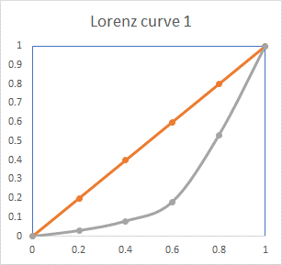
Illustrate Gini, Lorenz
Bottom 20% of pop has only 3% of the income
Next 20% (cum. 40%) of pop has only 7% of the income (cum 10%)
And so on… Next 20% (cum 60%) has about 10% (cum 20%) of the income
The line describing the actual situation is the real distribution: the Lorenz curve
The diagonal line is the “line of equality”
Whole blue area relative to the area under the line of equality hints at a measure of inequality, the Gini coeff. (Not tech. quite correct, don’t worry)

Slide 10
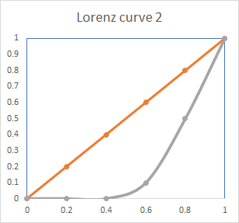
Illustrate Gini, Lorenz
Shows connection between inequality and some sense of absolute learning poverty as used in this PPT: here the bottom 40% score zero on EGRA, and hence have 0% of the cognitive achievement

Slide 11
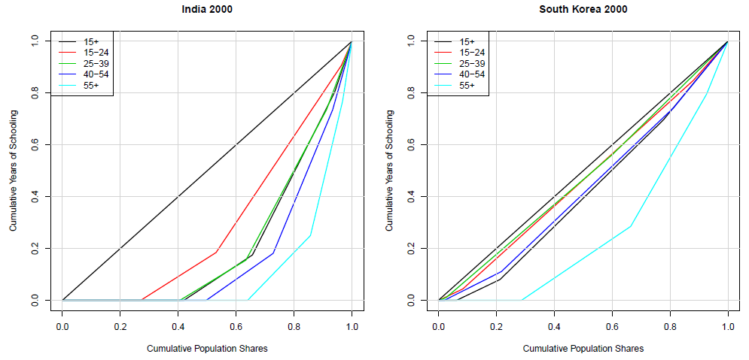
Historical look
By looking at successive cohorts you can see education inequality over time
India had as much inequality in 2000 (red line, 15-24) as Korea did in 1960 (blue line 55+)
This is a pretty good measure of how seriously S Korea takes these things.

Slide 12
Inequality impacts of foundational learning interventions
Foundational learning projects have been evaluated for mean effect.
Often good, effect sizes > 0.25 or even > 0.5
Systematic reviews: “structured pedagogy” and “teaching at the right level” are tops among the best interventions available, based on effect sizes
Some interventions evaluated for heterogeneity by gender or wealth quintile
But there has been little research into how these interventions affect “pure” inequality, as opposed to attribute-related (e.g., gender-related or wealth-related)
What if these interventions address “pure” inequality even if they were not intended to do so?
And if they do, why/how?

Slide 13
Why focus on foundational learning?
Interventions have been well-evaluated, lots of data
Because of good average effects, it makes sense to look further. If average effects were minor, not much point in seeing what (if any) other desirable results they generate
Some of the measurement tools lend themselves to metrics that are easier to interpret
Oral reading fluency is pretty easy to measure and interpret without IRT, more akin to and income metric
% of kids reading with 0 fluency is akin to absolute poverty and the WB’s learning poverty: also easy to interpret

Slide 14
Features of the data and interv.
Foundational reading (grades 1, 2, 3)
Some version of “structured pedagogy”
Use Oral Reading Fluency sub-test of EGRA as key metric
There are good justifications for this
Test out various inequality and learning poverty measures: CoV, Gini, P90/P10, and % reading at 0 fluency
Some projects more successful at raising the mean than others

Slide 15
Basic results
Country | Language | Grade | Phase | Mean | Gini | CV | p90/ p10 | p75/ p25 | % zero
Kenya PRIMR | English | 1 | Base | 6.5 | 0.799 | 2.0 | . | . | 62.4
 |  |  | End | 29.1 | 0.522 | 1.0 | . | 16.7 | 21.6
 |  | 2 | Base | 25.1 | 0.546 | 1.0 | . | . | 25.8
 |  |  | End | 54.5 | 0.363 | 0.6 | 25.3 | 2.7 | 8.5
 | Kiswahili | 1 | Base | 4.4 | 0.809 | 2.0 | . | . | 68.9
 |  |  | End | 18.9 | 0.499 | 0.9 | . | . | 25.8
 |  | 2 | Base | 17.8 | 0.522 | 0.9 | . | . | 30.7
 |  |  | End | 32.6 | 0.338 | 0.6 | 14.3 | 2.3 | 8.9
Uganda | English | 2 | Base | 3.0 | 0.874 | 2.8 | . | . | 72.8
 |  |  | End | 5.7 | 0.835 | 2.2 | . | . | 67.3
 | Luganda | 1 | Base | 0.2 | 0.988 | 9.0 | . | . | 97.7
 |  |  | End | 2.1 | 0.905 | 2.9 | . | . | 86.3
 |  | 2 | Base | 6.2 | 0.788 | 1.8 | . | . | 65.4
 |  |  | End | 10.4 | 0.672 | 1.3 | . | . | 48.5
P90/P10 and even P75/P25 are pretty useless because of all the zeroes
The three internal r average to 0.84: there is a latent construct of “reading inequality”
But the r is not so high that they measure exactly the same thing
The % zero is a concept of poverty, the others of inequality, but the % zero is a much easier thing to manage to
The visual representation of the Gini, with the Lorenz curve, includes the % at zero

Slide 16
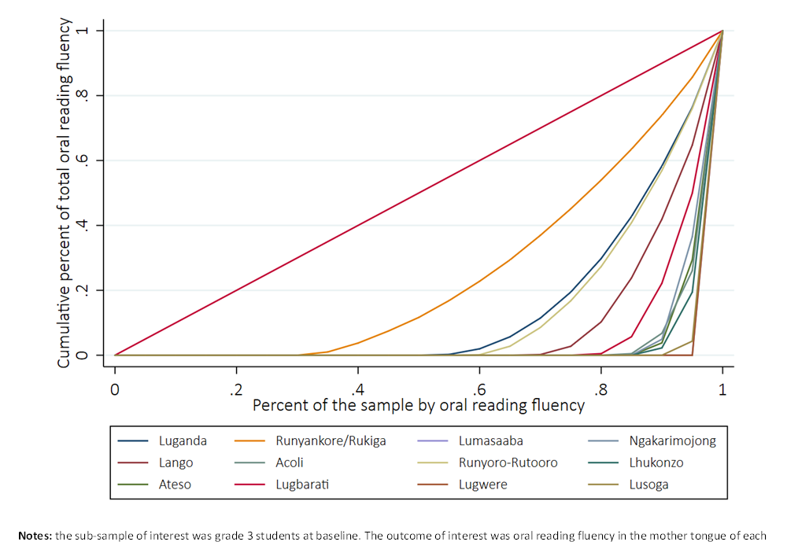
Some interpretations, as examples only
Subst: Home languages in Uganda differ hugely in their internal inequality. This is not necessarily due to differential poverty
Method: Notice how Lorenz curve nicely summarizes the % at 0 (hor. axis intercept) and the rest of the inequality

Slide 17
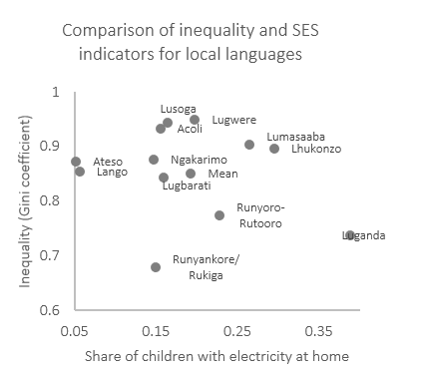
Learn ineq not highly corr w poverty
I am not enough of a sociologist / linguist to understand this but it probably has more to do with how old and widespread orthographies in these languages are, or home language methods, than with material poverty

Slide 18
Some interesting (??) insights
That there is more inequality among the poor
These interventions can help the poor more though they do not target (internal to the interv.) by poverty
Improvements in the mean are highest in Quartile 1, and within-Quartile 1 inequality is reduced the most
Kenya PRIMR Grade 2
SES Quart | Gini |  |  | % at zero |  |  | Oral Reading fluency
 | BL | EL | EL-BL | BL | EL | EL-BL | BL | EL | EL-BL
1 | 0.51 | 0.45 | -0.06 | 0.19 | 0.15 | -0.05 | 30.5 | 45.3 | 14.8
2 | 0.4 | 0.39 | -0.01 | 0.11 | 0.1 | -0.01 | 45.7 | 54.2 | 8.5
3 | 0.34 | 0.31 | -0.03 | 0.06 | 0.06 | 0.01 | 55 | 63 | 8
4 | 0.32 | 0.28 | -0.05 | 0.03 | 0.02 | -0.01 | 63.1 | 66.6 | 3.5
All | 0.4 | 0.35 | -0.05 | 0.09 | 0.08 | -0.02 | 49.4 | 58.1 | 8.7

Slide 19
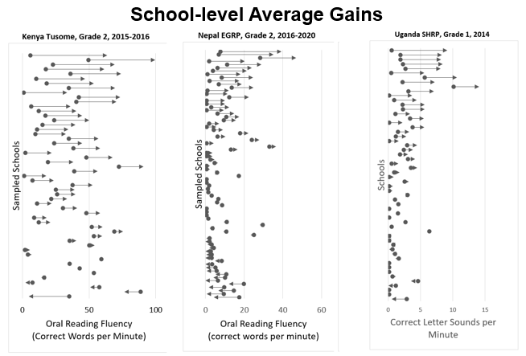
Interpretations, conclusions
Disaggregate, disaggregate, disaggregate
Inequality as shown here but also inequality in response
Most of the average impact is coming from ½ to 1/3 of the schools!
Why? Language? Maybe. Lower base, hence easier? No.
Individual coach effect? Maybe?
Do only some teachers absorb deeply and the rest just pretend but pedagogy is still quite bad despite the coaching?
Source: King, S. Presentation at RISE 2022 Conference, Oxford, UK

Slide 20
Interpretations, conclusions
Maybe silly (“not rocket science”) but:
Interventions that really, really focus on the foundational skills, with intensity and fidelity, end up helping the poor within the interventions even if there was no targeting-within
Self-targeting?
But how much more could be achieved if there was targeting based on SES or initial situation? But should there be? Or does the help provided by high intensity and fidelity enough?
We see improvements but kids are by no means fluent, not is inequality reduced to the levels of “good” systems, by a long shot
There is a lot we do not understand (previous slide)
We have a lot of work to do

