Slide 1

Public Expenditure and Institutional Review (PEIR):
Focus on Early Childhood Development in South Africa
RESEP QER Conference
31 August 2022
Co-authors: Elizabeth Ninan Dulvy, Amanda Devercelli, Servaas van der Berg, Martin Gustafsson, Gunilla Pettersson Gelander, Jesal Kika, Frances-Beaton Day
Notes:
This is one of the first multi-sectoral PEIRs done for ECD in Africa was jointly initiated by the World Bank, the Department of Basic Education (DBE) and National Treasury in preparation for the shift in the coordination function for Early Childhood Development (ECD) from the Department of Social Development (DSD) to the DBE on April 1, 2022. The technical analysis in the PEIR was supported by RESEP – particularly Martin and Servaas.

Slide 2
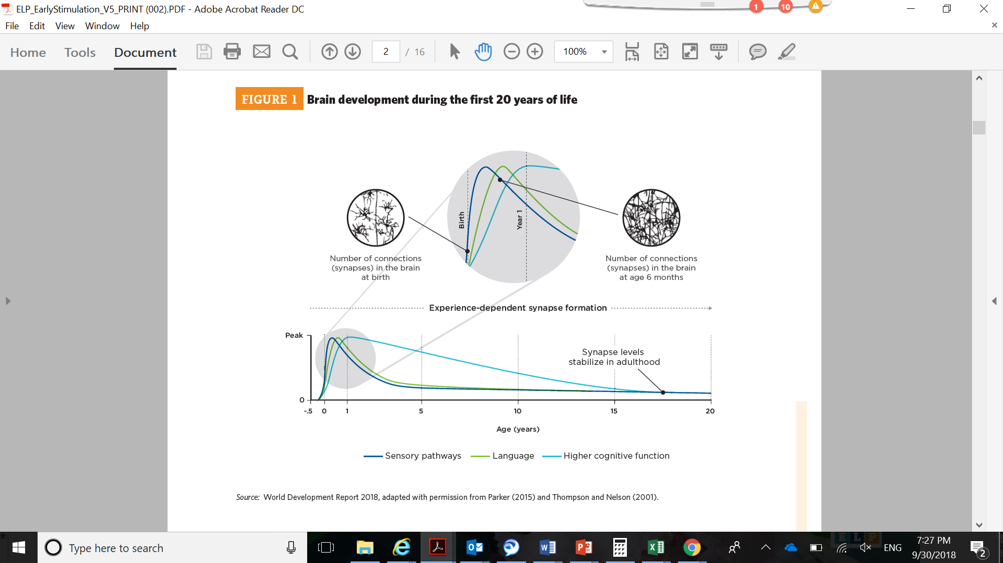
Why is early childhood development important?
Early childhood is a highly sensitive period for development.
During early childhood the brain matures faster than at any other time of life.
Brain development is sequential and cumulative: simpler networks develop first and then more complex ones
Notes:
In their earliest years—beginning even before birth—children develop the capacities on which their life-long learning, participation in society, contribution to the economy and well-being will depend.
During the early years, the brain matures faster than at any other time of life and is highly malleable, presenting a window of opportunity and Vulnerability if not adequately supported
Notice the rapid formation of synapses in the first few years of life that support language, hearing, vision and higher cognitive functions
Brain development is sequential and cumulative: simpler networks develop first and then more complex ones. Establishing strong foundations can lead to a virtuous cycle of development and life-long learning.

Slide 3
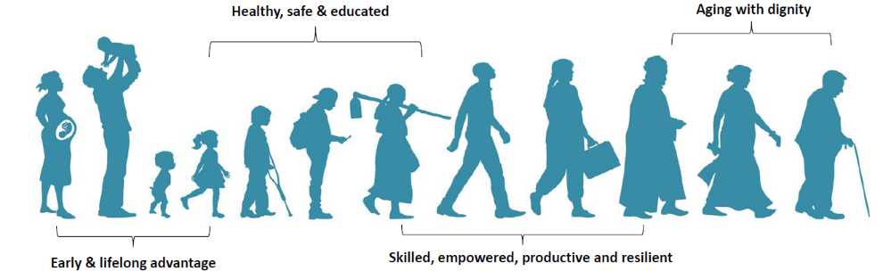

Investing in young children is one of the best things countries can do to build human capital.
Growth and development in the early years form the foundation for future learning, productivity and lifetime success.
Interventions that promote child development can take place from before pregnancy through to a child’s entry to primary school.
Notes:
. Markets are increasingly demanding workers with higher levels of human capital, especially advanced cognitive and socio-behavioral skills.

Slide 4








What will it take for children to reach their full potential?
Children are well nourished and healthy,
especially in the first 1,000 days.
Children are nurtured and
protected from stress.
Children receive early stimulation and learning opportunities from birth onwards.
4

Slide 5


Outcomes of focus for the review
Reduced malnutrition for young children
High levels of malnutrition: 27% of children were stunted in 2016
Improved early learning
Low levels of early learning: 55% of children in early learning programmes had not achieved expected learning levels by age 5 in 2021
Notes:
These outcomes were established based on government priorities, a number of interconnected factors resulting in these outcomes and by working closely with a multi-sectoral advisory committee established under the PEIR which included departments of basic education, health, social development, national treasury, DPME and COGTA.

Slide 6




Multiple inter-connected factors resulting in high levels of malnutrition and low levels of early learning
High levels of malnutrition
Low levels of early learning
Interconnected factors that contribute
Child poverty:
Among under 5s:
56% live below upper-bound poverty line
34% live below food poverty line
Maternal health status:
37% of women aged 25-34 are obese
31% of pregnant women are anaemic
21% of pregnant women do not make first ante-natal care visit in first 5 months
Rate of exclusive breastfeeding:
32% of infants under 6 months are exclusively breastfed
Participation in ECD programmes, especially for vulnerable children:
Among children aged 2-5:
30 percentage point difference in participation between richest and poorest children
6% participation rate in areas with no ECD centre nearby
Food insecurity:
7% of households with young children skilled a meal 5 days or more in the previous month
Adolescent fertility rate:
71/1,000 births per girl aged 15-19
Adequate diet:
23% of children 6-23 months fed minimum acceptable diet
Quality of ECD programmes:
37% of programmes have less than 10 play materials
14% are housed in shacks or shipping containers
64% of staff have less than NQF level 4 qualification
Child-practitioner ratio of 19:1 or higher in bottom quartile of programmes
Source: Draft SA ECD PEIR 2022, chapter 3.
Notes:
-These two outcomes are not mutually exclusive. Malnutrition, and stunting in particular, is a significant indicator of child development, including cognitive and social development. In addition, early learning programmes serve as a dual role of providing early stimulation and providing meals.
--> Adolescent fertility; adequate diet and we know that the low participation and low quality of ECD affect school readiness and overall learning poverty

Slide 7
Key integrated interventions for young children and their families
 | Pregnancy | Birth |  | 1 year |  | 2 years |  | 3 years |  | 4 years |  | 5 years |  | 6 years
 | PREGNANCY PACKAGE Antenatal care, iron and folic acid supplementation, counselling on adequate diet.
 |  |  | BIRTH PACKAGE Attended delivery, exclusive breastfeeding, birth registration.
 |  |  | CHILD HEALTH AND NUTRITION PACKAGE Immunisations, deworming, prevention and treatment of acute malnutrition, complementary feeding and adequate, nutritious and safe diet, therapuetic zinc supplementation for diarrhea.
 |  |  | EARLY LEARNING PACKAGE
 |  |  | Childcare |  |  |  |  | Early learning programmes, continuity to quality primary schools.
 | FAMILY SUPPORT PACKAGE Parental support for vulnerable families - planning for family size and birth spacing, maternal education, education about early stimulation, growth and development, parental leave and adequate child care, prevention and treatment of parental depression, social assistance transfer programme, child protection regulatory frameworks. Health, nutrition and sanitation for families - access to health care, access to safe water, adequate sanitation, hygiene/handwashing, micronutrient supplementation and fortification.
Source: Adapted from Denboba et al. 2014.
Notes:
There are some interventions considered essential for children’s growth and development starting from pregnancy through to the transition to primary school. The figure, adapted from Denboba et al. 2014 – presents a pregnancy package from before conception to birth, a birth package, a child health and nutrition package from birth onwards, an early learning package (from birth onwards, but in particular from age 3), and a family support package from pregnancy onwards.

Slide 8
Key integrated interventions for young children and their families
 | Pregnancy | Birth |  | 1 year |  | 2 years |  | 3 years |  | 4 years |  | 5 years |  | 6 years
 | PREGNANCY PACKAGE Antenatal care, iron and folic acid supplementation, counselling on adequate diet.
 |  |  | BIRTH PACKAGE Attended delivery, exclusive breastfeeding, birth registration.
 |  |  | CHILD HEALTH AND NUTRITION PACKAGE Immunisations, deworming, prevention and treatment of acute malnutrition, complementary feeding and adequate, nutritious and safe diet, therapuetic zinc supplementation for diarrhea.
 |  |  | EARLY LEARNING PACKAGE
 |  |  | Childcare |  |  |  |  | Early learning programmes, continuity to quality primary schools.
 | FAMILY SUPPORT PACKAGE Parental support for vulnerable families - planning for family size and birth spacing, maternal education, education about early stimulation, growth and development, parental leave and adequate child care, prevention and treatment of parental depression, social assistance transfer programme, child protection regulatory frameworks. Health, nutrition and sanitation for families - access to health care, access to safe water, adequate sanitation, hygiene/handwashing, micronutrient supplementation and fortification.
Source: Adapted from Denboba et al. 2014.
Notes:
Although all 5 packages are essential for children’s growth and development, this review focuses on interventions that are part of three packages – early learning, family support and early nutrition → which seek to reduce malnutrition and improve early learning. Each package does not cover all the types of interventions considered to be important for child development, but are defined for the purposes of this review, and this was particularly based on how programmes and sub-programmes were defined by national and provincial government in their budgets. The focus on these three packages does not imply that others are unimportant, but rather, the selection reflects government’s priorities of reduced malnutrition and improved early learning, underpinned by a strengthened system for ECD service delivery

Slide 9
PEIR scope
Greater emphasis on early learning package due to ECD function shift from DSD to DBE.
Group of interest is children ages 0 to 5.
Some interventions serve to both reduce stunting and hunger and improve early learning, to avoid double counting they were assigned to the package deemed most relevant.
Notes:
Early learning: Mainly under provincial departments of education and social development. Under DBE, main intervention is provision of Grade R in public schools and ECD centres and community schools. Other important, though much smaller in terms of expenditure interventions, include ECD infrastructure development and maintenance and human resources development training, out of which a small share is funded through the EPWP social sector grant. The biggest intervention under PDSDs is the subsidy for registered ECD centres which supports child development in terms of both nutrition and early learning.
Family support: All fall under DSD and administered by SASSA. CSG is the largest of the child grants by far and can serve as a way to reduce malnutrition and hunger, and help families pay for ECD programmes and other services essential to child development.
Early nutrition: Highly cross-sectoral. Interventions seeking to improve nutritional outcomes and food security under PDSDs beyond the CSG are limited. It includes food and food supplies under different sub-programmes and the SRD grant which among other things, provides food parcels over short periods of time to families in distress. Since nutrition is often integrated into health programming, expenditure on Health Promotion and Nutrition and on Child, Youth and School Health are included in the early nutrition package. Nevertheless, this package omits some nutrition expenditure. For example, expenditure on Maternal, New-born and Child Health interventions, part of which would benefit young children and belong in the early nutrition package, and part of which would benefit infants and belong in the birth package which is not examined by this review
5 but:
early learning package also includes interventions aimed at children age 6 to capture transition from ECD programmes to school through grade R.
early nutrition package expenditure analysis cannot be restricted to age group of interest because the financial data is not disaggregated by age. But included interventions are those highly likely to cover young children, and estimates of the amounts going to young children are provided.
Some interventions serve to both reduce stunting and hunger and improve early learning, to avoid double counting they were assigned to the package deemed most relevant. For example, ECD centres provider opportunities for early learning but also serve as an important avenue to reduce malnutrition through the provision of meals. Since the centres main role is to provide early learning, the subsidy which also covers, among other things, meals for children, is included under the early learning package.

Slide 10
Guiding questions for the PEIR
What are the main challenges to child development viewed from a national and international perspective?
What are the public expenditure patterns for the three intervention packages, and how easy is it to measure expenditure? How well is public expenditure lined up with priority outcomes to be achieved?
How equitable is public expenditure on services to promote child development in terms of socio-economic background, child age and geographic location?
What are the institutional arrangements to deliver ECD services? Where are the main overlaps, gaps and opportunities across spheres and across sectors?
How could services to promote child development be expanded, improved and made more equitable and have a higher impact in the context of current budget constraints?
Notes:
Inevitably, there are gaps in the analysis due to current data and information constraints, but also by virtue of this being the first PEIR dedicated to ECD in South Africa.

Slide 11
Main data sources used for the review
Financial
Other
Basic Accounting System (BAS) detailed data extracts November, December 2021.
Estimates of national expenditure (ENE) various years.
Estimates of provincial revenue and expenditure (EPRE) various years.
Medium Term Budget Policy Statements various years.
South African Social Security Agency (SASSA) statistical reports various years.
Stats SA Consumer Price Index series, January 2022.
Community Survey (CS) 2016.
DBE Education Management Information System (EMIS) extract 2021.
DBE 2021 ECD Census.
Demographic and Health Survey (DHS) 2016.
Early Learning Outcome Measure (ELOM) data various years.
General Household Survey (GHS) various years.
Living Conditions Survey (LCS) 2014-15.
Stats SA 2021 Mid-Year Update of Population Estimates (MYPE).
Thrive by Five Index 2022.
ECD Audit 2013/14.
Notes:
-For the provinces, expenditure breakdowns by economic classification below sub-programmes are not available in the published EPREs, but have been available since 2020 in the new format of National Treasury’s Excel version of the EPREs. To enable further deepening of the analysis, the National Treasury provided financial data disaggregated below the level seen in published reports and spreadsheets. We would like to thank National treasury, particularly Spencer and Shaneel for providing this information. We would also like to thank the DBE for sharing the ECD Census data before it was released, as well as Sonja and Team for sharing information from the Thrive by Five index.
- Interviews were also conducted with key national departments, line departments in KwaZulu Natal, Western Cape and Limpopo. We were able to meet with line departments in provinces from health, education and provincial treasuries, but were not able to secure meetings with provincial departments of social development. These discussions were also held before the function shift took place, so a lot of the institutional arrangements and what was meant to happen, was still in flux. It would be interesting to have these discussions a few months after the transfer to see how the function shift has transpired. We also consulted a number of technical stakeholders in the space, and are grateful to all of them – this includes colleagues from Ilifa Labantwana, Innovation Edge, the Nelson Mandela Foundation, UNICEF, the Lego Foundation and others.

Slide 12

Early learning package

Slide 13
Expenditure on early learning package by sub-programme (2021/22)
77% on ECD subsidy
Total expenditure on early learning package (2021/22)
R9.5 billion
(net expend.)
PDSDs: Programme 5 ‘Children and families’
PDoEs: Programme 6 ‘Infrastructure Development’
PDoEs: Programme 5 ‘Early Childhood Development’
Notes:
Total expenditure for the early learning package stood at R9.5 billion in 2021/22, which was 0.16% of GDP before the pandemic.
Pre-Grade R spending (mostly under social development) accounts for about 37% of total expenditure and education sector spending, which is mostly Grade R, accounts for about 63% - even though pre-Grade R accounts for approximately 2.5 times more children
Provincial funding for infrastructure and training of ECD practitioners remains limited – influencing both access and quality
Until April 2022, PDSDs funded ECD programmes in the amount of R3.5bn in 2021/22, of which the ECD subsidy constituted 77%.
Most of the budget for national DSD programme 4 ‘Children’ takes the form of an earmarked ECD grant for provinces – which is transferred to provinces. This leaves national DSD with around 91 million for activities such as planning and research.

Slide 14
Expenditure trends for the early learning package 2021/22
Grade R in schools has seen a steeper real expenditure increase in recent years compared to ECD centres
Source: National Treasury (ENE of 2021 and Excel EPRE file published in 2021)
Notes:
Expenditure on younger children has not expanded as rapidly as expenditure on older children
The 2020/21 peak in social development expenditure is exceptional and reflects emergency relief funding in the form of the ECD – ESRF (Employment stimulus relief fund) that was introduced to offset losses in fee income as ECD centres were forced to close
Public expenditure per participating child is considerably higher for school-based Grade R than for ECD centres, and is driven by large differences in average costs for grade R educators and ECD practitioners. Estimates show that the annual cost for ECD practitioners is approximately R31,000 while that of grade R teachers is five times higher at roughly R165,000 per year. (Grade 1 is around R410,000)

Slide 15
Access to ECD services
Children age 5 attending early learning programmes or lower primary (2019) | 93%
Children age 4 attending early learning programmes or lower primary (2019) | 75%
Children age 3 attending early learning programmes or lower primary (2019) | 53%
30 percentage point difference in enrolment for children from the richest and poorest quintile households
2021 ECD Census identified 42,420 ECD programmes in the country (33% report receiving the subsidy)
2017 Introduction of ECD Conditional grant resulted in real increase in public expenditure on ECD providers but no concurrent statistically significant increase in enrolment in ECD centres, whether subsidised or not.
Notes:
Two potential issues:
1.Possibility that some provinces substituted equitable share funding directed at ECD services with the conditional grant funding
2.Increased public funding on the subsidy may be displacing private fee expenditure, which is desirable if the beneficiaries are from low income households
The conditional grant has two components: Subsidy component for fully or conditionally registered centres and some eligible non-centre-based ECD programmes. But receipt was conditional on their being no reduction in existing expenditure on services through the equitable share allocation. Second is an infrastructure component, where the intention was for about a 5th of the grant to flow towards minor maintenance, upgrading facilities to improve their registration status, or supply of essential goods to prevent the spread of covid. But there have been reports of underperformance of this component of the grant.

Slide 16
Challenges to improving access to ECD services: Registration
Three types of registration (first two renewal every 5 years)
ECD programme registration: all providers.
Partial care registration: more than six children and operate more than 16 hours per week or more than 4 hours per day.
NPO registration: providers operating on a not-for-profit basis, which is compulsory to access public funding.
Key bottlenecks to registration
Meeting infrastructure standards
Municipal by-laws associated with obtaining building plans and land zoning requirements
Obtaining environmental health and safety certificates
While South Africa has lower standards for registration around, for example, around practitioner qualifications than Denmark, Chile, India and the United Kingdom, it has less flexibility in terms of requirements for physical structures.
Notes:
Registration requirements are:
Not well understood
Are complex, involving multiple documents
Involve stakeholders from multiple departments across a three-tiered governance system
And overall, are expensive to comply with
Expenditure on ECD infrastructure by provinces and municipalities is very low.
Further, Municipalities are using a tiny fraction of the value of the Municipal Infrastructure Grant (MIG) for ECD infrastructure.
Earmarking for specific areas is possible within the MIG, but is currently not used for ECD infrastructure.
Expenditure is mainly for new construction rather than repairs and maintenance.

Slide 17
Challenges to improving access to ECD services: ECD subsidy
Applying for the subsidy
Claiming the subsidy
Using the subsidy
Challenging application process
Unpredictable funding based on attendance makes centres more vulnerable given fixed costs
Inadequate subsidy amount
Unclear eligibility of conditionally registered centres for the subsidy
Onerous reporting process
Recommended subsidy usage misaligned with centre needs
Available funding often not adequate to cover all eligible children
Notes:
Even when programmes are registered, there are then challenges with applying for the per child per day subsidy, claiming the subsidy and using the subsidy.
Applying for the subsidy: To apply for the subsidy, centres must go through partial care registration, ECD registration, and in some instances, are required to register as an NPO to receive the subsidy. The application process is also not standard across provinces with variations in how many levels of DSD interact with the process. For example, some province operate fully from the provincial level, while others cascade these services up from Service Offices to province level, and there are also variations in relation to how many assessment panels are required to sit and at what levels. In some provinces, funding applications are a standalone process whereas others combine registration and funding processes. Across these processes, there are also duplications of supporting documents required.
There is also a lack of clarity around the circumstances in which conditionally registered centres are able to receive the subsidy
Claiming the subsidy: The subsidy based on child attendance creates unpredictable funding flows for providers who need to cover their fixed costs. But it seems as though the subsidies provided through the conditional grant may not be changed during a year – and perhaps this is something that will be taken forward. The process for claiming the subsidy and requires provders to sign SLAs with provinces every 3 years and provide a number of supporting documents. Through the interviews, we also learnt that many eligible children do not receive the subsidy due to rationing by provinces – for example, in situations of insufficient budget, provinces may cover a certain proportion of eligible children, some may reduce the daily rate, and others may fund fewer days per child.
Using the subsidy: The subsidy amount is inadequate (at R17 per child per day) to cover full operating costs, where unpublished estimates show that the operating costs of ECD programmes are currently at around R31 per child per day. We’ll discuss this in the next slide. The suggested usage of the subsidy (40% nutrition, 40% salaries, 20% equipment) is not always aligned to centre needs and it may be better for there to be some flexibility in how this is implemented.

Slide 18
Is the ECD subsidy reaching the poor and is it adequate?
  In 2019/20, about 1,5 million children ages 4 to 5 received the Child Support Grant, but only about 630,000 (ages 0 to 5) received the ECD Subsidy.
  Household expenditure to attend ECD centres was estimated at around R14 billion in 2019, of which:
  R3.7bn was spent by the poorest 60% of households
  R2.8 billion on the ECD centre subsidy by the public sector.
  Families are paying approximately R1,400 a year on average in private fees for each subsidised child. In the absence of the subsidy, annual fee payments are estimated to be about R6,300.
  The ECD centre subsidy amount is inadequate and has declined in real terms.
  Estimates find a minimum daily operating cost per child of R31 (unpublished) compared to the ECD subsidy amount of R17.
  The real value of the subsidy declined by 14% between 2015 and 2021.
Notes:
Data on the number of ECD subsidy recipients is not available by single age. The numbers are also probably underreported by provinces

Slide 19
Quality of ECD services
  Irregular measurement of child development outcomes till now (Thrive by Five), but measurement needs to be done systematically going forward to be able to track progress.
  Favourable educational staff to child ratios on average, but large difference across centres and training of staff is variable
  From 2021 ECD census, child to educational staff ratio of 15:1 in ECD programmes (comparable to international norms). But for the bottom decile of ECD programmes the ratio is 26:1 or higher, indicating that these programmes are under-staffed.
  Majority of staff in subsidised (61%) and to unsubsidised (66%) have less than an NQF level 4.
  Average salary for ECD practitioners is similar to the national minimum wage, contributing to low retention.
  Average annual salary for ECD practitioners – R31,000/ year (0.3 of GDP per capita)
  Grade R teacher- R165,000/ year (1.6 times GDP per capita)
Notes:
Most training programmes focus on the 18-month NQF level 4 and 5 qualifications for ECD using the EPWP grant or the Sector Education and Training Authority (SETAs) to fund learnerships. Funding fluctuates each year making it difficult to do proper planning. In KwaZulu-Natal, EPWP training commenced in 2020 for 1,713 NQF level 4 practitioners but no funding has yet been allocated for a next round of training to take place. In the Eastern Cape, a study from 2018 highlighted that very limited training was taking place, it alleged that training of ECD practitioners was last provided in 2010, due to conflict in the internal PDoE procurement process for ECD service providers. By contrast, in Western Cape, learnerships are offered for NQF level 4 for ECD practitioners and NQF level 5 for grade R teachers that currently have level 4 (identified through a yearly qualification audit). In 2021 and 2022 around 600 learnerships were offered for level 4 and around 1,000 for level 5 in identified Technical Vocational Education and Training (TVET) colleges in the province, with training fees covered as well as a stipend with support from EPWP and SETA funding. Key informant interview.

Slide 20

Family support package
Notes:
Examines barriers to accessing and expenditure on the three grants, as they can serve an important role in improving early nutritional and learning outcomes by supporting families in financial need, in particular the CSG,

Slide 21
Expenditure on the family support package
Total expenditure on family support package (2021/22)
R24 billion
 | Amounts paid per grant per month in 2021/22 (Rands) | Total expenditure R million at constant 2021/22 prices | Number of young beneficiaries (aged 0 to 5) | Total expenditure for children aged 0 to 5, R million at constant 2021/22 prices
Department of Social Development: Sub-programmes within programme 2
Foster Care Grant | R1,050 | R4,338 | 11,394 | R160
Care Dependency Grant | R1,890 | R3,658 | 19,115 | R466
Child Support Grant | R460 | R73,318 | 4.2 million | R23,746
Total |  | R81,314 |  | R24,371
Source: National Treasury (ENE 2021 SASSA Statistical Report: Payment system of March 2020 and March 2021
Notes:
The family support package includes the child support grant, care dependency grant and foster care grant. In 2021/22, R81 billion was spent on South Africa’s three child grants – which cover children until they turn 18.
The child support grant is the most widely distributed of the child grants and benefits about 4.2 million children between the ages of 0 and 5.
Only one of the three grants can be received per child.
The grants are an important source for families to ensure adequate nutrition, especially during the first 1000 days of a childs life.
Expenditure on the child grants for children ages 0 to 5 comes to approximately R24 billion.

Slide 22
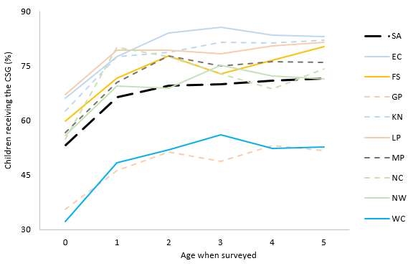
Access to the CSG by age and province
For ages 1 to 5, over 700,000 children per age cohort were benefitting from a child grant in 2021/22. This is over 70% of children in this age range. The number is 550,000 for age 0
Delays in initial receipt for the CSG following birth (age 0 beneficiaries were 78% of ave for age1-3 beneficiaries in 2017)
Source: Estimates based on pooled GHS 2017 to 2019 data with each year weighted equally.
Notes:
- age 0 recipients divided by the average across ages 1 to 3 ranges from 62% in Western Cape to 85% in Limpopo
Families are required to provide identity documentation for the applicant and a birth certificate for the child, specific documentation relating to each grant, and proof of income (notarized bank statements) for the means testing for the CSG and CDG
Even though most women give birth at a hospital or health facility, a considerable proportion of births (20% before the pandemic and 29% during) are not registered until 30 days or more after occurring.
Applications have to be made in-person at one of the 389 local South African Social Security Agency offices. there have been some promising advances on this during the pandemic when local offices were closed and SASSA had to rapidly develop a new electronic application and registration system to handle the millions of applications for the special COVID-19 grant.
Travelling to each of these locations, especially from rural areas, is costly, time-consuming and challenging, especially for new mothers
Delays in the initial receipt of the CSG following birth is a widely acknowledged problem. One indicator of this is the number of beneficiaries age 0 divided by the average over children ages 1 to 3.
Late birth registration is by far most serious in KwaZulu-Natal, where only 69% of births were registered within 30 days of occurrence in 2018. The second-worst province was Gauteng, with 76%,
Child grant coverage age 1 to 5 by province for the poorest 40% of young children 2019: Apart from coverage in Gauteng (67%)and Western Cape (78%) emerging as relatively low, this also appears to be the case in North West, where only 80% of children among the poorest 40% access a child grant,

Slide 23
Is the CSG sufficient to cover basic food costs for young children?
Trend in purchasing power of the CSG
The purchasing power of the CSG has risen since it was introduced in 1998; the real increase has been 34%.
In 2021, even after recent increases in the purchasing power of the CSG, the amount came to 74% of the per capita food cost (R624) used by Stats SA.
Source: UNICEF 2019; SASSA; Stats SA CPI publications
Notes:
The real increase over the whole 1998 to 2021 period is 34%. This is slower than growth in average remuneration in the public sector, which was around 47% in real terms for just the 2006 to 2019 period (MTBPS, 2020). This comparison is made given the argument often put forward by the government in recent years that wage growth in the public sector has adversely affected what government can spend on the non-wage inputs of service delivery
While it is very unlikely that all of the CSG would be spent on food for the child beneficiary, it is convenient and instructive to compare the grant amount to estimates of what it costs to feed a child adequately per month.
Arguments to increase the amount of the CSG to at least the Stats SA per capita food cost are compelling. Yet, existing research on the impact of the CSG points to smaller welfare and nutritional benefits than could be expected, even with historical CSG amounts (Devereux and Waidler, 2017). Future strategies should focus both on the grant amount and complementary interventions, such as initiatives aimed at informing vulnerable households about good nutritional practices.
Does it make sense to increase the grant amount for 0-2?

Slide 24

Early nutrition package
Notes:
the period of conception to the first five years of a child's life remains a critical window for their growth and development. If malnutrition is not addressed during this period, the opportunity for a child to reach her/his full potential diminishes. nutrition prevention programmes that enable building a foundation for brain development are far more valuable than nutrition replacement interventions, which address malnutrition only once a deficit has occurred.The latter highlights the importance of education, screening, referral and early nutritional interventions for pregnant women, newborn and young children. Although malnutrition may manifest in different ways, the approach to prevention is the usually the same following a life-course approach. This includes the provision of adequate maternal nutrition before conception, during pregnancy and breastfeeding; breastfeeding in the first two years of a child's life; optimising access to nutritious and safe foods in early childhood; enabling access to basic health, water.

Slide 25
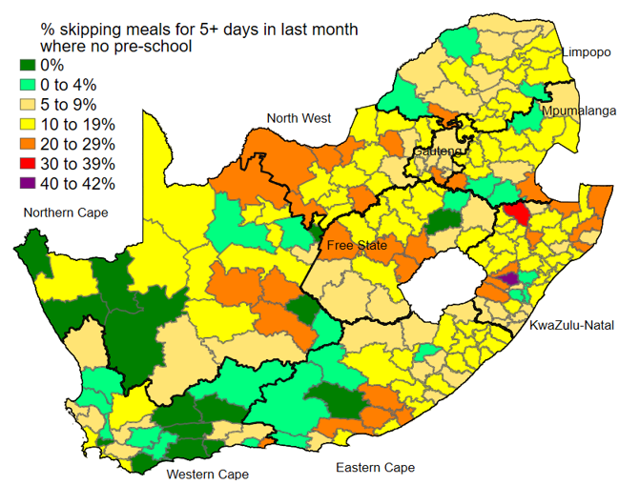
Doubly disadvantaged children: food insecurity and no pre-schooling, 2016
Source: Community Survey 2016 microdata.
Notes:
Food insecurity is an issue in South Africa- About 10% of South Africa households with young children aged 4-5 skipped at least 5 meals in the last month.
A large group of children are doubly disadvantaged, suffering from food insecurity and not attending any form of pre-schooling. In a majority of local municipalities, more than 10% of children ages 3 to 4 were hungry and not attending any form of early learning programme in 2016 (yellow coloring). In some municipalities, this proportion rises to 20% or more (mustard/orange/red/purple). ECD centres serve a dual role of providing early stimulation and providing meals.
supporting the establishment of new centres in under-serviced areas could improve not only early learning outcomes but also help reduce hunger.

Slide 26
Expenditure on the early nutrition package
R million at constant 2021/22 prices | Total expenditure | Expenditure possibly flowing to ages 0 to 5
National school nutrition programme (NSNP) – National DBE | 8,115 | 406
Social Relief of Distress (SRD) 2019/20 pre-pandemic- National DSD | 444 | 51
Nutrition sub-programme- Provincial DoH | 245 | 28
Provincial social development food packages | 113 | 13
Total without NSNP | 802 | 92
Total with NSNP | 8,917 | 498
Total expenditure on early nutrition package (2021/22)
R498 million
National Food and Nutrition Plan for 2018-2023 which sets out strategies to improve food and nutrition security, but many elements of it remain unrealised, e.g. multi-sectoral Food and Nutrition Security Council.
Source: National Treasury (ENE of 2021 and Excel EPRE files published in 2021)
Notes:
Expenditure on nutrition interventions aimed at young children outside the early learning and family support packages is tiny at about R498 million in 2021/22.
The bulk of this expenditure, around R400 million, is through the NSNP which is administered through the DBE and the most of it is directed to children aged five, but also a few children aged four, enrolled in Grade R in public schools. This program does not benefit younger children who have not entered school yet, or even children who are enrolled in private low-fee paying schools.
In budgetary terms, the social development sector’s Social Relief of Distress (SRD) grant is a relatively large intervention which could potentially be used to alleviate food insecurity among young children. About R51 million a year is directed to the population ages 0 to 5, which is about 11.4 percent of total SRD expenditure. (potential to ramp up quickly). In its 2019 annual report it indicates that ‘The current social relief of distress regime is fragmented, the legislative framework outdated, the institutional arrangements defunct and delivery to the destitute people is unresponsive’
Direct spending on nutrition for young children is low.
This is a rough picture, as details on expenditure both within these budget lines, and elsewhere, devoted to the nutrition of young children are scarce. What appears certain, however, is that expenditure on nutrition for young children outside the early learning and family support packages and outside the NSNP, is tiny and fragmented. The total of R92m is only 0.4% of expenditure on children ages 0 to 5 in the family support package and just 1% of the early learning package.

Slide 27

Institutional Analysis

Slide 28
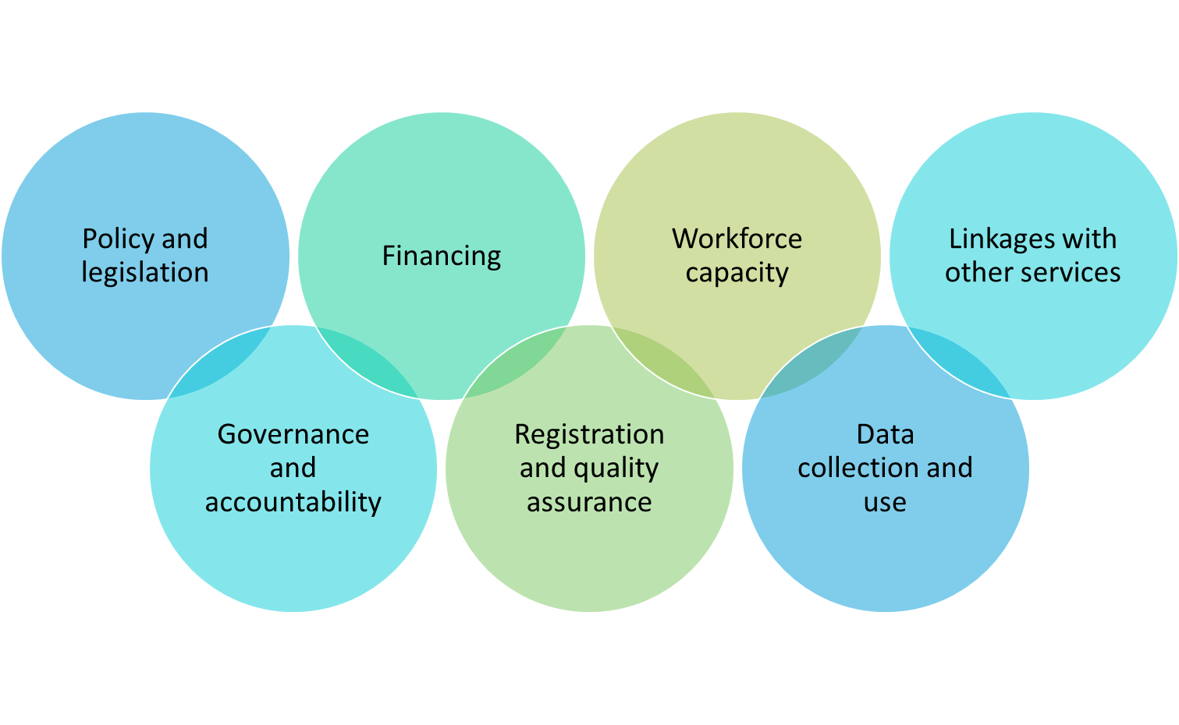
Institutional elements that we set out to analyze
Notes:
Policy: New legislation may be considered relating to registration processes and funding
Governance and accountability: split between national and provincial spheres. Multi-sectoral coordination structures for ECD and across spheres of government – but considered to be largely ineffective. APPs and annual reports – important nexus for improving planning and accountability. But often thin on detail, released with some delay, or omit key indicators required to understand ECD performance
Financing: No holistic approach to budgeting for child development across key departments and key interventions → insufficient funding in areas that span multiple departments, e.g., nutrition.
Registration and quality assurance: Implementation variability in registration and accreditation across provinces. Needs to be better implemented and simplified across packages.
Workforce capacity: Limited workforce capacity – different spheres of government and ECD workforce (practitioners) and training variations across provinces. Shortage of Community Health Workers (0.8 per 1,000 individuals) – high workloads with no room for additional activities.
Data collection and use: Data focused on limited high-level indicators for APP reporting, with gaps on quality and outcomes. Limited capacity to analyze and use the data within and across departments
Linkages with other services: Opportunities include: accompanying measures alongside social assistance grants (or conditional cash transfers); leverage early learning services for growth monitoring and malnutrition; use CHWs to promote broader parental support and early stimulation

Slide 29
Summary and recommendations

Slide 30
Summary
Funding needs to be directed to ECD expenditure on nutrition and stimulation interventions for the youngest children.
A substantial increase in funding for the ECD system is inevitable if the Government’s goals of reduced malnutrition and improved early learning are to be achieved.
 | Early learning package | Family support package (0-5 years) | Nutrition package | Total expenditure for three packages
Total expenditure (constant 2021/22 prices) | R9.53 bn | R24.37 bn | R498 mn | R34.94 billion
Notes:
Expenditure on the three packages does not line up with international evidence on which types of interventions and at what ages yield the highest rates of return-

Slide 31
Phasing the implementation of Recommendations (WIP…)
 | First Phase | Second Phase
Reduced Malnutrition | Women apply for the CSG while they are pregnant, link to nutrition info (R1.1bn) | Raise the CSG amount for 0-2 year olds (R2.57bn)
Improved Access to Early Learning | Make ECD programme registration more accessible | More access to infrastructure grants for private ECD programmes
Improved Quality of Early Learning | Full subsidies to ECD programmes for all children (R7.1bn) | Improve the attractiveness of a career as an ECD practitioner ($820m/year)
Strengthened System | Establish Functioning institutional structure Regular collection and analysis of data to monitor quality (~14m) Capacity needs assessment & training for National and Provincial DBE | Train ECD practitioners Strengthen provincial annual performance plans and reports

Slide 32

Discussion

Slide 33
Recommendations
Outcome: Reduced Malnutrition
Allow women to apply for the CSG while they are pregnant (R1.1 billion/year)- link provision of the CSG with information and support for better nutrition and stimulation of young children
Raise the CSG amount for 0-2 year olds, which is currently inadequate to cover a basic per child food cost (R2.57 billion/year)
Outcome: Improved Access to Early Learning
Make ECD programme registration more accessible by amending compliance requirements to retain only those that are essential and appropriate (within existing budget)
Provide more access to infrastructure grants for private ECD programmes (to be costed)
Provide provinces with sufficient funds to provide full subsidies to ECD programmes for all children meeting eligibility criteria (R7.1 billion/year which includes an increase in the subsidy amount to R21/child/day to return to the real value in 2015)

Slide 34
Recommendations
Outcome: Improved Quality of Early Learning
Provide all ECD programmes with copies of the national Grade RR curriculum (within existing work programme of DBE)
Train ECD practitioners to follow effective practices (to be costed)
Improve the attractiveness of a career as an ECD practitioner and raise retention through higher remuneration (approximately R820 million/year)
Outcome: Strengthened System of Service Delivery
Establish a high-powered institutional structure at national level to provide leadership and coordinate the ECD system across sectors and spheres of government - to focus on child outcomes
Regularly collect data and establish a mechanism to assure the quality of ECD programmes (approximately R14 million )
Conduct a capacity needs assessment for DBE and PDoEs to recruit and train staff as required (to be costed)
Strengthen provincial annual performance plans and reports to become more focused on tracking and linking budgets, implementation, and outcomes

