Slide 1
Assessment of young children – Why and how?
Linda Richter
RESEP Early Learning Workshop
Stellenbosch 4-5 July 2019

Slide 2
Why assess young children?
Early detection/screening for remediation
Clinical: administrative (eg mental disability}; progress in response to intervention
Programme evaluation
Population monitoring
Research

Slide 3
Assessement dimensions
Comparative assessment
A child is compared to others eg IQ
Criterion-referenced assessment
Task sampling eg maths curriculum
Construct / performance
Construct eg intelligence, development, learning
Performance on task/criterion

Slide 4
Types of tests/procedures
Non-construct performance tests
Non-construct comparative tests
Construct-based performance
Construct-based comparative tests
- not mutually exclusive

Slide 5
Non-construct performance (task sampling) eg
School (curriculum) tests
International/regional benchmarks
TIMMS (Trends in International Mathematics and Science Study) - 4th grade
PIRLS (Progress in International Literacy) – 4th grade
SACMEQ The Southern and Eastern Africa Consortium for Monitoring Educational Quality – primary/std 6

Slide 6
Construct performance tests
Feuerstein Learning Propensity Assessment Device (LPAD)
Purports to measure learning potential (Vygotsky’s zone of proximal development)
Examines how an individual learns through repeat tasks and mediation (what and how much help is needed)
Pre-primary onwards
Notes:
Feuerstein, R., Rand, Y. A., & Hoffman, M. B. (1979). The dynamic assessment of retarded performers: The learning potential assessment device, theory, instruments, and techniques. Scott Foresman & Co.
Tzuriel, D. (2000). Dynamic assessment of young children: Educational and intervention perspectives. Educational Psychology Review, 12(4), 385-435.
Another example is Reaction Time

Slide 7
Non-construct comparative
Reaction time
Measures elapsed time between stimulus and response, usually key presses
Considered measure of mental processing speed (actually sensory-motor speed)
Compared to others
Notes:
Feuerstein, R., Rand, Y. A., & Hoffman, M. B. (1979). The dynamic assessment of retarded performers: The learning potential assessment device, theory, instruments, and techniques. Scott Foresman & Co.
Tzuriel, D. (2000). Dynamic assessment of young children: Educational and intervention perspectives. Educational Psychology Review, 12(4), 385-435.
Another example is Reaction Time

Slide 8
Construct comparative
Where the rubber hits the road …
Adequacy of the measure of the construct (reliability, validity etc)
Adequacy of the comparative/normative /standardisation process

Slide 9
Measuring constructs
Development
Learning
IQ, cognition
Maturity
Social competence
Executive function etc

Slide 10
Executive function
Originally 3 main areas (then 7, 8 etc):
Working memory - attention, holding information in memory during a task
Cognitive flexibility (flexible thinking) – problem solving, seeing alternatives
Inhibitory control (self-control) – keeping behaviour and emotions in check

Slide 11
Construct validity
Does the test measure the construct?
Classical
theoretical concepts and their interrelations
Measurement & empirical investigation of the concepts eg Spearman’s g (general intelligence) and s (specific skills)
Criterion validity – compares well with measures of same construct administered at the same (concurrent) or future (predictive validity)

Slide 12
Types of validity
Intrinsic validity – “performance” (task sampling) - a asking a child’s to name letters of the alphabet is an intrinsically valid measure of literacy at a specified level
Face validity – the test "looks like" it is going to measure what it is supposed to measure
Content/logical validity – covers all domains of the construct eg development (cognition, language, gross motor, fine motor, personal-social etc)

Slide 13
Psychometric validity
Internally consistent
Reliable
Discriminates between children on construct of interest
Etc

Slide 14
Comparative process
Adaptation
Cultural/language adaptation, translation
Creating norms:
Establishing levels of performance of representative samples of children
Standardization
Adjusting scores to a normal curve (norming)
Converting raw scores into standard scores (standardisation) and gge standardization, if needed

Slide 15
Summary
Other than classics (Wechsler etc), very few tests for young children have gone through rigorous construct validation
In addition, no ability/development/IQ psychometric tests/ratings administered below 5y of age predicts adult performance, except at very low end
Question is – what is the purpose of the assessment?

Slide 16
Lack of prediction, a.o.
Imperfect near-age prediction
Birthweight predicts infancy, infancy predicts preschool, preschool predicts school-age, late school-age predicts adults
Tasks change eg fine-motor→ language → logic/problem-solving
Strong effect of SES
Apart from SES, adult success may depend on abilities and personality characteristics

Slide 17
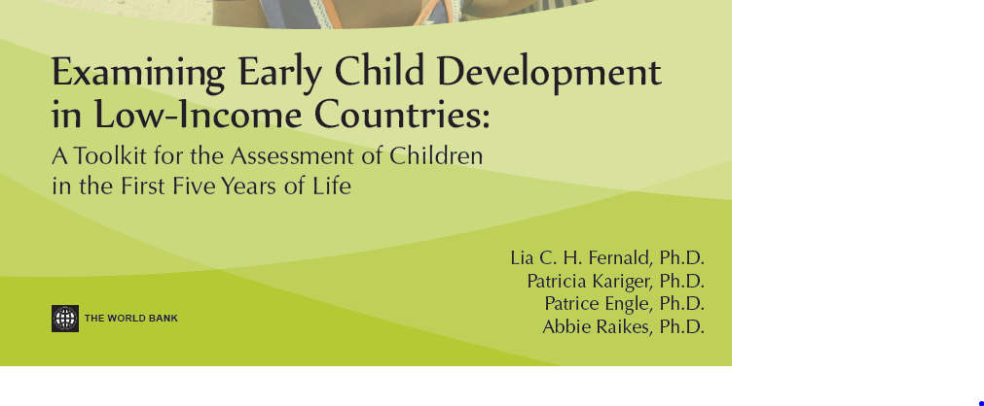
Proliferation of tests
a.o World Bank-sponsored reviews in 2009, 2017
Identified 147 early child development and preschool measures that had been used in LMICs

Slide 18
Preschool approaches, eg
Mainly task-sampling, some constructs
EDI Early Development Index (Canada, 2000), 3.5-6.5y, +110 items, teacher report –Physical, Language-Cognitive, Socio-emotional
EGRA, EGMA Early Grade Reading & Maths Assessment (USA, 2006-), Grades 1-3 – Literacy, Numeracy
IDELA Int Development and Learning Assess (UK, 2011), 3.5-6y 22 items, directly observed – Motor, Language, Numeracy, Socioemotional (+Parent Survey)

Slide 19
MELQO
Measuring Early Learning Quality Outcomes (USA-led consortium, 2014), 3-8yr
Child and environment, and by observation and survey
Exec function, maths, literacy, socio-emotional, physical
In anticipation of global ECD interest and SDG target 4.2

Slide 20
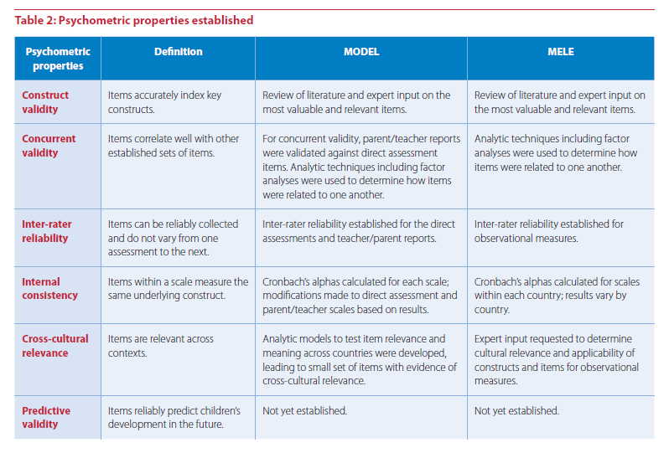
Researchers typically establish construct validity by presenting correlations between a measure of a construct and a number of other measures that should, theoretically, be associated with it (convergent validity) or vary independently of it (discriminant validity)

Slide 21
No shortage of tests ….
Decisions based on purpose of assessment
Early detection/screening for remediation (eg is child ready for school?)
Programme evaluation
Population monitoring

Slide 22
Early detection/screening
Instruments not needed by trained professionals to make decisions, refer, specialised instruments for treatment
Standardised, administrative, task-shifting (time, expertise, resources) – how useful, well used and actually used
Must be accompanied by:
Referral
Assessment for remediation
Remediation
Progress monitoring
If not, screening can do more harm than good

Slide 23
Programme evaluation
Baseline and follow up measures
Require tests built for re-testing capability (alternate forms)
Tests need to detect meaningful changes in target behaviours
No norms required – group comparisions
Evaluation designs to accommodate age- and experience- changes

Slide 24
Population monitoring 1
Feasibly incorporated into representative h/hold surveys
UNICEF MICS Early Child Development Instrument (ECDI) - 2009
Parent report 10 items, under revision (longer?)
Literacy, Physical, Learning, Soc-Emot
3-4y
Tier 2 SDG 4.2 indicator 3-5 years
To date ~80 countries
Motivation to include in DHS

Slide 25
Global Scale for Early Development
0-3 years
Derived from 3 sources:
2018
WHO Infant and Young Child Development (IYCD)
Harvard Caregiver-Reported Early Development Instrument (CREDI)
GCDG Jamaica Developmental Score (D-Score)
Longitudinal data from +36,000 children in 11 countries
Rasch model to order items by difficulty
Aim for ~15-20 items, z-score by age

Slide 26
Assess children, environments?
Emphasis on child assessment – when development, apart the low end, is dynamic
Less on environment (MELOQ has environment measures)
Yet, disadvantage at home and/or school tends to continue unchanged
Programme assessment needs to include the environmental changes that are assumed to underpin child changes

Slide 27
Eg Global “proxy” indicator
Proxy indicator - risk for poor development developed in ECD Lancet Series (2017)
Children under 5 living in extreme poverty (<US$1.90) or stunted (<2SD HAZ)
Longitudinal studies show strong associations with outcomes in adulthood
Height, schooling, health, wages, ht and cog in next generation
Used for longitudinal assessment in ECD Countdown to 2030

Slide 28
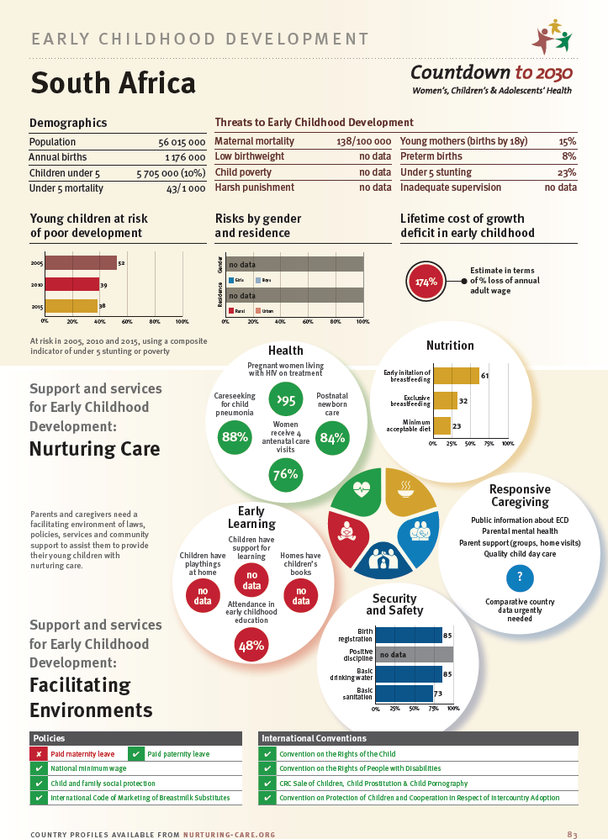
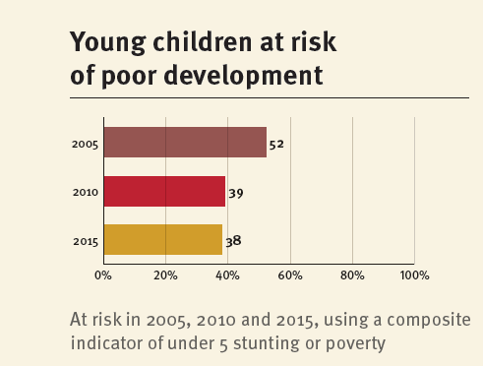
Eg South Africa
No MICS, therefore no ECDI or measure of home environment

Slide 29
Time scale for use?
Richter et al (1992) Bayley Scales for Infant Development– 722 children 2-30m - adapted, standardised and norms developed
Richter et al (1994) McCarthy Scales for Children’s Abilities– 350 children 3-7y - adapted, materials developed, translated (Zulu, Xhosa, Tswana, Venda, N Sotho, standardised and norms developed
Not “institutionalised” – gone on closure of IBS
Bayley now in 3rd edition
McCarthy replaced by Kaufman

Slide 30
Institutionalisation?
Institutional home, financing for longevity beyond few years
UNICEF ECDI – may be relegated to a Tier 3 SDG if 0-3y version not given technical support
USAID EGRA and EGMA – 70 countries, 120 languages
USAID MELQO – expanding, supporting African consortium
?WHO GSED – 3-country pilot in place

Slide 31
adapted, translated, standardised and norms developed
Beggs (2016) – Global Alliance to Monitor Learning. USAID

Slide 32
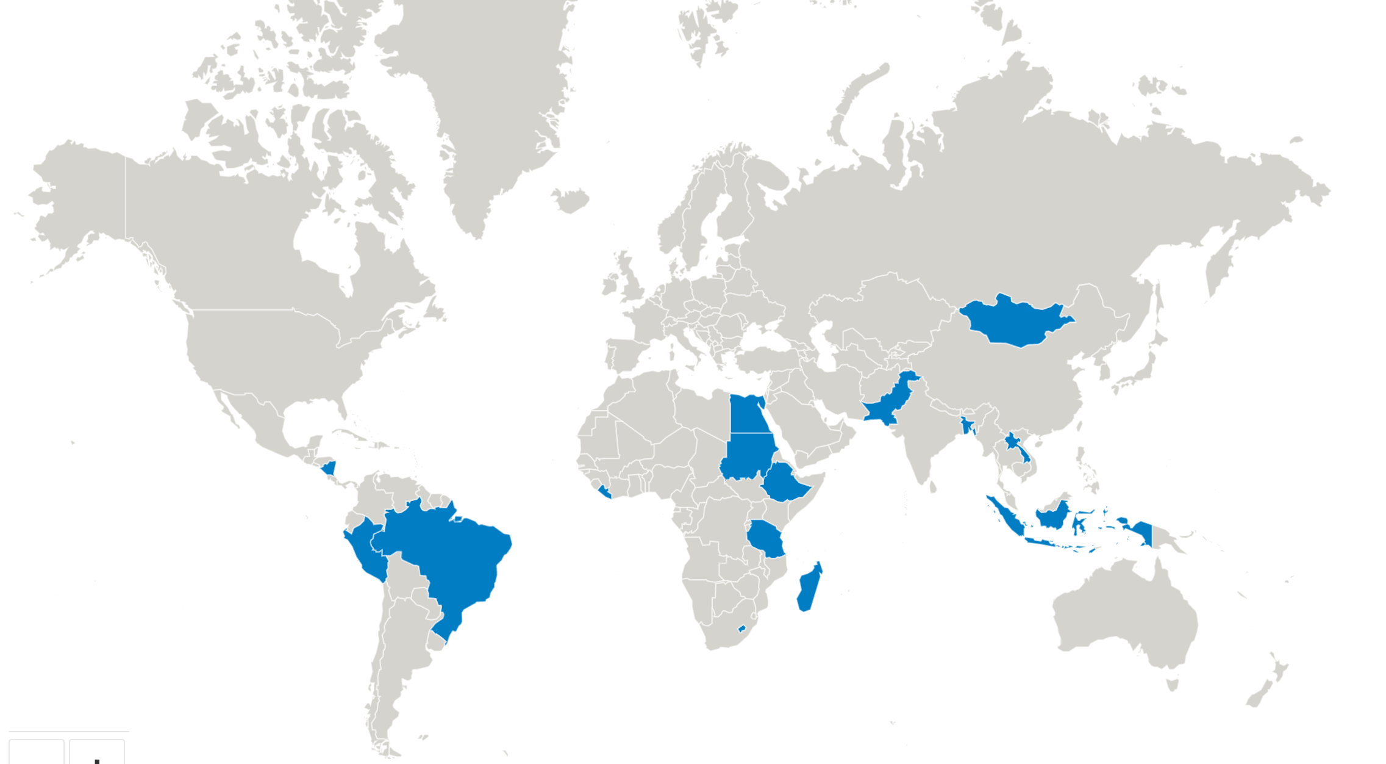
MELQO Countries

Slide 33
Large consortium, sub-group in Africa

Slide 35
Beggs (2016) – Global Alliance to Monitor Learning. USAID

Slide 36
The psychologist should lead the way in finding good criterion measures rather than construct imperfect tests
Gulliksen, H. (1950). Intrinsic validity. American Psychologist, 5(10), 511-517.

