Slide 1
The Language in Education conundrum from an empirical perspective:
Using evidence to inform policy
Centre for Evaluation and Assessment
Surette van Staden
Mishack Tshele
ReSEP, July 2019
Faculty of Education

Slide 2
Presentation Overview
A look back at previous analyses
Questions that guided the current analysis using PIRLS Literacy 2016 data
Results
Discussion and implications
Faculty of Education
Faculty of Education

Slide 3
POLICY CONTEXT ISSUES
Challenges of LiEP:
Learners are to receive mother tongue education from Grade 1 to 3.
Many schools teach these learners in a language that is nonetheless different from their home language.
When learners progress to Grade 4, the language of learning changes again, which means a further 80% of learners are taught in a further second language, usually English, a language spoken by fewer than 10% of the population.
Therefore: For Grade 1 to 3 learners ‘home language’ does not necessarily coincide with ‘language of learning’.
Currently the LiEP fails to address these disparities and currently offers a one-dimensional solution to achieve goals of equity and equality.
Faculty of Education
Faculty of Education

Slide 4
Language analysis from prePIRLS 2011
What are the differences in reading literacy achievement of Grade 4 learners between home language and language of the test across the 11 official languages with English test language as reference category?
To what extent does the discrepancy between the language of the test and membership to a broader linguistic group contribute to reading achievement of Grade 4 learners when controlling for learner characteristics?
(Van Staden, S., Bosker, R. & Bergbauer, A., 2016, ‘Differences in achievement between home language and language of learning in South Africa: Evidence from prePIRLS 2011’, South African Journal of Childhood Education 6(1), a441. http:// dx.doi.org/10.4102/sajce. v6i1.441)
Faculty of Education

Slide 5
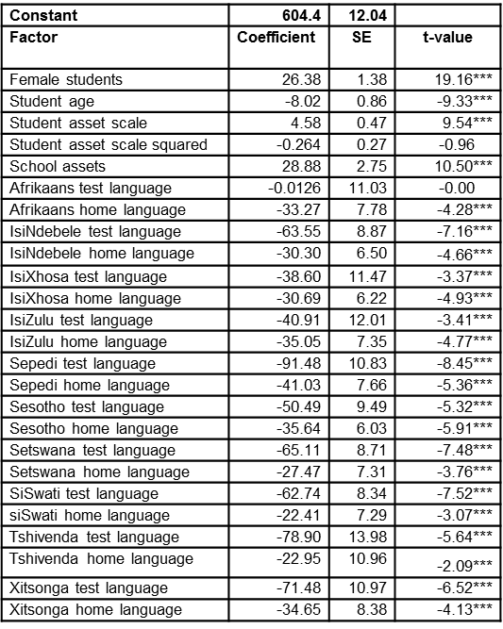
Question 1: What are the differences in reading literacy achievement of Grade 4 students between home languages and languages of the test across the 11 official languages with English test language as reference category?
Findings illustrate a substantial effect on reading literacy achievement when a discrepancy exists between language of the test and home language when controlling for learner background characteristics.
Students from African language backgrounds are most severely affected when the language of the test and their home language did not coincide with achievement being worst in test language across al languages except Afrikaans.
Faculty of Education

Slide 6
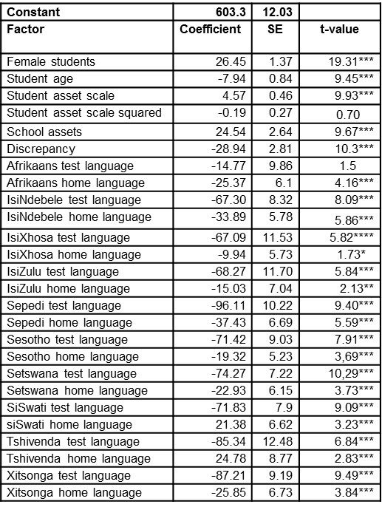
Question 2: To what extent does the discrepancy between the language of the test and membership to a broader linguistic group contribute to reading achievement of Grade 4 students when controlling for student characteristics?
Belonging to a different language group than what the test was written in results in a 29 point decrease in reading literacy achievement, a decrease by almost three quarters of a year for learners who wrote the test in a language outside the broader language group to which they belong.
Faculty of Education

Slide 7
Language analysis from PIRLS Literacy 2016
For purposes of PIRLS Literacy 2016, 12 810 Grade 4 learners were tested nationally in 293 schools.
The difference between test language and home language was obtained by comparing the language in which the test was written and the learner’s response to a question in the learner questionnaire about their home language.
71% same vs 29% different still the same proportion between prePIRLS 2011 and PIRLS Literacy 2016 overall sample,
For the most part, achievement was lower where the language of the test and the home language did not coincide. The achievement pattern from prePIRLS 2011 therefore remains the same.
Faculty of Education
Faculty of Education

Slide 8
Differences in achievement between test language and home language
Faculty of Education
Faculty of Education

Slide 9
Differences in achievement between test language and home language
Faculty of Education

Slide 10
Score point differences between differences in test language and home language
 | prePIRLS 2011 | PIRLS Literacy 2016
Afrikaans | 29 | 22
English | 91 | 89
IsiNdebele | 19 | -3
IsiXhosa | 39 | 11
IsiZulu | 34 | 9
Sepedi | 11 | -5
Sesotho | 42 | 10
Setswana | 32 | 4
SiSwati | 30 | 12
Tshivenda | 45 | 45
Xitsonga | 36 | 1

Slide 11
Two additional questions for PIRLS Literacy 2016
We asked the same question as for prePIRLS 2011:
What are the differences in reading literacy achievement of Grade 4 learners between home language and language of the test across the 11 official languages with English test language as reference category?
We added two scenarios:
Scenario 1: Better performing predictors
Girls, many resources at home and a combination of school location in medium city, urban and suburban
Scenario 2: Lower performing predictors
Boys, few resources at home and school location as remote rural
Faculty of Education
Faculty of Education

Slide 12
Scenario 1: Best background predictors with better home language achievement predictor
 |  | Regression | Regression
 | Regression | Coefficient | Coefficient
 | Coefficient | (s.e.) | (t-value)
____________________ | ___________ | ___________ | ___________
(CONSTANT) | 685,52 | 38,20 | 17,94
ASDAGE | -15,75 | 2,83 | -5,57
AFRIKAANS HL | 12,49 | 14,63 | ,85
ISINDEBELE HL | -34,46 | 16,16 | -2,13
ISIXHOSA HL | -59,18 | 15,67 | -3,78
ISIZULU HL | -40,21 | 13,98 | -2,88
SEPEDI HL | -93,52 | 12,34 | -7,58
SETSWANA HL | -54,99 | 14,79 | -3,72
SESOTHO HL | -20,68 | 14,60 | -1,42
SISWATI HL | -30,97 | 13,92 | -2,23
TSHIVENDA HL | -51,49 | 13,62 | -3,78
XITSONGA HL | -63,33 | 14,65 | -4,32
Gender-Male | -42,26 | 3,67 | -11,50
Location-Rural | -53,23 | 15,10 | -3,52
Location-Small town or Village | -67,88 | 14,53 | -4,67
Location-Township | -52,65 | 15,33 | -3,43
Few Resources | -103,91 | 16,88 | -6,16
Some Resources | -75,13 | 14,99 | -5,01

Slide 13
Scenario 2: Lower background predictors with lower test language achievement predictor
 |  | Regression | Regression
 | Regression | Coefficient | Coefficient
Variable | Coefficient | (s.e.) | (t-value)
____________________ | ___________ | ___________ | ___________
(CONSTANT) | 486,14 | 34,35 | 14,15
Age | -15,75 | 2,83 | -5,57
AFRIKAANS TL | 12,49 | 14,63 | ,85
ISINDEBELE TL | -34,46 | 16,16 | -2,13
ISIXHOSA TL | -59,18 | 15,67 | -3,78
ISIZULU TL | -40,21 | 13,98 | -2,88
SEPEDI TL | -93,52 | 12,34 | -7,58
SETSWANA TL | -54,99 | 14,79 | -3,72
SESOTHO TL | -20,67 | 14,60 | -1,42
SISWATI TL | -30,97 | 13,92 | -2,22
TSHIVENDA TL | -51,48 | 13,62 | -3,78
XITSONGA TL | -63,33 | 14,65 | -4,32
Location-Small town or Village | -14,65 | 9,43 | -1,55
Location-Township | ,58 | 11,86 | ,05
Location-Urban, Suburban and Medium city | 53,23 | 15,10 | 3,52
Gender-Girl | 42,26 | 3,67 | 11,50
Some Resources | 28,78 | 4,89 | 5,89
Many Resources | 103,91 | 16,88 | 6,16

Slide 14
Discussion and Implications
Students from African language backgrounds are most severely affected when the language of the test and their home language did not coincide with achievement being worst in test language across al languages except Afrikaans.
For the most part, achievement was lower where the language of the test and the home language did not coincide. The achievement pattern from prePIRLS 2011 therefore remains the same.
Score point differences between differences in test language and home language from prePIRLS 2011 to PIRLS literacy 2016 have:
Remained consistent for three languages
Reversed for two languages where learners who were tested in IsiNdebele and Sepedi achieved slightly higher when they were not tested in HL
Percentage gaps decreased substantially in the PIRLS Literacy 2016 cycle when looking at differences between HL and TL
Regression results for two scenarios show that even when controlling for lower background predictors, using English test language as constant, children from African languages, whether tested in HL or TL, are still worse off.
Do we perhaps have evidence that English test language, even in a low home resource environment for boys from rural areas would yield better results than testing in African languages?
With the decrease in the score points difference gap between HL and TL in PIRLS Literacy 2016, should our attention not be perhaps on reading pedagogy in the classroom regardless of the language of instruction?
Faculty of Education

Slide 15
Thank you Surette van Staden: Surette.vanstaden@up.ac.za Mishack Tshele Mishack.tshele@up.ac.za

