Slide 1

4 ways to
stay safe online
Equipping FP teachers to teach reading for meaning in African languages:
Coaching, Resources and Training
Nwabisa Makaluza
Early Learning Workshop
4 July 2019
With the growing presence and sophistication of online threats like viruses, ransomware, and phishing scams, it’s important to have the right protection. Office 365 Home and Office 365 Personal give you advanced security tools to help keep your information secure and private.

Slide 2
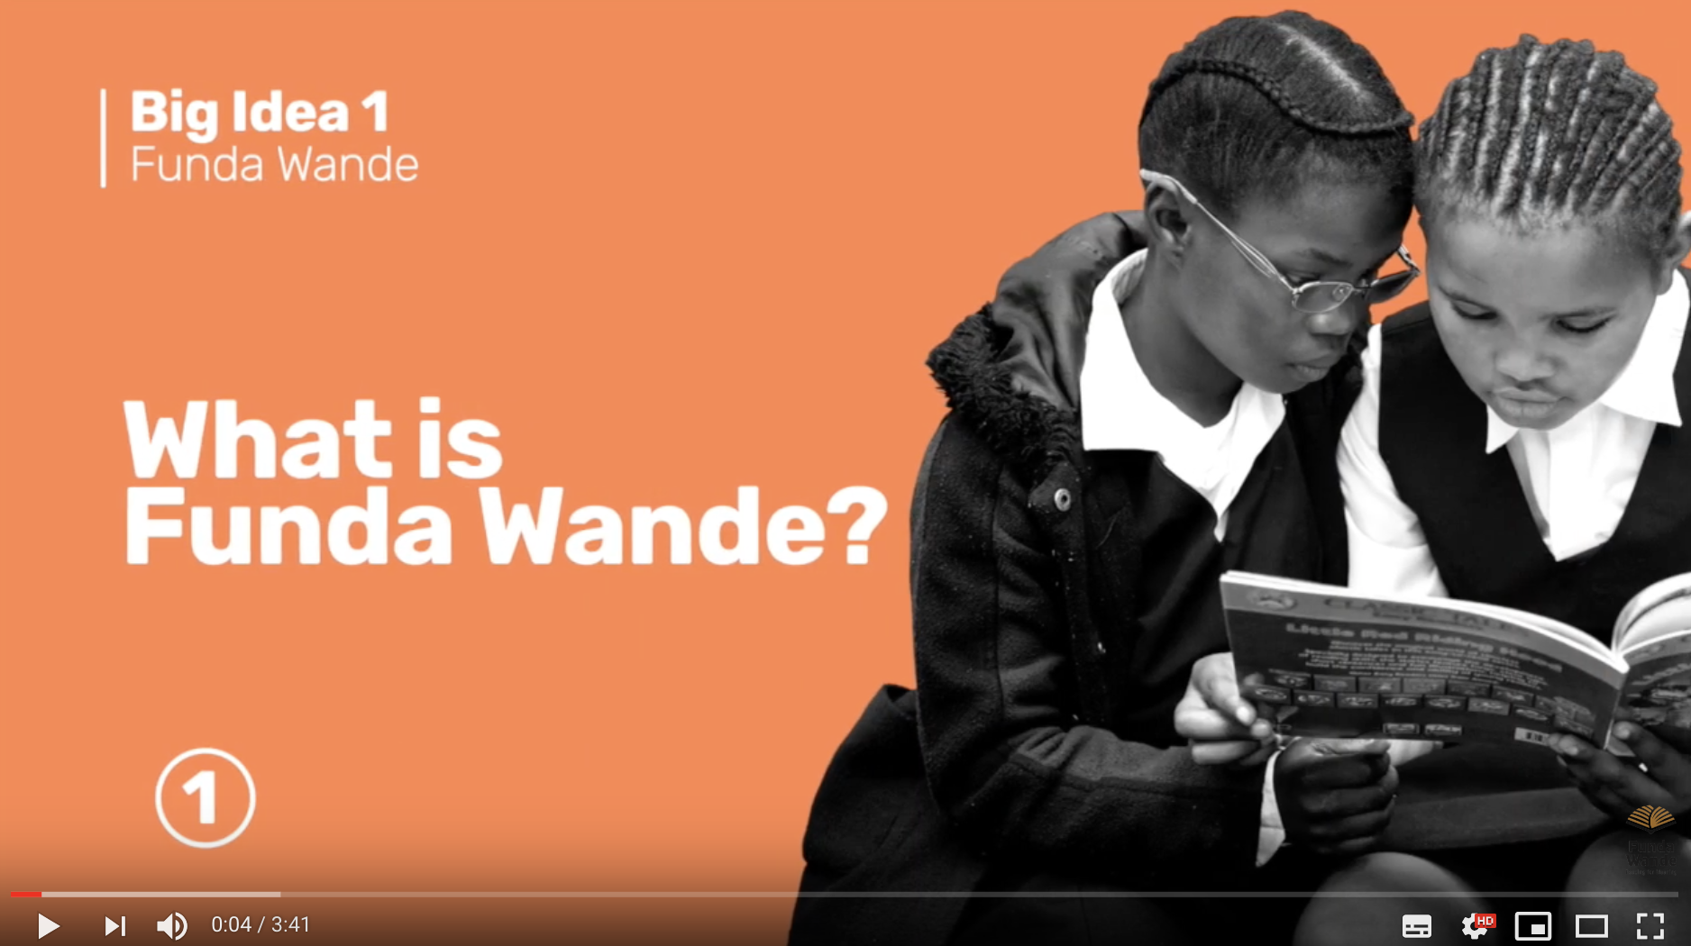

Slide 3
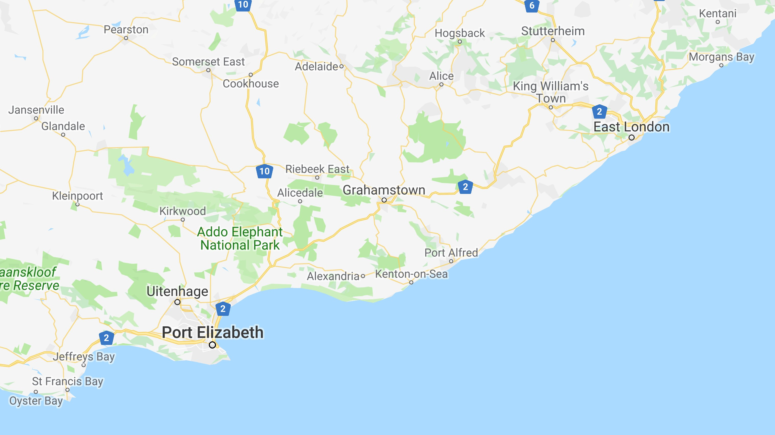




Slide 4
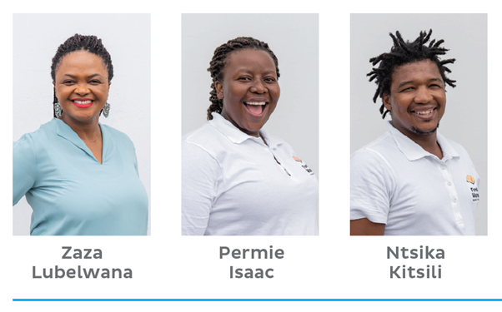

Coaching

Slide 5
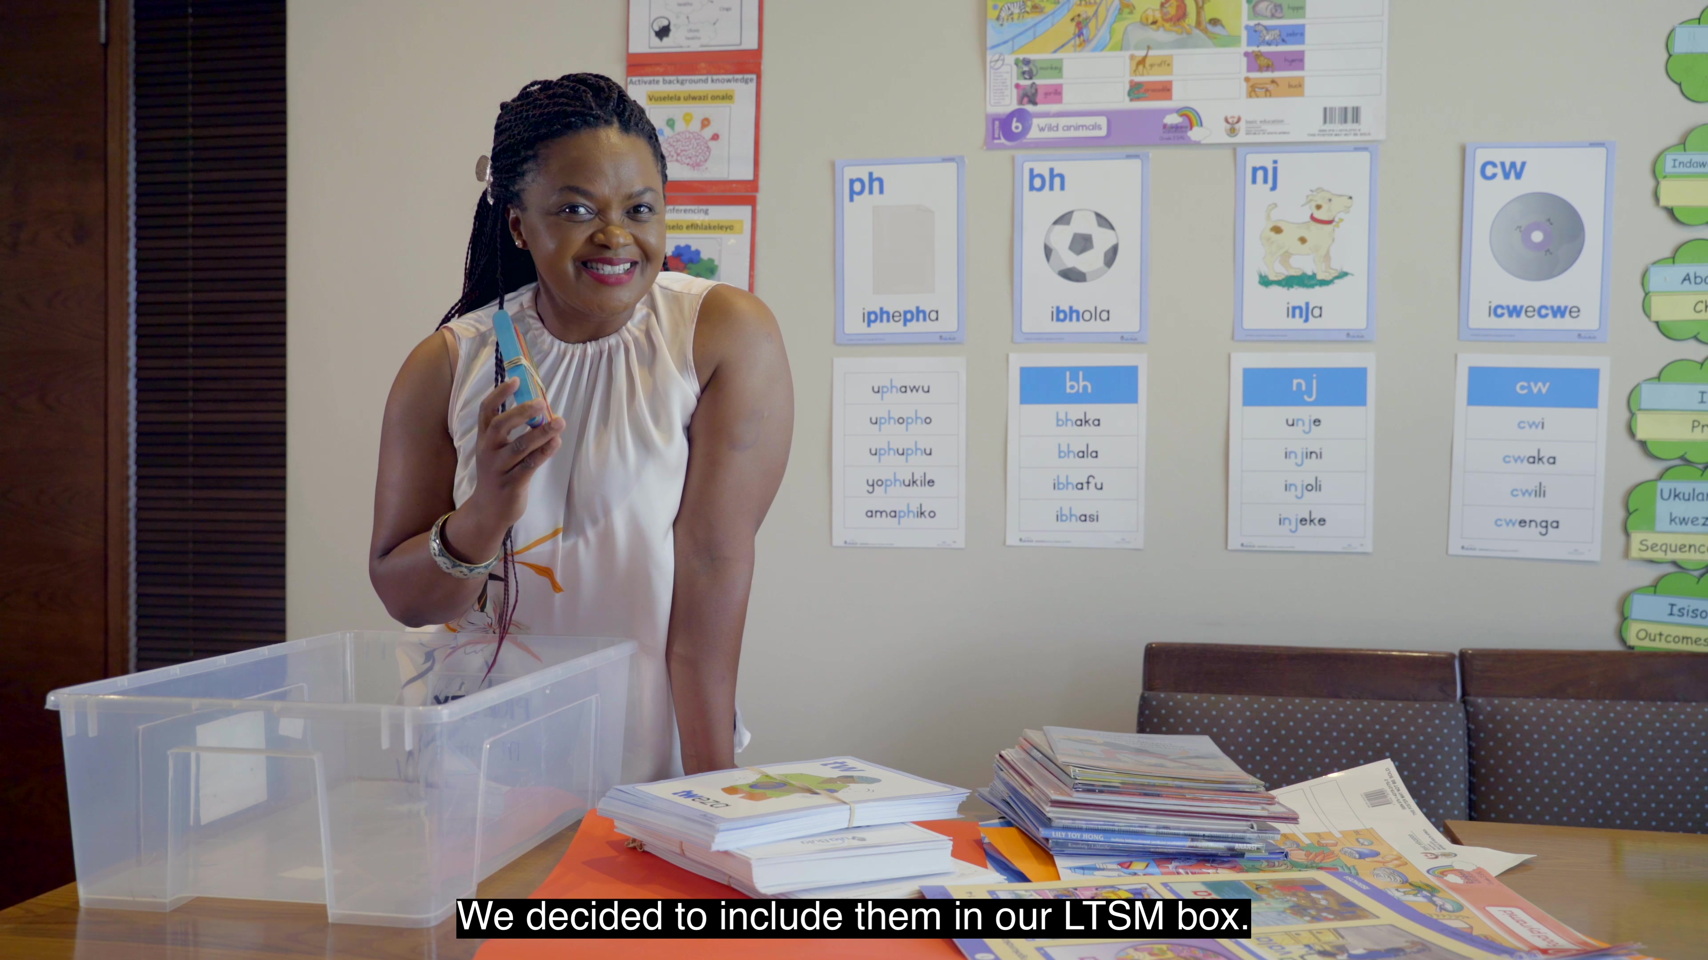
LTSM Box

Slide 6
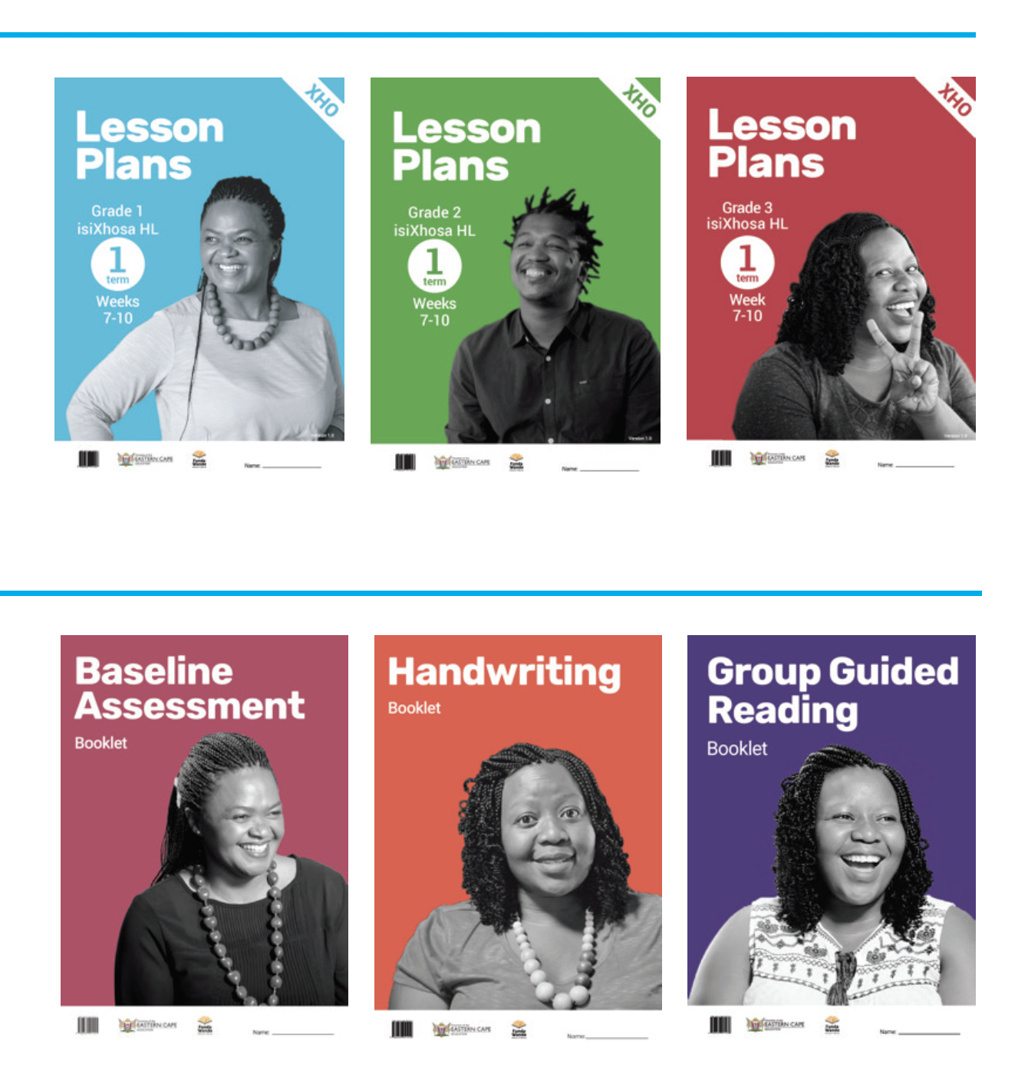
Funda Wande materials

Slide 7

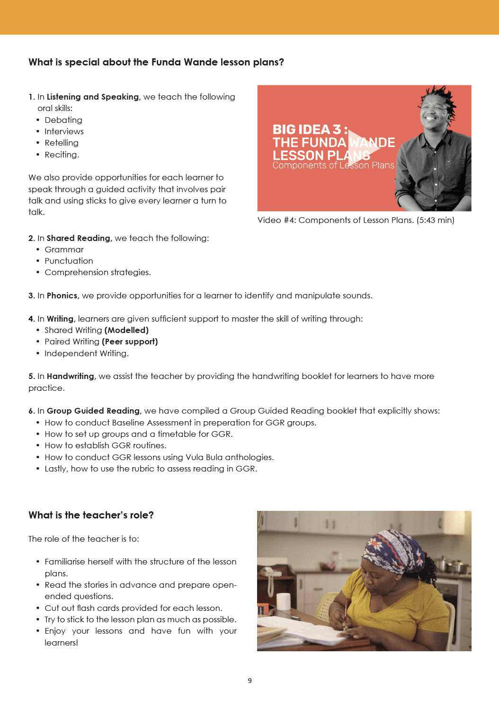
Lesson Plans

Slide 8
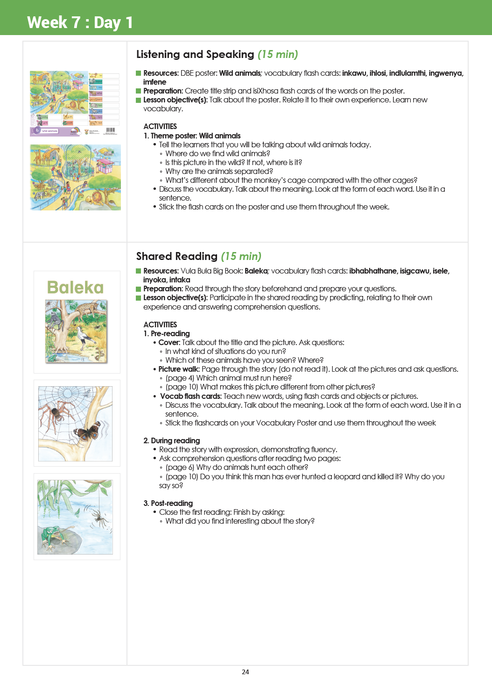
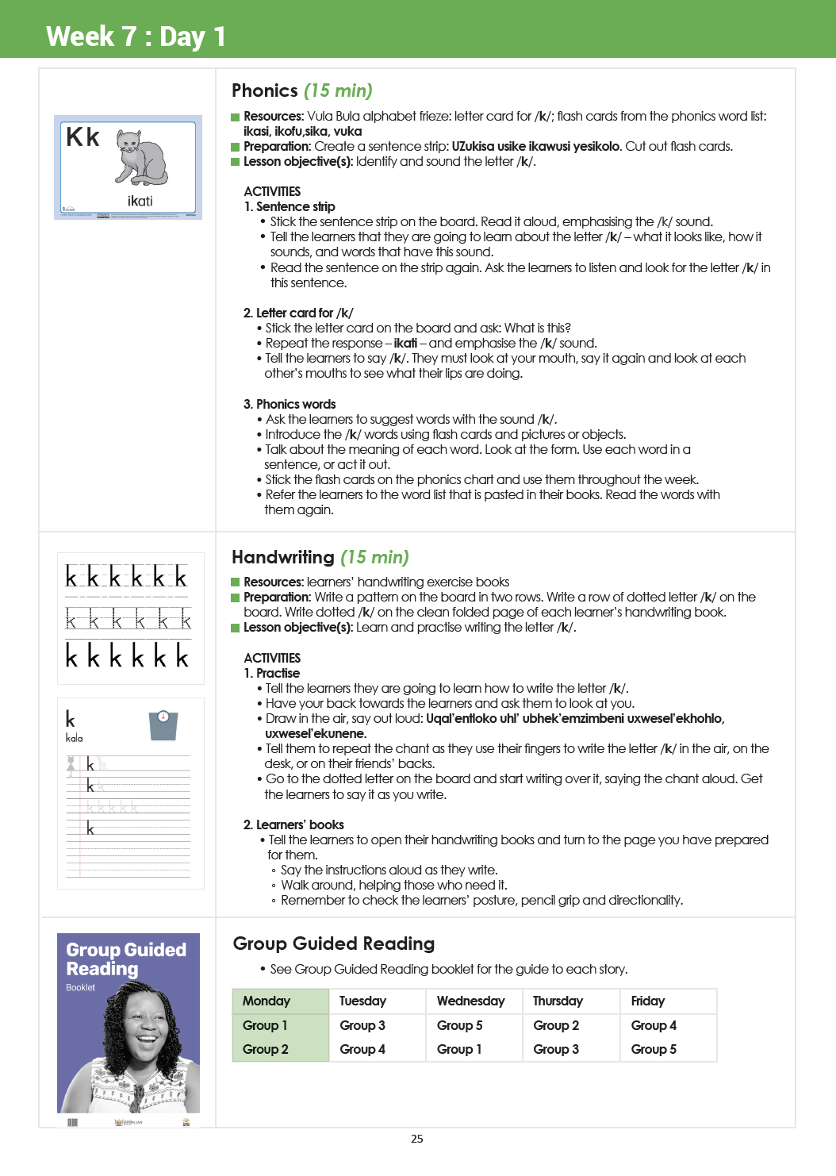
Lesson Plans

Slide 9
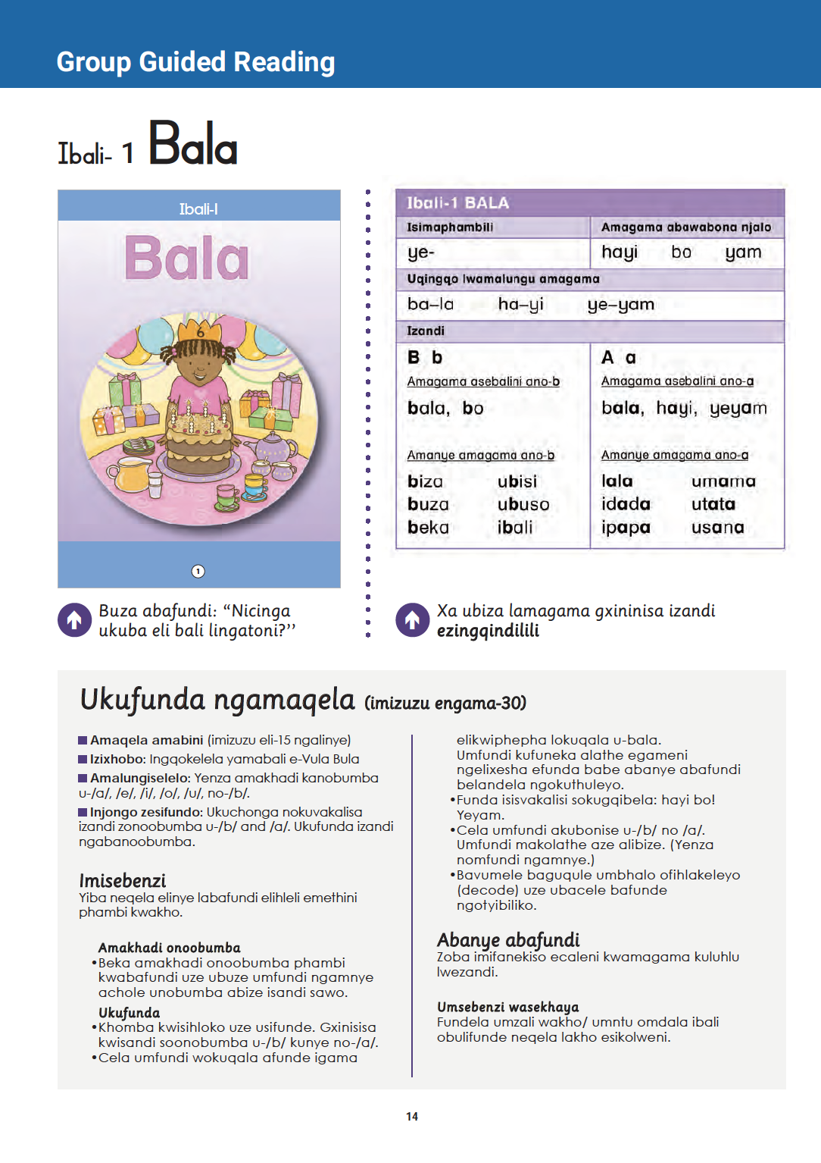
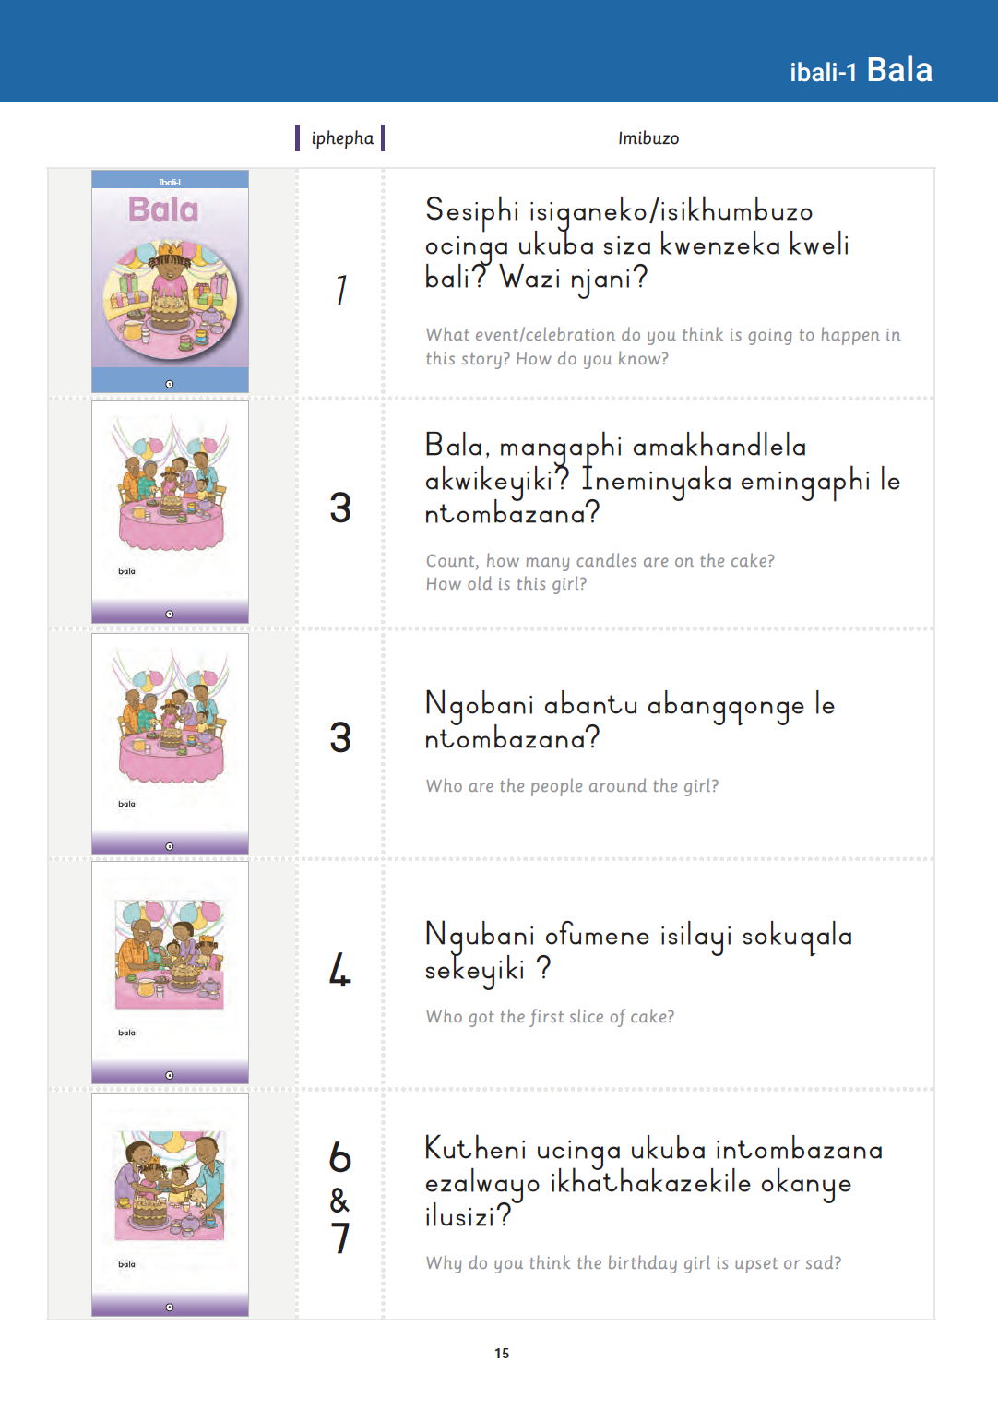
Activity Booklet

Slide 10
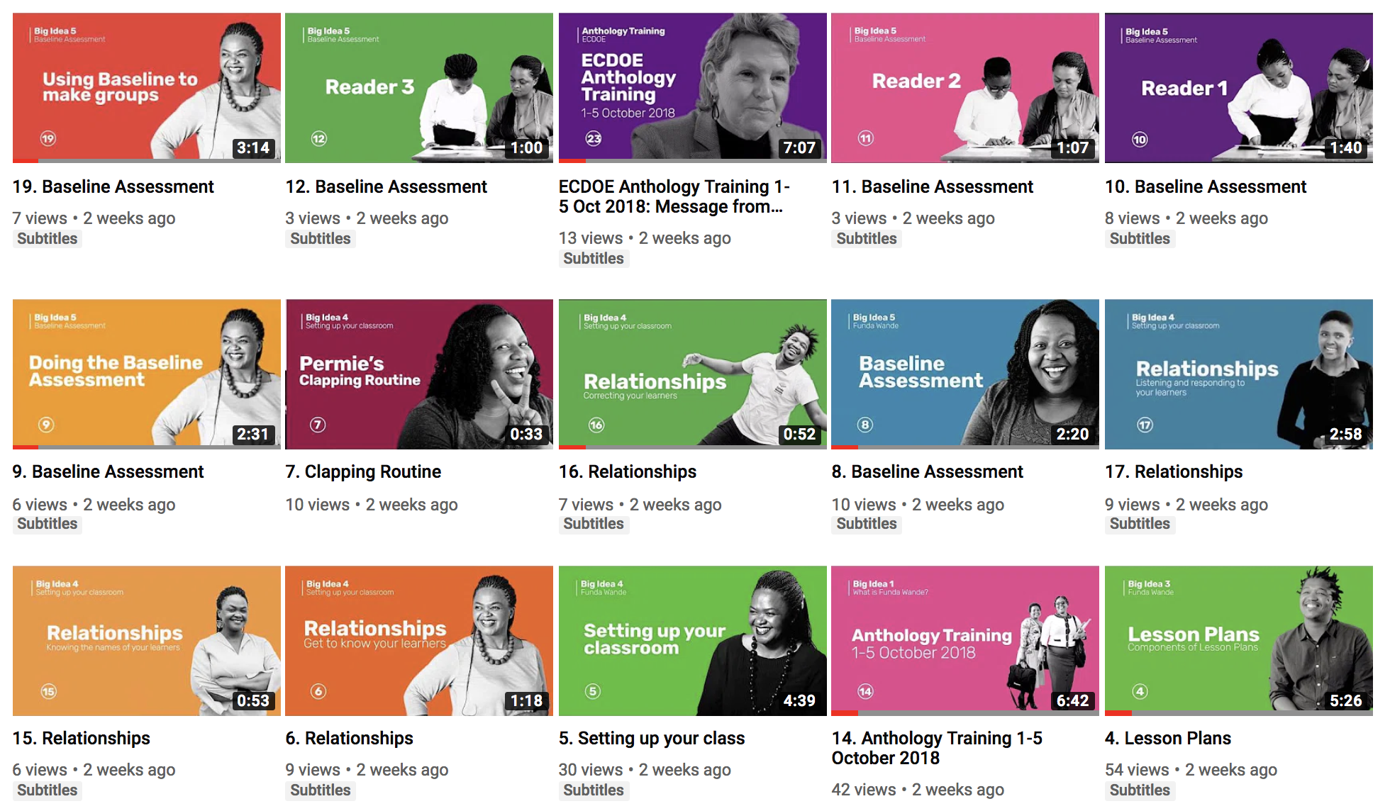

Slide 11
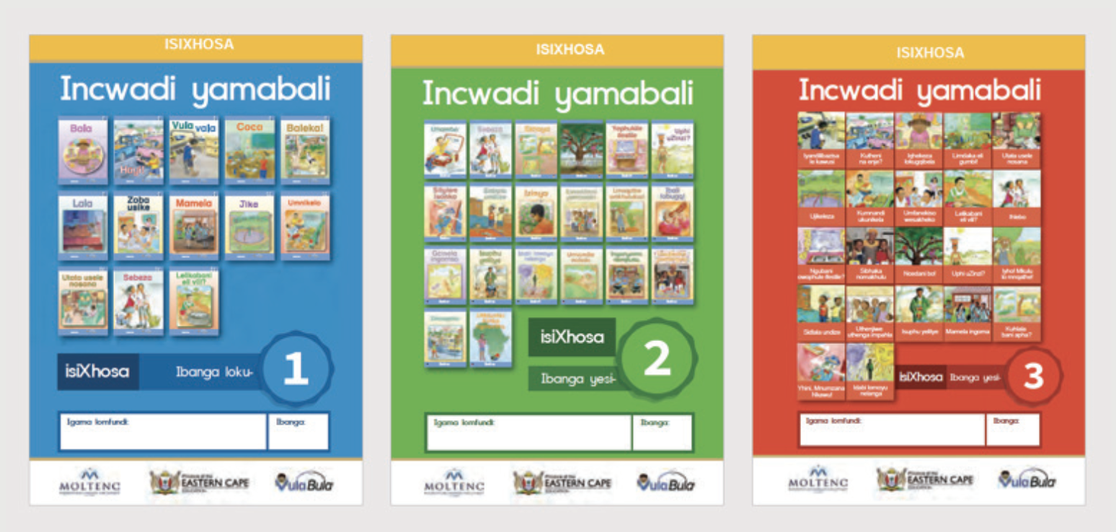
Partnering with Government
824,345 anthologies printed and distributed by ECDOE.

Slide 12
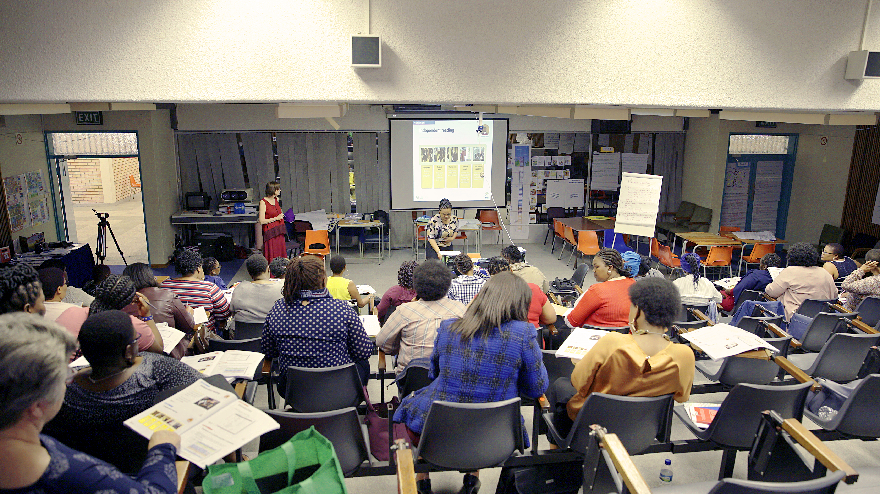
Anthology Training

Slide 13
SAQA Accredited course

Slide 14
SAQA Accredited course

Slide 15
SAQA Accredited course

Slide 16
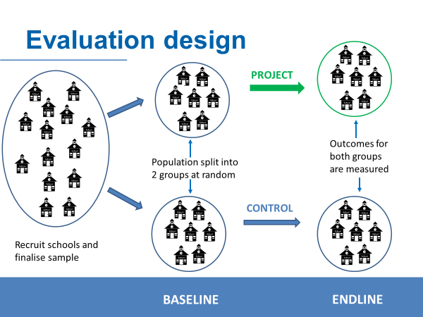

Impact Assessment
Prof Cally Ardington
(UCT & JPAL)
30
59
30
Feb
2019
Nov 2019
Nov 2020
29
29
MIDLINE

Slide 17


Baseline Results
52% of Gr1 learners cannot identify one letter sound
57% boys and 47% girls
Ardington (2019)

Slide 18
Baseline Results
52% of Gr1 learners cannot identify one letter sound
44% of Gr2 learners cannot read one word
50% boys and 39% girls
Ardington (2019)

Slide 19
Baseline Results
52% of Gr1 learners cannot identify one letter sound
44% of Gr2 learners cannot read one word
90% of Gr2 learners cannot answer an interpretive question about a passage they have read
Ardington (2019)

Slide 20

“We are not just language teachers, we also teach maths!”

Slide 21
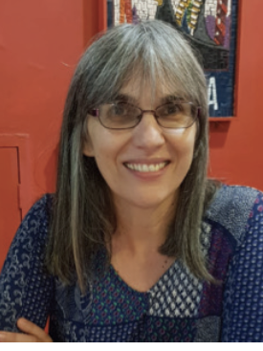
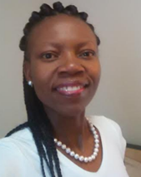
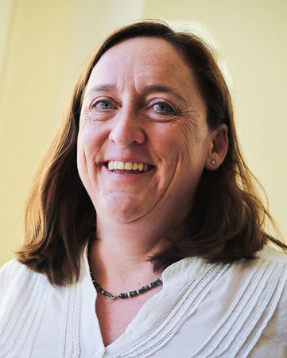
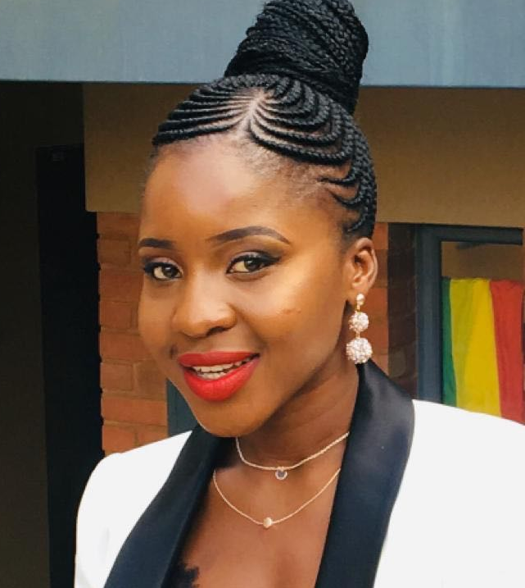
Maths team
Ingrid Sapire is leading the project and has 25 years experience in early grade mathematics in South Africa. She is highly regarded in the mathematics field; in 2018 she was appointed by the Minister of Basic Education to be the Chairperson of the Task Team to develop a framework for teaching mathematics in South Africa.
Thulelah Takane is currently a Head of Faculty for Education at the Independent Institute of Education and associated with the Wits Maths Connect Primary Project. She is completing her PhD in Primary Mathematics Education at Wits. She is a recipient of the Mamokgethi Phakeng Award for the most distinguished black woman Masters student in the field of mathematics education.
Lynn Bowie holds a PhD in Mathematics Education from Wits University. Her 30 years of experience in mathematics education includes teaching and being involved in all levels from grade R to postgraduate studies. She is an active member of the PrimTED project working to improve the initial education of primary mathematics teachers in South Africa.
Dineo Mokoro is currently completing her PhD in Computational abd Applied Mathematics at Wits University and is enrolling for a PhD in Education focussing on FP Mathematics. In 2017 & 2018 she was a researcher on the team led By Ingrid Sapire researching Multilingualism In Foundation Phase Mathematics.

Slide 22
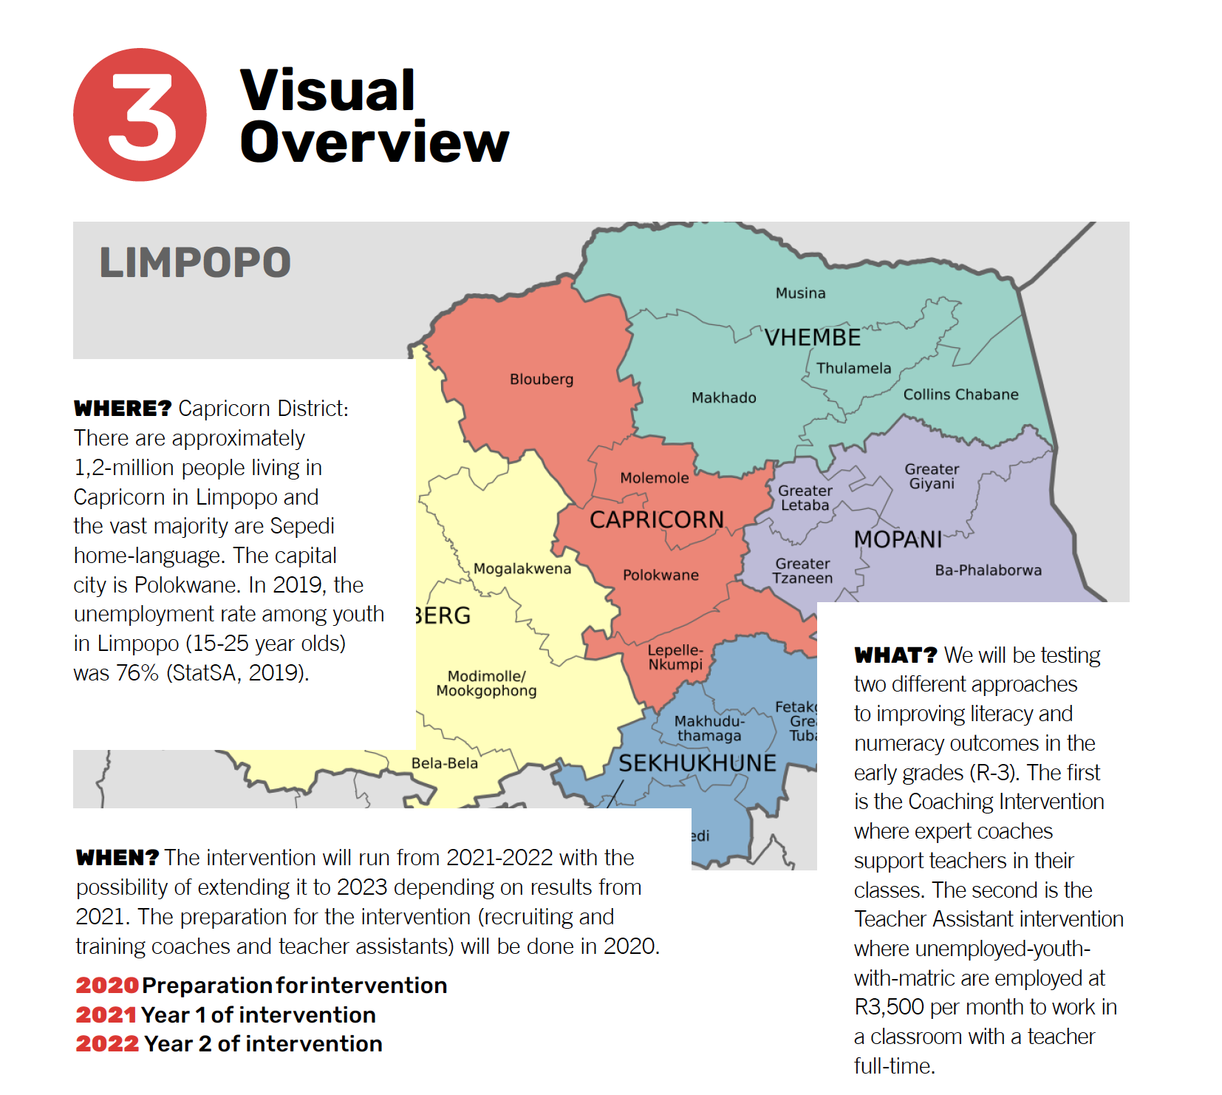

Slide 23

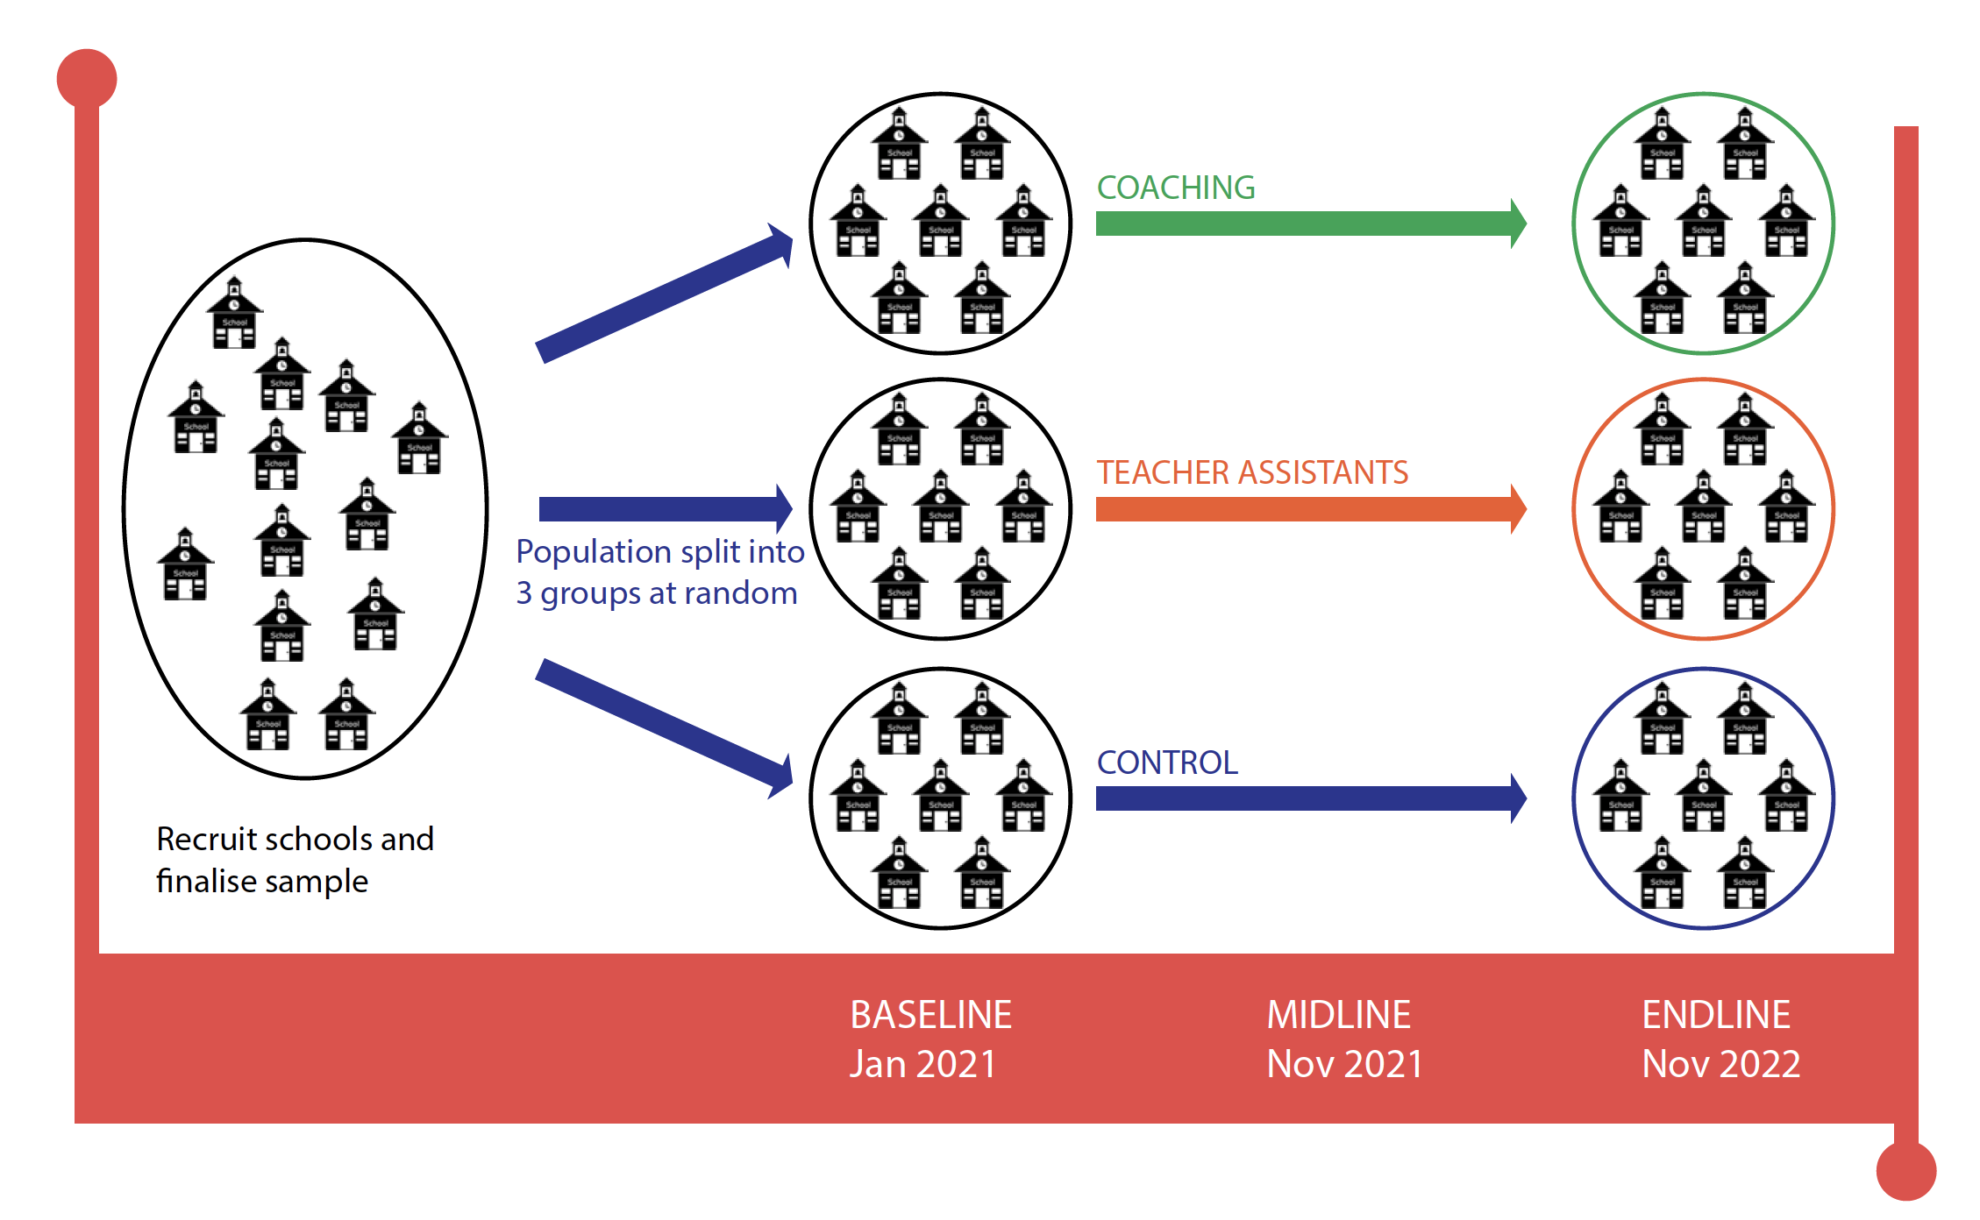
Prof Cally Ardington
(UCT & JPAL)
40
40
120
40
40
40
40

Slide 24



Slide 25
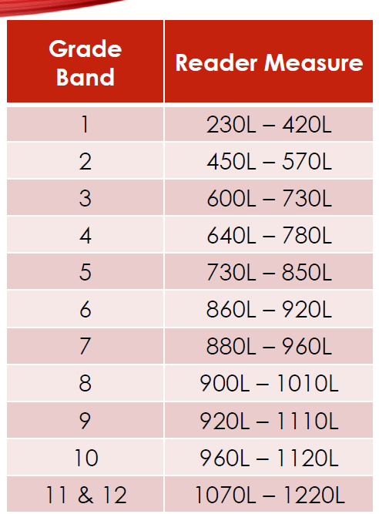
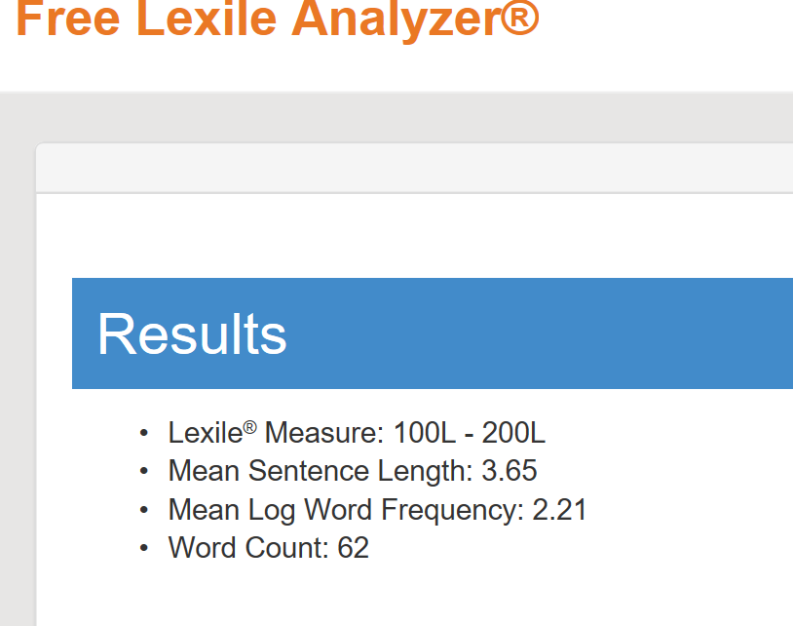
isiXhosa Lexile measure
Grade 3 Story measures
below grade 1 band
100L-200L
https://lexile.com/educators/measuring-growth-with-lexile/lexile-measures-grade-equivalents/

Slide 26
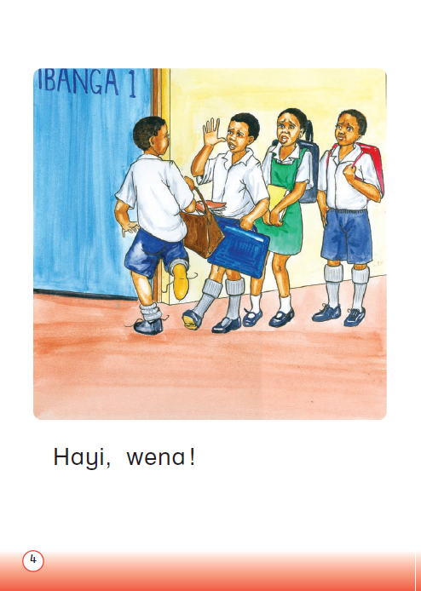
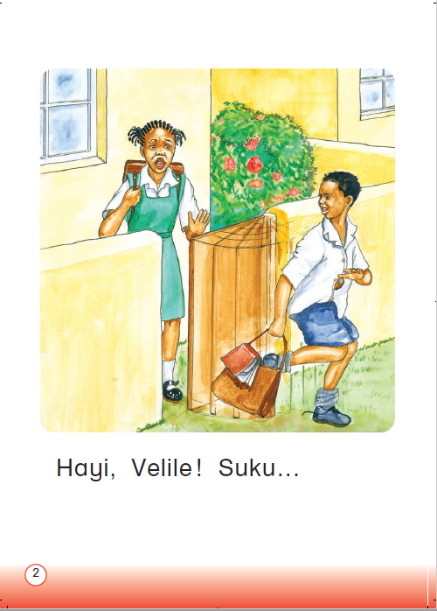
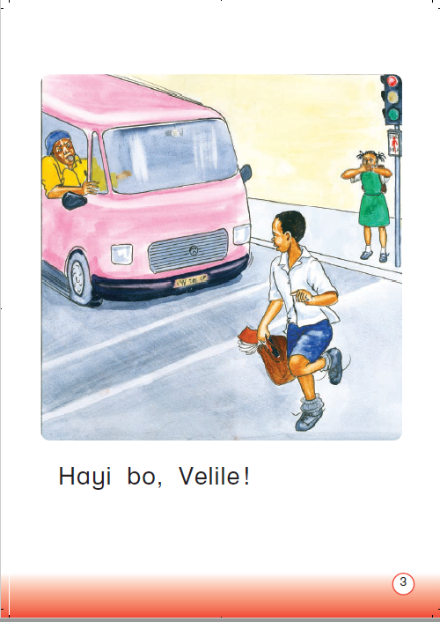
isiXhosa Grade 1 text

Slide 27
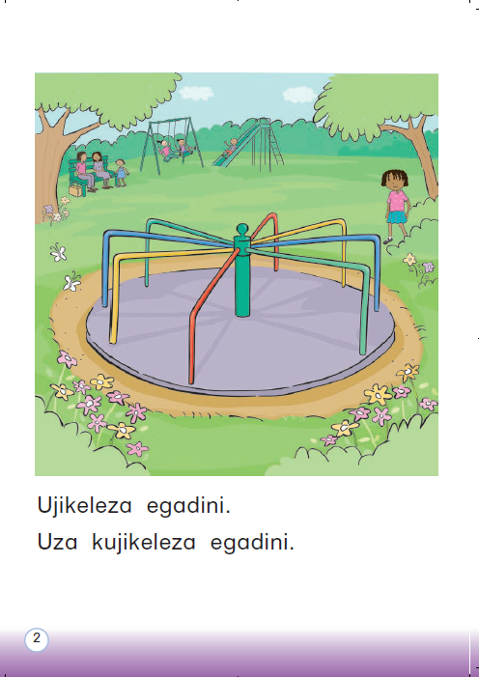
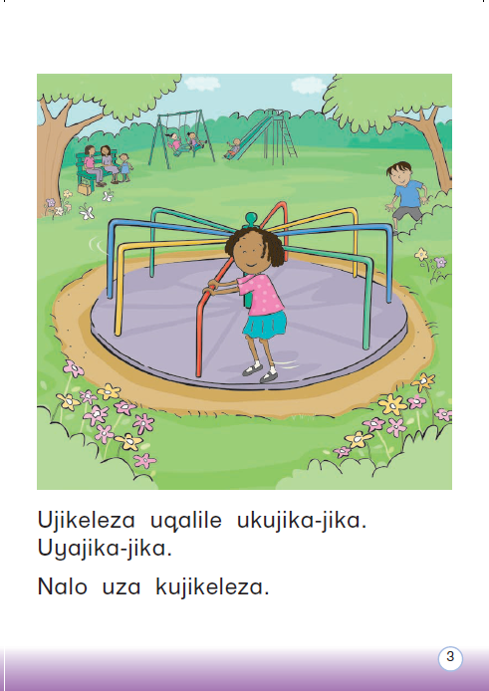
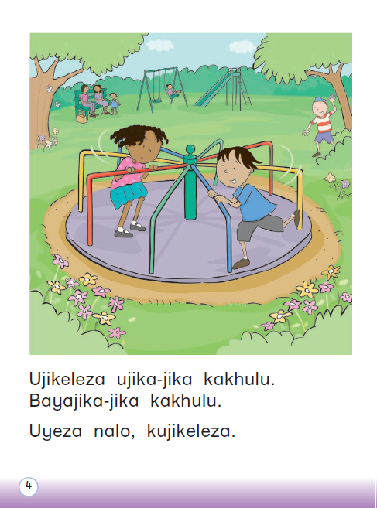
isiXhosa Grade 2 text

Slide 28
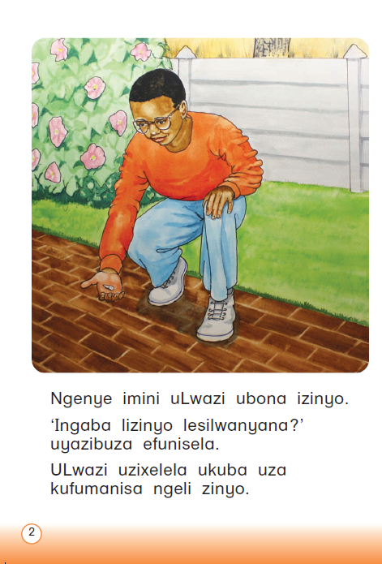
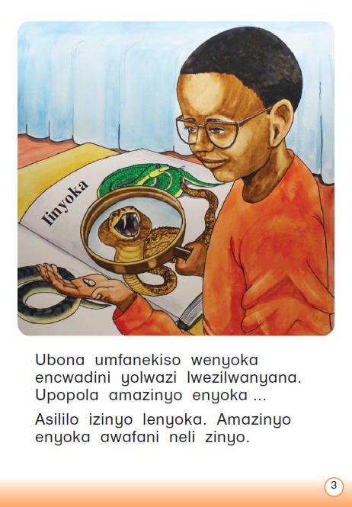
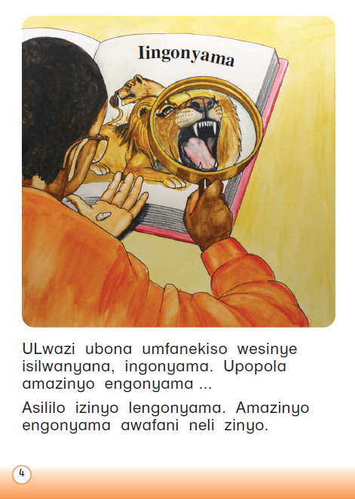
isiXhosa Grade 3 text

Slide 29
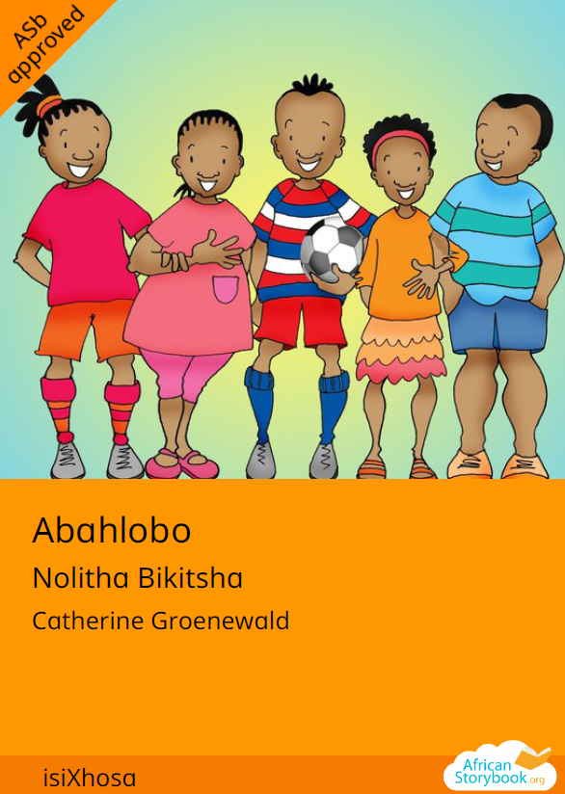
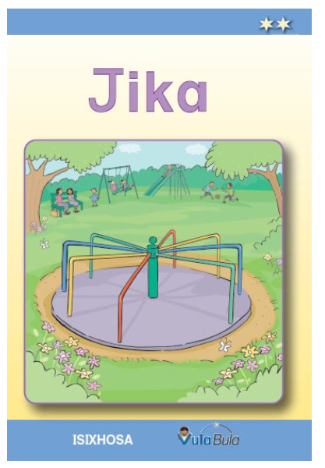

Early Grade Corpus
isiXhosa Grades R – 3 reading texts (±250)
Includes stories from:
    African Storybook
    Cambridge
    DBE
    Kagiso
    Macmillan
    Oxford
    New Heights
    Sunshine
    Vuma
    Vula Bula
Total of 141 stories in the Corpus
Use the program R to do the text analysis

Slide 30
Methodological Approach
Important variables that need to be included in the readability index:
Word length
Sentence length
Word frequency
Semantic and syntax of a languages
What does this look like for isiXhosa?

Slide 31
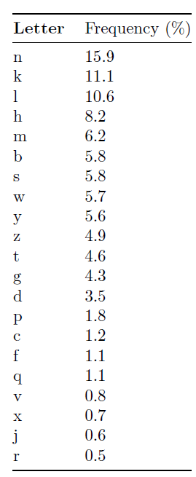

Letter Frequency analysis
n, k and l are the highest frequency letters
> 10%
In calculating in the index, should lower versus higher letter frequency be included?
v, x, j and r are the lowest frequency letters
<1%

Slide 32
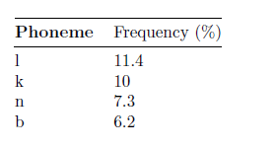
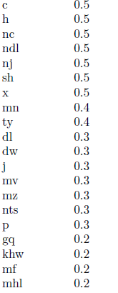
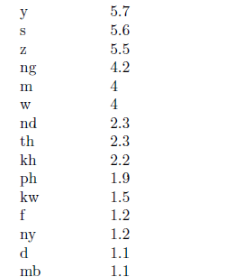
Phonemes Frequency analysis
According to CAPS mf introduced in HL isiXhosa Gr 1 term 1

Slide 33
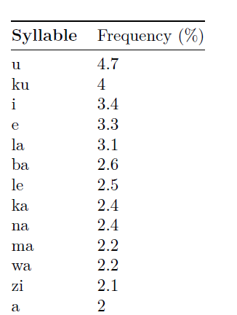
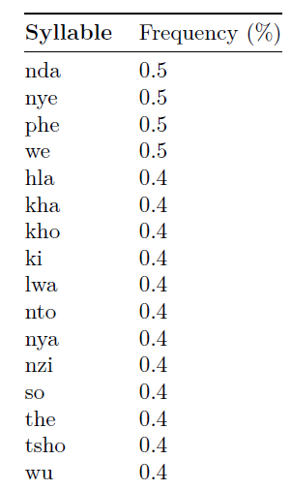
Syllables Frequency analysis

Slide 34
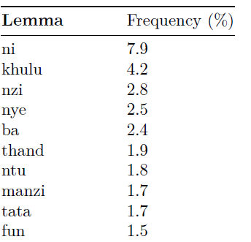
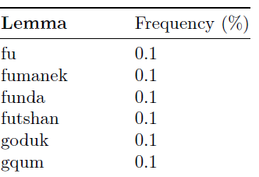
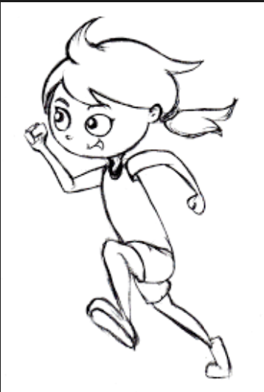
Lemmas Frequency analysis
Still need to figure out how to factor in morphemes
i.e
Baleka - run
Uyabaleka – you are running
Ubalekile – he/she has run away
Usabaleka – are you still running?
Siyabaleka – we are running

Slide 35
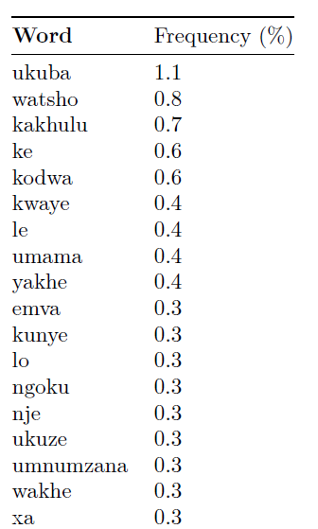

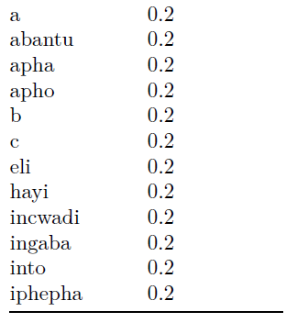
Word Frequency analysis

Slide 36
Methodological Approach
Text Difficulty index
Word & Sentence length
Word log/frequency
Syntax
Semantic
diagraphs, trigraphs & quadgraphs
Syllables
Morphemes
Phonemes

Slide 37
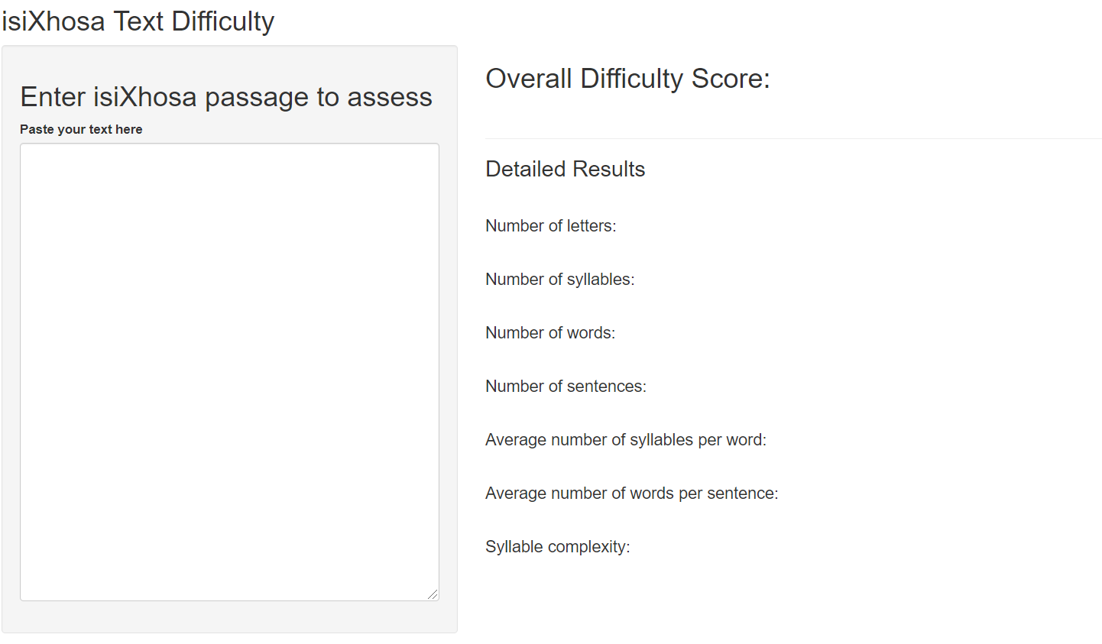
Text Difficulty Index

Slide 38
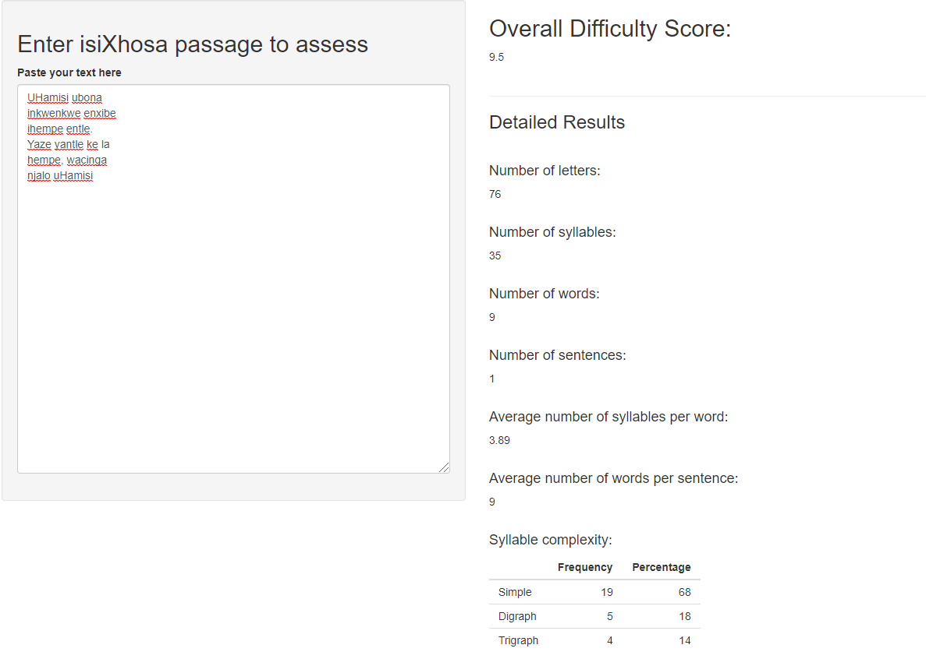
Text Difficulty Index

Slide 39
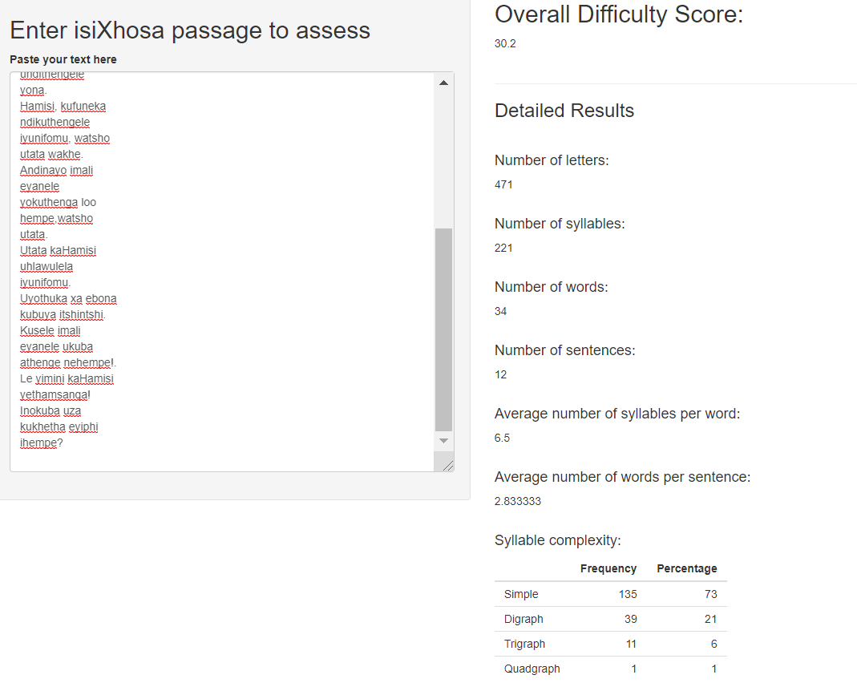
Text Difficulty Index

Slide 40
Text Difficulty Index
Text difficulty index = 0.05*(no. of letters)
+ 0.05*(no. of words)
+ 0.1 *(no. of sentences)
+ 0.4 *(ave syllables per word)
+ 0.4 * (words per sentence)

Slide 41

THANK YOU!

