Slide 1
G3 Diagnostic Assessment: Outcomes of Scaling Up SA Numeracy Chairs & DBE collaboration with AMESA, SAARMSTE, OLICO YOUTH (NGO), PROVINCE Reps & PROFESSORS MIKE ASKEW & BOB WRIGHT Stellenbosch UNIversity, 4 July 2019
Hamsa Venkat (with Mellony Graven & Mark Chetty)

Slide 2
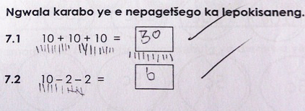
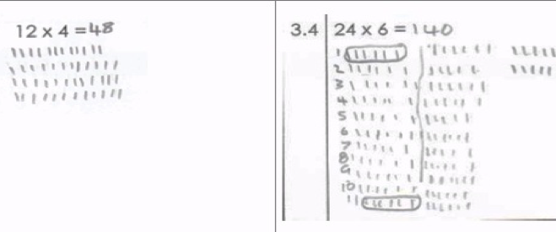
Concerns with primary learners’ number skills
Limited evidence of work with mental recall of a bank of basic facts, and of development and application of this recall in problem-solving
Limited evidence of work with mental recall of a bank of basic facts

Slide 3
Current FP curriculum & assessment
FP CAPS curriculum specification does include attention to key clusters of fluent recall skills, and problems that can be efficiently and flexibly understood and solved with good number sense
BUT
ANAs and Common Assessment largely did not/do not assess for these kinds of number skills in marking for the correct answer only

Slide 4
KEY NUMBER SKILL CLUSTERS IN CAPS FP
- Bridging through 10 (16 + 7)
- Jump strategies (102 – 27)
- Re-ordering (3 + 78; 19 + 27 + 21)
- Relationship between + and – (13 + __ = 81)
- Compensation (54 – 9)
- Doubling and Halving (26 + 26 ; 76 divided by 2)
All of these strategies rest on known or rapidly recalled facts, mostly set in the 1-20 number range
Notes:
Currently, assessment does not test for either rapid recall or for strategic, rather than procedural, calculation

Slide 5
ITEM CATEGORIES Research-based with multi-organizational consensus
RAPID RECALL | STRATEGIC CALCULATING | STRATEGIC THINKING
Basic doubles | Items such as 99+99, that are laborious to do in a procedural calculation orientation, but easy to compute mentally if recognized in relation to 100 +100 | Items focused on number structure, properties and relationships, and the behaviour of operations, rather than on ‘operating’: e.g. Given that 43+138=181 What is 181-43?
Add/subtract 1, 2, 3, 4, 5 and 10 to any number
Place value decompositions of number
Fact triples in 1-20 range

Slide 6
Diagnostic Assessment format
3 week test-teach-test format focused on a particular cluster (e.g. Bridging though 10), including Rapid Recall, Strategic Calculating and Strategic Thinking items.
Time-limited test
Teacher guidance & materials for interim activities related to cluster for mental maths lesson section
Re-test provides feedback on learning, and hence, success of teaching
3 clusters/term; all 6 clusters revisited in Terms 3/4

Slide 7
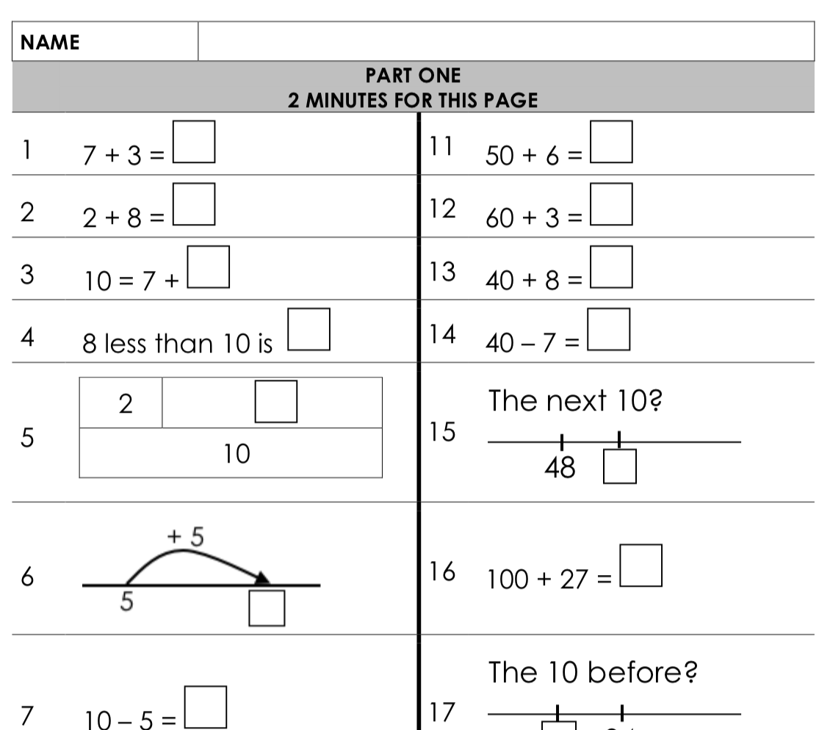
Rapid recall items
Focus on underlying skills.
Variations and connections as key design principles

Slide 8
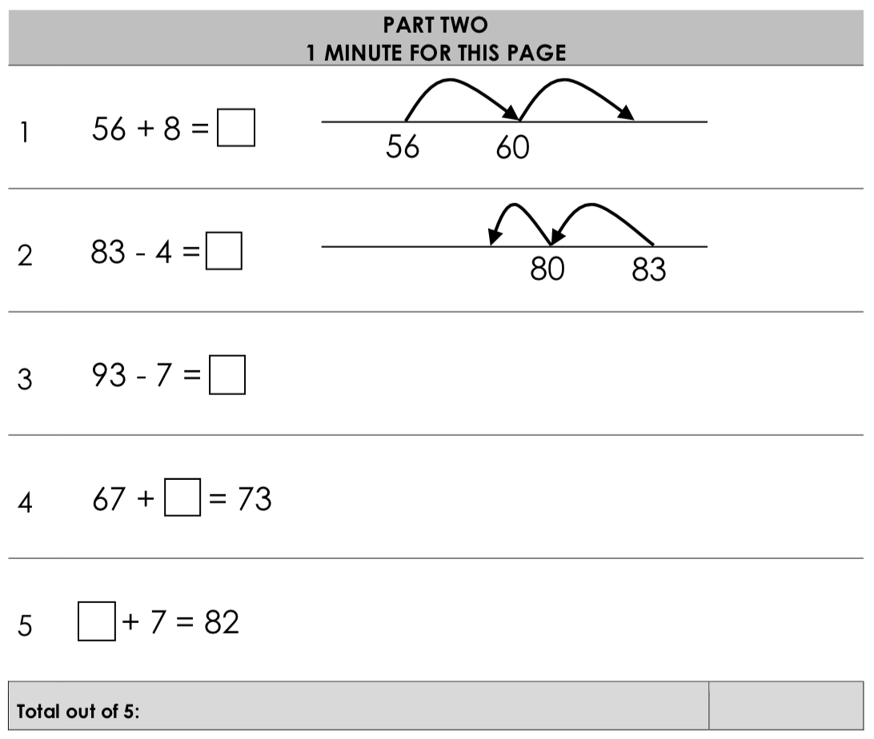
Strategic calculating

Slide 9
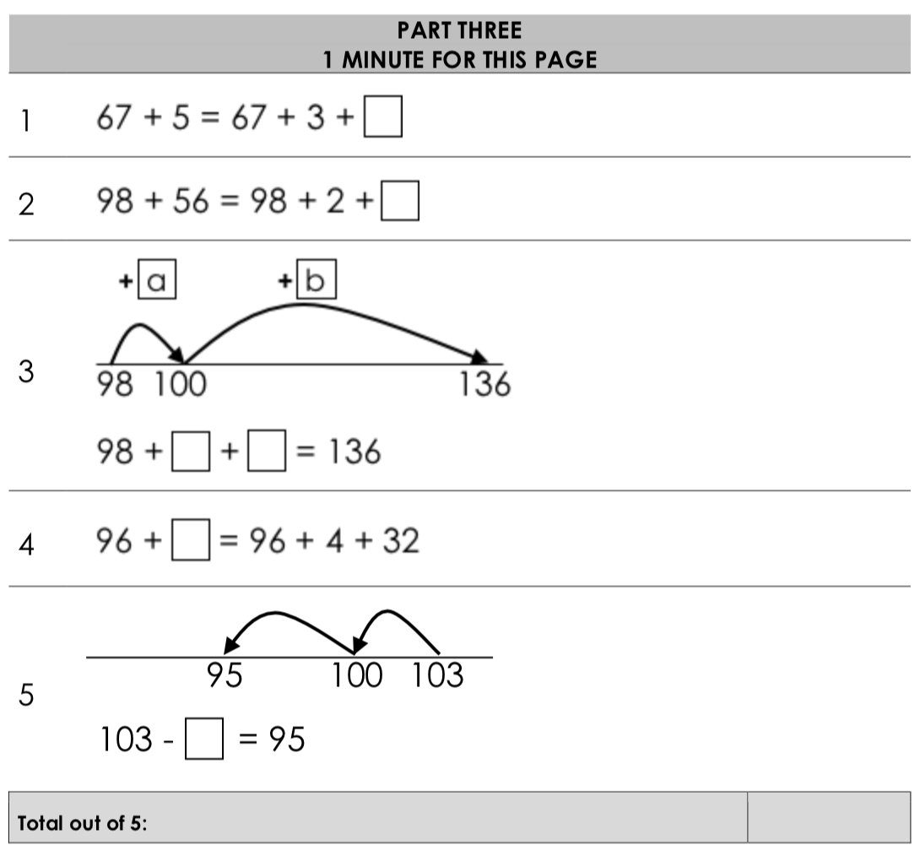
Strategic thinking

Slide 10
Intervention starters booklet

Slide 11
Initial feasibility trials in Gauteng & EC, 2017
Chair teams administering & marking tests, worked directly with teacher on training for intervention starter activities
Gauteng, 2 schools, Q1 and Q5, n = 134 learners
Pre-test mean: 45% Post-test mean: 60%
EC, 1 school, Q3, n = 65 learners
Pre-test mean: 30% Post-test mean: 47%
Evidence of model & materials with potential to work
…. at broader scale?

Slide 12
DBE National trial, 2019
Three provinces (NW, Gauteng & EC), two districts in each province, 9 cross quintile schools in each district
Half-day training session for FP SAs on supporting teacher work with intervention materials, & with district staff administering, marking and capturing pre- and post-test responses
Marks-data and scripts collected, checked for marking accuracy

Slide 13
National sample
Total N=1889 matched learners across 54 schools in 3 provinces

Slide 14
Outcomes - overall
17% point increase overall from pre- to post-test
Gain patterns in line with initial trials: largest gain is in the rapid recall section (21% point gain), Strategic Thinking (13,6% point gain) and Strategic Calculating (3.7% point gain)
Possible for model/materials to be disseminated via FP Subject Advisers in ways that support learning gains
Strategic thinking and strategic calculating outcomes

Slide 15
Outcomes by quintile
Higher gain in Quintile 4/5 schools than in the other quintile bands
but
Improvements in performance across all categories for all quintiles

Slide 16
Reflections
Results, once again, suggest potential for further scaling
Point to areas for work in ‘revisting’ skill clusters in second half of G3
Working with personnel ‘in the system’ and curriculum in the system to produce gains
Materials developed from a research base in mathematics, with consensus sought and worked for
Intervention researched for strengths and weaknesses
From proof of possibility to proof of probability
Cheap; government-district-university collaboration; less large scale experiment, more capacitating for scale.

