Slide 1




Assessing first grade children’s mathematical competence
Elizabeth Henning, Nozipho Motolo, Lars Balzer,
Lara Ragpot, Annemarie Fritz-Stratmann & Roelien Herholdt
RESEP Conference: 19 – 20 September 2016

Slide 2

"
#imbes2016 International Mind, Brain and Education Society
Daniel Ansari ‏@NumCog
"The literature is replete with failures of older students to grasp fundamentals" @DHClements #imbes2016

Slide 3

OUTLINE
How can one assess number concept development of school beginners?
Background: test development in South Africa
Language in South African schools
Empirically transferring MARKO-D to South Africa
Final version SA, norming data in SA
Norming, manual, test to be published in South Africa
Learning support booklet: “Meerkat Maths” (Pilot with 15 Gr classes completed)
Grade 1 booklet after evaluation in 2017

Slide 4

Semiotic challenges of using an assessment tool across language- and cultural borders

Slide 5
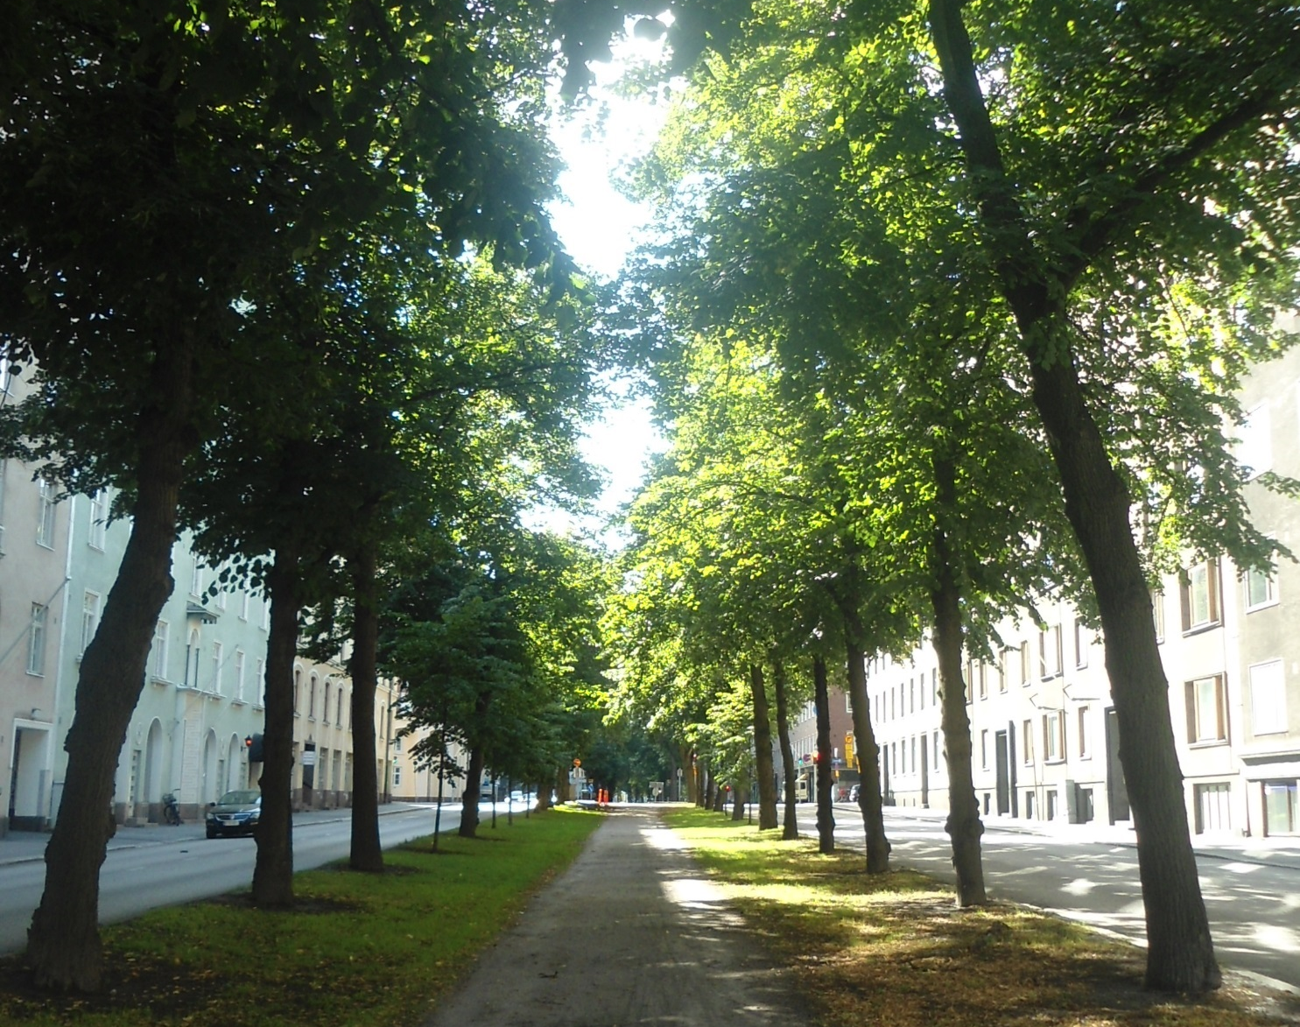
How do languages from different linguistic origins, with semiotic systems that differ, serve as medium to test the same construct?
One has to test the linguistic migration empirically…
With a sizable sample…..
That is representative of an identified population…..
To get some idea?

Slide 6
Talking of language……
12 Official school languages (11 and sign language)
Reality: 18 different languages with significant representation in the population of Grade 1 Gauteng.
Difference between English Home Language (HL) and English First Additional Language (FAL) as medium of instruction
More difficult to learn English (a non-transparent language) and learn in English at the same time
Children have only heard English a few weeks when we tested
How many teachers are actually proficient in English in ‘English medium’ schools.

Slide 7
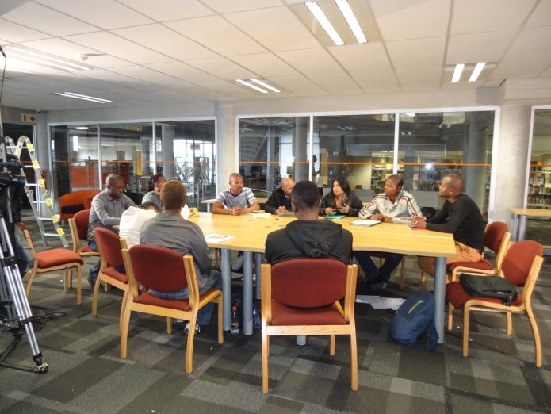
Development of the MARKO-D in South Africa
MARKO test translated into 4 languages
Why English HL and English FAL split – not just difference in delivery but also do not represent the same category in population
Variety of schools & socio-economic backgrounds
The fee/no fee numbers in the population - language also represents on average broad socio-economic classes.
Progression of translation process: test went through 14 iterations of translation; Pilots 2012- 2014 (n=3000+)

Slide 8
HL and FAL and EFAL – acronyms make light of …… dense phenomena
Need good tests catering for English Home Language (HL); English First Additional language (FAL) and the African languages as well as Afrikaans
Why we split the English Home language (HL) and First Additional Language (FAL) groups? - don’t represent same category in population
The fee/no fee numbers in the population - language also represent on average broad socio-economic classes.

Slide 9
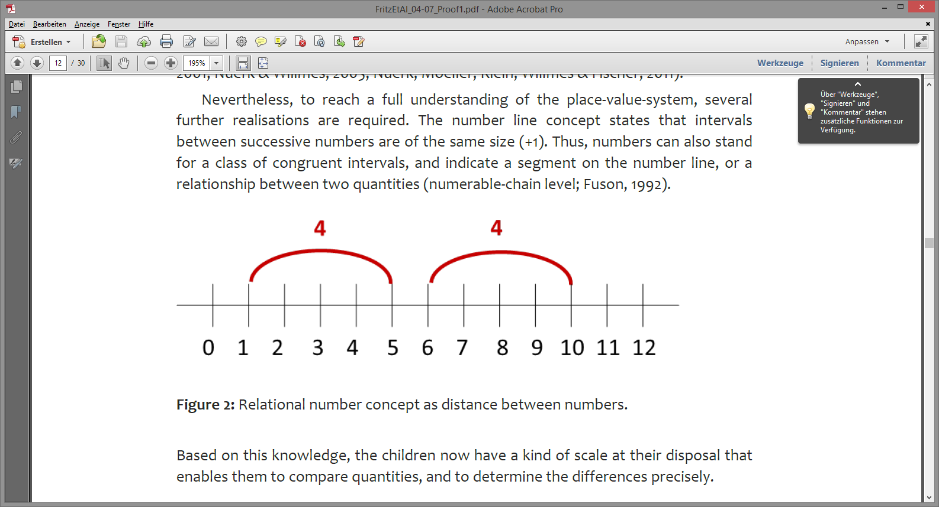
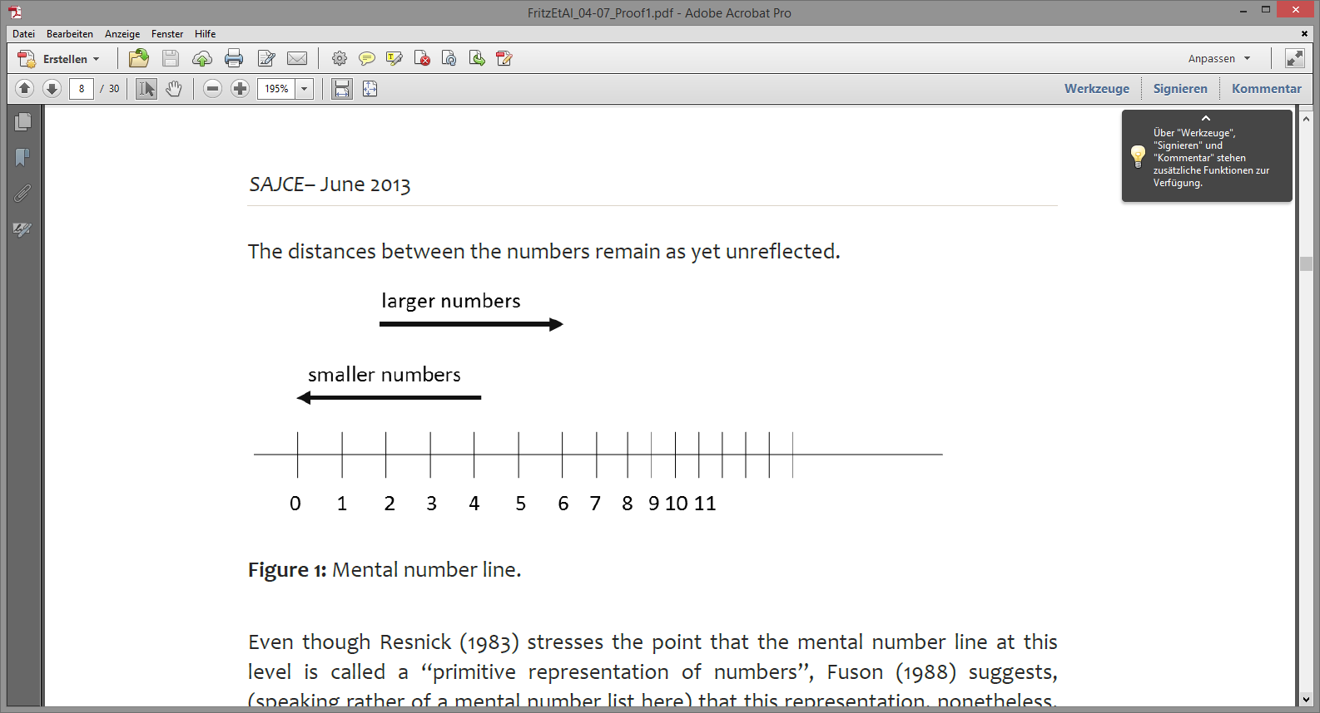
MARKO-D theoretical model - stuck on the ‘numberline‘? https://www.google.com/search?q=chi+quiet+classmate&ie=utf-8&oe=utf-8&client=firefox-b&gfe_rd=cr&ei=B6rfV4iuFeio8wfyhpToBg
Ricken, G., Fritz, A. & Balzer, L. (2013).
MARKO-D: Mathematik- und Rechenkonzepte im Vorschulalter - Diagnose (Hogrefe Vorschultests). Göttingen: Hogrefe.
Level V: Relational number
concept
7
Level IV: Part-part-whole concept
2
5
Level III: Cardinal number concept
Level II: Ordinal number concept
Level I: Counting number
(Fritz & Ricken, 2008; model extension: Fritz, Ehlert & Balzer, 2013)

Slide 10
Structure of the MARKO-D
the mathematical concepts build on each other
they build a ‘hierarchical’ structure and are stored in memory (this takes time and practice)
earlier concepts form the foundation for ’subsequent‘ mathematical concepts
children build the concepts (mostly) successively
concepts cannot be retrieved from memory if they are absent from memory

Slide 11
Does the theoretical model also hold empirically
?

Slide 13
mathematical achievement
high
low

Slide 14
mathematical achievement
high
ability
X = person
X
X
X
X
X
X
X
X
X
X
X
X
X
X
X
X
X
X
X
X
X
X
X
X
low

Slide 15
mathematical achievement
high
ability difficulty
X = person
X
O
O = item
X
X
O
X
X
X
X
O
X
O
X
X
X
O
X
X
X
O
O
X
O
X
X
X
O
O
X
X
X
O
O
X
X
O
X
low

Slide 17
mathematical achievement
high
ability difficulty
X = person
X
O
O = item
X
X
O
X
X
X
X
O
X
O
X
X
X
O
X
X
X
O
O
X
O
X
X
X
O
O
X
X
X
O
O
X
X
O
X
low

Slide 18
Normation study in Germany
Measurement 2009-2010
1095 pre-schoolers
(528 girls, 567 boys),
M(age) = 64.6 months, range from 48-87 months, SD = 7.2 months
MNSQ Infit between 1±0.3 for 55 Items
MNSQ Infit between 1±0.2 for 53 items
Separation Index = 3.26
Person reliability index .91
segments can be identified on the scale for all five levels, which each include items from (only) one particular level
the sequence of these segments on the scale follows the sequence of levels in the model
V
IV
III
II
I
uni-dimensional (1PL)
Rasch-model
using Winsteps 3.66

Slide 19
Pilot testing in South Africa
isiZulu (N = 83)
  MNSQ infit between 1±0.3 for 55 items
  50 items also met the more stringent criterion of 1±0.2
  person reliability index = .82
  separation index = 2.11
Sesotho (N = 75)
  MNSQ infit between 1±0.3 for 55 items
  47 items also met the more stringent criterion of 1±0.2
  person reliability index = .87
  separation index = 2.63
Afrikaans (N = 82)
  MNSQ infit between 1±0.3 for 53 items
  47 items also met the more stringent criterion of 1±0.2
  person reliability index = .88
  separation index = 2.7

Slide 20
isiZulu

Slide 21
isiZulu

Slide 22
Sesotho
Afrikaans

Slide 23
ITEMS 50 and 51: FRUIT
English: “Can you divide the fruit (10) for Bongani and Naledi so that both have the same? Put the fruit by Bongani and Naledi.”
Meaning of ‘fruit’ is too general
Apples

Slide 24
WHERE TO FROM HERE?
Test publishing and manual
Small pilot validity study: Marko with Eng FAL learners against the ANA and assessment
Question: how useful is the Marko at identifying the learners at risk but also concurrent validity with ANA and teacher marks, and some predictive validity with end of year marks given by teachers.
If this study is successful, then we can extend it to other languages.

Slide 25

Elizabeth Henning, South Africa Research Chair (NRF) Centre for Education Practice Research, UJ, ehenning@uj.ac.za
Nozipho Motolo, administrator in SA Research Chair, UJ. nmotolo@uj.ac.za
Annemarie Fritz-Stratmann, University of Duisburg-Essen, Fritz-Stratmann@uni-due.de
Lars Balzer, Swiss Federal Institute for Vocational Education and Training & Centre for Education Practice Research, University of Johannesburg, evaluation@lars-balzer.info
Lara Ragpot, Dept Childhood Education, UJ, lragpot@uj.ac.za
Roelien Herholdt, JET Education Services – Johannesburg, rherholdt@jet.org.za

