Slide 1
STUDENT ENGAGEMENT AND READING SCORES IN SOUTH AFRICA
A Mediation Analysis
Kerwin Fortune

Slide 2
ORDER OF PRESENTATION
Background
What is Engagement?
The Model
Results
Conclusion

Slide 3
1. BACKGROUND
Educational psychologists suggest that highly engaged students will perform better on test scores, have higher attendance rates and be less at risk of dropping out prematurely.
This study aims to test the validity of these hypotheses by applying data and exploring the effect of engagement on 4th grade reading scores in South Africa.

Slide 4
2. WHAT IS ENGAGEMENT?
The American Heritage College Dictionary defines engagement as “[being] actively committed”; to be engaged is “to involve oneself or become occupied; to participate” (a definition based on behaviour).

Slide 5
2. WHAT IS ENGAGEMENT?
The educational psychology literature suggests there are three broad classes of engagement, namely:
Behavioural Engagement
Emotional Engagement
Cognitive Engagement

Slide 6
2.1. Behavioural Engagement
In terms of involvement - Klem and Connell (2004)
Intensity of concentration of students
Time spent on work assigned
Ability of the student to stay on task
Positive conduct – Fredericks, et al (2004)
Following the rules
Respecting teachers
Not cutting class and/or disrupting other learners
Student Participation – Finn (2003)
In school-related activities i.e. sports, societies, school governance etc.

Slide 7
2.2. Emotional Engagement
Refers to student’s non-cognitive reactions in the classroom. Influenced by:
Fredericks, et al (2014)
Enthusiasm
Curiosity
Optimism towards school work
Finn and Voekl (1993)
How students identify with the school – i.e. do students feel like they belong. Do they feel their presence adds value

Slide 8
2.2 Emotional Engagement
Klem & Connell (2004)
Clear linkages to the “reaction to challenge” concept
How do students respond to unexpected challenges faced on a daily basis?

Slide 9
2.3. Cognitive Engagement
Fredericks, et al (2014)
Draws on the idea of investment; incorporates thoughtfulness and willingness to exert the effort necessary → psychological investment in learning
How do students set goals, plan and organise study efforts? Do they seek help if needed? Do they actively monitor their comprehension? → strategic (self-regulating) learning
Difficult to measure [cognition]

Slide 10
3. THE MODEL
Engagement index constructed based on the degree of agreement with seven key statements:
I like what I read about in school
My teacher gives me interesting things to read
I know what my teacher expects me to do
I think of things not related to the lesson
My teacher is easy to understand
I am interested in what my teacher says; and
My teacher gives me interesting things to do
Source: PRE-PIRLS (2011)

Slide 11
METHODOLOGY – CAUSAL MEDIATION ANALYSIS
The goal of such an analysis is to investigate alternative causal mechanisms by examining the roles of intermediate variables that lie in the causal paths between the treatment and outcome variables.

Slide 12
CAUSAL MEDIATION ANALYSIS
The aim is to understand if and to what extent the effect of a treatment variable T, on an outcome variable Y, is mediated through a third variable M
T
M
Y
Source: Grotta & Bellocco (2013)

Slide 13
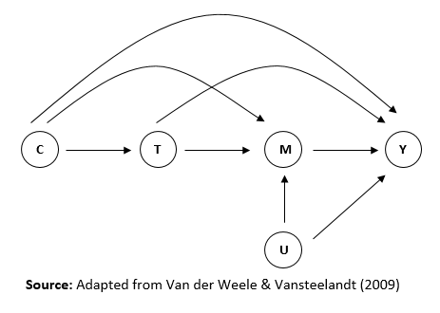
CMA: Key Assumptions

Slide 14
CMA: Hicks and Tingley (2011)
2 stage regression analysis
The product of the coefficient on the treatment variable in the first specification and the coefficient on the mediator in the second specification produce the average causal mediated effect (ACME)

Slide 15
STUDENT ENGAGEMENT AND READING SCORES
Treatment(s) – Safety and Belonging
Mediator – Student Engagement
Outcome – Reading Score
Limitations

Slide 16
4. RESULTS – Safety
Dependent Variable: | (1) Student Engagement | (2) Reading Test Score | (3) Student Engagement | (4) Reading Test Score
Student Engagement |  | 0.302*** (0.027) |  | 0.154*** (0.018)
High Sense of Safety | 0.790*** (0.052) | 0.332*** (0.043) | 0.702*** (0.496) | 0.206*** (0.032)
ACME | 0.239*** (0.027) |  | 0.108*** (0.014)
Direct Effect | 0.332*** (0.045) |  | 0.206*** (0.031)
Total Effect | 0.571*** (0.052) |  | 0.314*** (0.035)
% of Total Effect Mediated | 41.9 |  | 34.8
Controls | No | No | Yes | Yes
Constant | -0.499 | -0.063 | -0.644 | -0.335
Observations | 12851 | 12851 | 12851 | 12851
R-squared | 0.141 | 0.123 | 0.1992 | 0.497

Slide 17
RESULTS – Safety by test language
 | African Language Schools |  | English/Afrikaans Language Schools
Dependent Variable | (1) Student Engagement | (2) Reading Test Score | (3) Student Engagement | (4) Reading Test Score
Student Engagement |  | 0.143*** (0.019) |  | 0.228*** (0.034)
High Sense of Safety | 0.735*** (0.559) | 0.267*** (0.358) | 0.540*** (0.075) | 0.135*** (0.049)
ACME | 0.105*** (0.016) |  | 0.124*** (0.024)
Direct Effect | 0.267*** (0.035) |  | 0.138*** (0.048)
Total Effect | 0.372*** (0.039) |  | 0.262*** (0.054)
% of Total Effect Mediated | 28.3 |  | 47.2
Controls | Yes | Yes | Yes | Yes
Constant | -0.699 | -0.521 | -0.644 | 0.000306
Observations | 11160 | 11160 | 1691 | 1691
R-squared | 0.196 | 0.252 | 0.201 | 0.574

Slide 18
RESULTS – Sense of belonging
 | (1) Student Engagement | (2) Reading Test Score | (3) Student Engagement | (4) Reading Test Score | (5) Student Engagement | (6) Reading Test Score
Student Engagement |  | 0.299*** (0.027) |  | 0.163*** (0.018) |  | 0.146*** (0.018)
Strong Sense of Belonging | 0.718*** (0.052) | 0.362*** (0.041) | 0.613*** (0.047) | 0.162*** (0.029) | 0.382*** (0.034) | 0.106*** (0.028)
ACME | 0.215*** (0.024) |  | 0.100*** (0.015) |  | 0.055*** (0.009)
Direct Effect | 0.361*** (0.042) |  | 0.162*** (0.029) |  | 0.107*** (0.026)
Total Effect | 0.577*** (0.051) |  | 0.262*** (0.033) |  | 0.163*** (0.030)
% of Total Effect Mediated | 37.4 |  | 38.3 |  | 34.1
Controls | No | No | Yes | Yes | Yes | Yes
Constant | -0.408 | -0.058 | -0.528 | -0.290 | -0.714 | -0.356
Observations | 12851 | 12851 | 12851 | 12851 | 12851 | 12851
R-squared | 0.123 | 0.128 | 0.176 | 0.494 | 0.226 | 0.498

Slide 19
5. Sensitivity Analysis
“[…] addresses the related problem of estimating direct and indirect effects when the causal effect of the treatment (T) on an outcome (Y) is mediated by intermediate variables (M), and in particular when confounders (U) of the mediator–outcome relationships are themselves affected by the treatment” (Daniel, et al., 2011: 480).

Slide 20
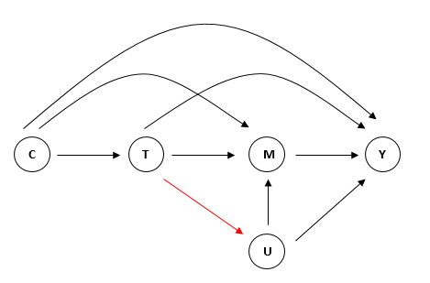
Sensitivity Analysis

Slide 21
Sensitivity Analysis: g-Formula
 | (1) g-Formula Computation | (2) ACME
Dependent Variable | High Sense of Safety | High Sense of Safety
Total Causal Effect | 0.207*** (0.011) | 0.314*** (0.035)
Natural Direct Effect | 0.159*** (0.011) | 0.206*** (0.031)
Natural Indirect Effect | 0.049*** (0.003) | 0.108*** (0.014)
% of Total effect mediated | 23.7 | 34.4

Slide 22
5. Conclusion
The results show that engagement does indeed have both a direct and indirect effect on 4th Grade reading scores in SA with the magnitudes differing by treatment
Further research:
Try and find data that captures teacher reported engagement
Explore further with teacher/school level variables as they are important from a policy perspective

