Slide 1
John Kruger Conference on Quantitative Economic Research 21 August 2024
Prioritising Education Spending in the Face of Austerity

Slide 2
Overview
Escaping the fiscal trap … but beware the education trap
What the budgets are doing
Levels of spending – trends
Use of spending
What can be done?

Slide 3
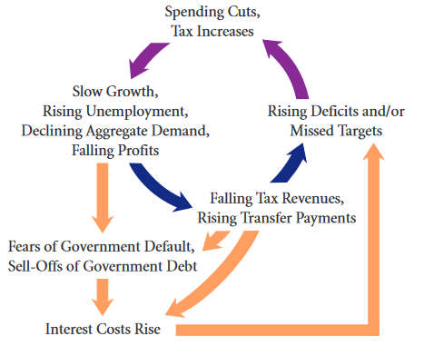
The fiscal – “low growth, high-interest” - trap
With interest rates exceeding the economic growth rate, government debt continues to grow as a proportion of GDP, becoming a “vicious circle”
“Higher debt makes investors and ratings agencies nervous, … . This increases [our]borrowing costs and hurts investment spending, making fiscal consolidation more and more difficult, making the fiscal position worse and raising the sovereign risk premium. The interest rate rises again, and the cycle continues.”
Hollander & Haveman 2024 (Also see SCIS February 2024)
Hanssgen & Papadimitrou (2012)

Slide 4
But many potential traps …
“If there is one important lesson from the literature reviewed …, it should be that there are hundreds of traps that the economy can fall into, and any policy intervention that attempts to pull the economy out of one trap may end up pushing it into another. As we know, any attempt to solve a problem can often become a source of another, even bigger problem.”
Matsuyama 2010 in Palgrave Dictionary of Economics
For example:
“… low quality schools act as a poverty trap … entrench exclusion and marginalization …”
Van der Berg et al 2011

Slide 5
A framework for a “human capital trap”
Income/ Economy
Other policy incl health & social protection
Public Finance
SES
Education Inputs: PSET, Skills, Basic, ECCE
Macro-economic & Industrial Policy
Production/Work
(Productivity)
Learning
Skills
Knowledge
but beware of the “education gospel” … “education as economic gospel”? (Buchanan et al. 2020, also Allais & Marock 2023 )
Notes:
The situation/story: Been making progress in learning as measured by standardized international test and also when looking at where performance in the system is but (1)Covid-19 led to substantial learning losses and impacted most strongly on the most vulnerable (2) because of expansion in demand and costs, there have been pressure on inputs with teacher and manager numbers declining in spite of rising learner and student numbers – LE ratios up and class sizes bigger although they have already been above average (3) and now severe pressure on budgets because of slow growth, sluggish revenue and rising debt – these probably related to governance, but complex causes buried in the political economy
This picture is too simple. Andrew – education is also about “social control” (“social stratification, roles, signaling”). Should not be read as saying that if we can just get more learning the economy will grow and the positive cycle will be reignited – what Allais and others call the “the education gospel” – “the view of education as economic salvation” or that “education is the critical factor for individual’s success in obtaining and succeeding in work” . Clearly there are many other factors that must also be in place, such as labour demand and other policy areas such as industrial and labour market policy and indeed social protecton and health policy. Also, it should not be read as saying that inputs are the only factors in producing learning outcomes. We know it also depend on the quality of inputs and how well they are targeted and indeed that social factors (the socio-economic status of learners and the socio-economic composition of schools) are probably the determining factors (Taylor and Yu). While opening the money and resources tap may therefore not necessarily lead to the growth we need, closing the financial taps will have negative repercussions. (And the issue of the individualistic bias of the human capital approach
In our workshop we have learnt about aspects of this framework. Andrew – things have indeed changed over the three decades and warnings about (a) how we should not overestimate what education can do and (b) should also not oversimplify the role of education – it is about more than human capital or just cognitive function - also about “Also about social control: stratification, roles, signaling (discipline)” (Do not be too reductionist) Allais and others talk about the nurturing of learning dispositions whhc also include cooperation with others. Sonja Keller and Michale Sachs both pointed to the severity of the adjustment. Keller – on a real per capita basis, a7% contraction has been achieved – but a further 3.5% to go – and there are certain risks (debt drivesr such as SOE bailouts and interest rates. Michael – 7.6 reduction in rela per capita spending (against GEAR 6.3%) - a severe post-Covid austerity
Take stock of the broad sectoral budgets before we hear more from people deeply experienced in the different sub-sectors.
“Education is expected to perform the heavy lifting in poverty eradication as well as economic growth and development in poor countries1. Little emphasis is placed on how poverty constrains education2. As in the past, education will ‘fail’ to meet these expectations, because it cannot do what macro-economic and industrial policy alone can do to create quality jobs. The idea of solving inequality through individual social mobility created through education is part of an ideology of that avoids tackling economic and social development directly. ‘Failed’ education and the ‘failure’ of individuals to obtain the ‘relevant skills’ are the scapegoats for lack of development.”

Slide 6
The state of the SA human capital cycle: fragile
“core spending has fallen by R2,325 per South Africa from R30,440 (in 2019) to R28,116 (in 2023)” (Sachs)
Income/ Economy
Real per Learner/ Student Spend declining
Finance
Context: LERs been worsening & large class sizes
Teacher “headcounts will need to fall” (Sachs)
7% contraction in real per capita spending. 3.5% to go & could be more (Keller)
Inputs
Learning
Production/Work
“the overall picture is one of progress. The pandemic was of course devastating for learning, and would have eliminated some of the past gains, though by no means all” (Gustafsson 2023)
Notes:
The situation/story: Been making progress in learning as measured by standardized international test and also when looking at where performance in the system is but (1)Covid-19 led to substantial learning losses and impacted most strongly on the most vulnerable (2) because of expansion in demand and costs, there have been pressure on inputs with teacher and manager numbers declining in spite of rising learner and student numbers – LE ratios up and class sizes bigger although they have already been above average (3) and now severe pressure on budgets because of slow growth, sluggish revenue and rising debt – these probably related to governance, but complex causes buried in the political economy
This picture is too simple. Andrew – education is also about “social control” (“social stratification, roles, signaling”). Should not be read as saying that if we can just get more learning the economy will grow and the positive cycle will be reignited – what Allais and others call the “the education gospel” – “the view of education as economic salvation” or that “education is the critical factor for individual’s success in obtaining and succeeding in work” . Clearly there are many other factors that must also be in place, such as labour demand and other policy areas such as industrial and labour market policy and indeed social protection and health policy. Also, it should not be read as saying that inputs are the only factors in producing learning outcomes. We know it also depend on the quality of inputs and how well they are targeted and indeed that social factors (the socio-economic status of learners and the socio-economic composition of schools) are probably the determining factors (Taylor and Yu). While opening the money and resources tap may therefore not necessarily lead to the growth we need, closing the financial taps will have negative repercussions. (And the issue of the individualistic bias of the human capital approach
In our workshop we have learnt about aspects of this framework. Andrew – things have indeed changed over the three decades and warnings about (a) how we should not overestimate what education can do and (b) should also not oversimplify the role of education – it is about more than human capital or just cognitive function - also about “Also about social control: stratification, roles, signaling (discipline)” (Do not be too reductionist) Allais and others talk about the nurturing of learning dispositions whhc also include cooperation with others. Sonja Keller and Michale Sachs both pointed to the severity of the adjustment. Keller – on a real per capita basis, a7% contraction has been achieved – but a further 3.5% to go – and there are certain risks (debt drivesr such as SOE bailouts and interest rates. Michael – 7.6 reduction in rela per capita spending (against GEAR 6.3%) - a severe post-Covid austerity
Take stock of the broad sectoral budgets before we hear more from people deeply experienced in the different sub-sectors.

Slide 7
Large education spend
Widely defined, the biggest function in budget: PSET, Skills Training, Schools (Basic), ECCE
In 2023/24 followed by:
Social Protection: R376.9 billion
Debt service cost: R356.1 billion
Health: R263.2 billion
Debt service overtaking Social Protection over next three years
Category | 2023/24 R billion, Nominal | % of Gov Non-Interest Spend | % of GDP
Gov. Educ Dept Spend | 473.0 | 24.7% | 6.7%
Gov Spend (excl debt-service cost) | 1,912.7 |  | 27.1%
GDP | 7,049.0
Source: National Treasury 2024, Budget Review (BR) Tables and Annexures (GDP, Total Spending) & Estimates of Provincial Revenue & Expenditure (EPRE)

Slide 8
From 2020, spending growth interrupted
Real education spend rising to R480 billion in 2019/20, then a COVID reduction and stays flat
As a proportion and per capita also turning down
“Post-Covid Austerity” show in education spending
And
Cost index an issue
Population growth underestimates learner growth
Different trends in subsectors
Data source: National Treasury 2024, BR Tables and Annexures (GDP, Total Spending) & EPRE

Slide 9
Shifts in composition of spending
Data source: National Treasury 2024 Budget Review and EPRE

Slide 10
And diverse trends in the subsectors
Education Departments Spend as a % of GDP
2024/25
Total Education Departments R486.8b
Basic Education (excl Gr R) R337.8b
PSE (excl skills) R112.7b
Skills R24.8b
ECCE R11.5b
Data source: National Treasury 2024, BR Tables and Annexures (GDP, Total Spending) & EPRE
Notes:
As in slide on total, increase to 2020 and then decline – almost at same level as in 2015/16
Basic Education similar up and down but going below level in 2015/16
PSET strong growth from less than 1% to about 1.4%, after turning a1.7% - the upward trend is because of NSFAS (funding of student living cost and study fees. Funding to institutions stagnating (so only part of the increase “education”, could be with social protection (a similar case with school nutrition/meals?
Skills funding fairly flat except for the Covid-19 dip
ECCE including GradeR staying static at around 0.15%
2018/19 Gr R R5.4b; Pre-sch R4.4b HR/Infrast R0.4b
2023/24 Gr R R8.4b; Pre-sch R2.2b HR/Infrast R0.4b (Increase in Gr R in GrR in centres

Slide 11
Post-School Education and Training
PSET spending (Real billion)
PSET spending (Real per capita)
After NSFAS explosion – levelling off;
Per capita real spending turning down
Data source: National Treasury 2024, BR Tables and Annexures (GDP, Total Spending) & EPRE

Slide 12
Basic Education
Data source: National Treasury (various years), ENE & EPRE; DBE (various years), School Realities

Slide 13
Early Childhood Care and Education
Modest growth – but off relatively low base & against large quality and access issues
Subsidy unrealistic & decreasing in real terms (Kika, 2024)
ECCE Spending

Slide 14
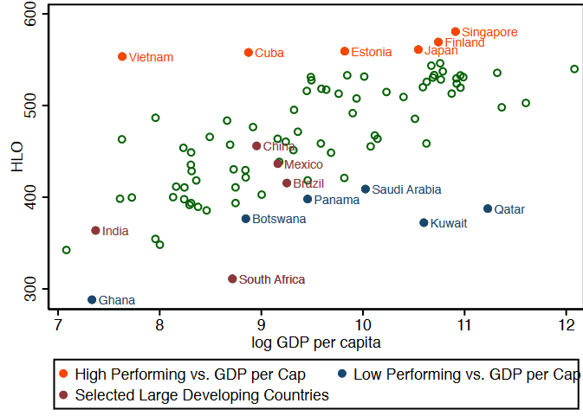
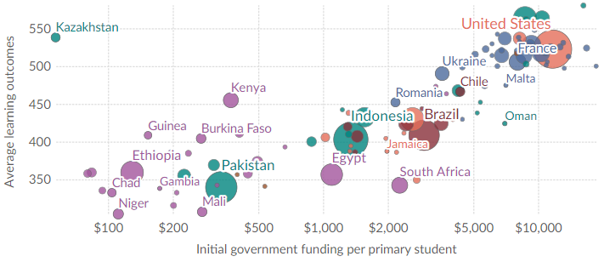
And issues on value for money
Average Harmonized Learning Outcome Score (2000-2017) vs. 2015 GDP per Capita
Average Learning Outcomes - World Bank (2023) data
Data Source: World Bank (2023) – processed by Our World in Data. “Average learning outcomes” [dataset]. World Bank, “World Bank Education Statistics (EdStats) 2023” [original data].
https://ourworldindata.org/grapher/national-average-learning-outcomes-vs-government-expenditure-per-primary-student?tab=table
Source: Patrinos & Angrist (2018), Global Dataset on Education Quality (2000 -2017)

Slide 15
… so how to escape the human capital trap?
Reduce spending reductions/spend more?
“Use of government’s balance sheet”
“Shifting the balance of consolidation towards taxation”
(Sachs/SCIS 2024)
Factoring in technological change & “new assets”
Finance
Inputs
Prioritise/invest differently between subsectors?
Balance between: ECCE, Basic, Skills and PSET
Learning
Primary vs Secondary Education & cost of subject choice
Shifts in grade 6 & 7
School & teacher management (class size)
Approach to dealing with staff reductions
NSFAS resolution
Spend better within sub-sectors?
Notes:
Spend more: unlikely but (1) innovative efforts around broader funding in sub-sectors – impact bonds; (2) remaining high inequality and room for redistribution; (3) changing technology and “new” assets (& are we taxing the digital economy sufficiently) (4) a slow pivot away from bursary scheme to a loan scheme in PSET
Spend differently: Reallocating within education for more efficiency (1) greater prioritisation of early ECCE (2) dealing with repetition in early years (3) focus on poverty, health and housing (4) teacher assistants higher priority? (5) A remuneration strategy (6) cross-sub-sector strategies
Spending better? (1) technology, and better use of data (2)
?
Keeping the lid on wages
(And does one weigh in on the basic income grant – beware of grand redistributive strategies, they have not propelled us forward: housing, child grant, …? But the horse might have bolted?)
Making sure the NSFAS funding pays off?
Not using resources well in the school system – teacher quality and motivation. Accountability? Support?
Teachers not well enough trained
A school-culture mismatch – not empowering children
Where do you invest most to turn the problem around?
Equity
Grave threats
Routes are:
Spending more – finding new sources of finance
ECD – Impact binds and
Spending differently
Potentially “adverse prioritisation” – look at skills funding; prioritisation in higher education
Mix between schools and ECCE – economise on early enrolments and repetition
Spending better
Options:
UK Women’s Budget Group – there is money, this austerity is all about a class battle to shrink the size of the state and maintain the positions of the elite

Slide 16
THANK YOU
Research on Socio-Economic Policy (Resep)
Stellenbosch University
https://resep.sun.ac.za/

Slide 17
References
Allais, Stephanie, and Carmel Marock. ‘What Problem Should Skills Solve?’ International Higher Education, no. 117 (2024): 26–27.
Allais, Stephanie. ‘The National Qualifications Framework in South Africa: A Democratic Project Trapped in a Neo-Liberal Paradigm?’ Journal of Education and Work 16, no. 3 (September 2003): 305–23. Ang, Yuen Yuen. How China Escaped the Poverty Trap. Cornell Studies in Political Economy. Ithaca ; London: Cornell University Press, 2016.
Buchanan, John, Stephanie Allais, Michael Anderson, Rafael A Calvo, Sandra Peter, and Tamson Pietsch. ‘The Futures of Work: What Education Can and Can’t Do’. UNESCO’s Futures of Education Initiative, Background Paper for Topic 4, Work and Economic Security: What Role Can Education Play in Ensuring the Human Centredness of the Future of Work? Paris: UNESCO, September 2020.
Burger, Philippe, and Estian Calitz. ‘Soaring Deficits and Debt II: Budget 2020 and a Looming Debt Trap?’ Econ3x3, 2020.
Diemer, Andreas, Simona Iammarino, Andrés Rodríguez-Pose, and Michael Storper. ‘The Regional Development Trap in Europe’. Utrecht University, Department of Human Geography and Spatial Planning …, 2022.
Gustafsson, Martin ‘Education Is Improving but the Message Is Hard to Convey’ (Cape Town: Econ 3x3, March 2023)
Hollander, Hylton, and Roy Havemann. ‘Is South Africa Caught in a Fiscal Trap?’ Southern Africa – Towards Inclusive Economic Development (SA-TIED) (blog), March 2024.

Slide 18
Matsuyama, Kiminori. ‘Poverty Traps’. In Economic Growth, edited by Steven N. Durlauf and Lawrence E. Blume, 215–21. London: Palgrave Macmillan UK, 2010. https://doi.org/10.1057/9780230280823_27.
Patrinos, Harry, and Anthony Angrist. ‘Global Dataset on Education Quality : A Review and Update (2000-2017)’. Text/HTML. World Bank, 2018.
Pritchett, Lant, Michael Woolcock, and Matt Andrews. ‘Capability Traps? The Mechanisms of Persistent Implementation Failure -’. Working Paper. Washington, DC: Center for Global Development, 2010. https://www.cgdev.org/publication/capability-traps-mechanisms-persistent-implementation-failure-working-paper-234.
Ritsatos, Titos. ‘“Fiscal Trap”, the Case of Greece’. Southern University College of Business E-Journal 8, no. 1 (2022).
Sachs, Michael, Rashaad Amra, Thokozile Madonko, and Owen Willcox. ‘Austerity Without Consolidation: Fiscal Policy and Spending Choices in Budget 2023’. SCIS, 1 June 2023. https://hdl.handle.net/10539/35683.
Sachs, Michael, Arabo Ewinyu, and Olwethu Shedi. ‘Public Services, Government Employment and the Budget’. Johannesburg: Southern Centre for Inequality Studies (SCIS), 2022.
Spaull, Nic, Adaiah Lilenstein, and David Carel. ‘The Race between Teacher Wages and the Budget - The Case of South Africa 2008-2018’. Stellenbosch: Research on Socio-Economic Policy, 19 June 2020. https://resep.sun.ac.za/the-race-between-teacher-wages-and-the-budget/sample-post/.
Van Der Berg, Servaas, Cobus Burger, Rulof Burger, Mia De Vos, Gideon Du Rand, Martin Gustafsson, Eldridge Moses, et al. ‘Low Quality Education as a Poverty Trap’. SSRN Electronic Journal, 2011. https://doi.org/10.2139/ssrn.2973766.

