Slide 1
Have grade repetition patterns changed in light of the progression policy in the FET phase?
Jesal Kika & Janeli Kotze
February 2020

Slide 2
Background

Slide 3
Grade repetition
Grade repetition is an important measure of efficiency of an education system. It is seen as ‘both an outcome of a previous failure, and a predictor of subsequent failure’
(Anderson, Case, & Lam, 2001).
South African context
Conservative estimate of repeaters in public schools in South Africa → about 1.2 million learners. In monetary terms → R20 billion (van der Berg et al. 2019)
According to Q3:2019 QLFS, 32.3% of 15 to 24-year-olds were NEET
According to the GHS, 19.4% of learners repeated Grade 10 in 2018

Slide 4
Grade repetition
Beneficial remedial practice
Provide low achieving students with an additional opportunity to meet academic standards, allowing them to re-learn material and ‘catch-up’ with their peers (Chen, Zhang, Shi, Scott, & Liu, 2010)
Detrimental effects
Negative impacts on socio-emotional outcomes such as low self-esteem (Martin, 2011)
Higher risk of school dropout (Jimerson & Ferguson, 2007)
Lower likelihood of completing secondary school and completing post-schooling education (Fine & Davis, 2003)
Economic costs – burden of financing an additional year
Capacity constraints to enroll additional learners, larger class sizes and higher pupil-teacher ratios
Repetition earlier on reduces the cost of remediation at later stages
The threat of failing could increase effort on the part of the learner
Controversy

Slide 5
Policy context
 | Foundation Phase (Grades 1 – 3) | Intermediate Phase (Grades 4 – 6) | Senior Phase (Grades 7 – 9) | Further Education and Training Phase (Grades 10 – 12)
1998 – 2012 Admission Policy for Ordinary Public Schools | Repetition: One year per school phase where necessary (Maximum of four years per phase) |  |  | Repetition: More than one year per school phase
2013 onwards National policy pertaining to the programme and promotion requirements of the National Curriculum Statement Grades R - 12 | Repetition: One year per school phase where necessary (Maximum of four years per phase)
Notes:
Essentially, the DBE introduced this policy to reduce the clogging up of enrolments in grades 10 and 11. So, in a way, forcing schools to push weaker learners into Grade 12, but with the reassurance that their results would not feature among the school’s core results. Their results would be noted separately, and if necessary, they could write the examinations over two years through the multiple exam opportunity.

Slide 6
Implementation challenges
Different interpretations of the policy across the system, leading to varied implementation
The dispensation relating to the Multiple Examination Opportunity was viewed as a mechanism to manipulate pass rates
Progressed learners feeling stigmatised and carrying a label
As well as teachers not being able to provide differentiated support to progressed learners given their current workload

Slide 7
Research Questions

Slide 8
Research questions
1. What have the general repetition patterns looked like using Wave 1 (2008) and Wave 5 (2017) data?
2. What did repetition patterns look like just-before and just-after the progression policy was endorsed in the FET phase?
3. What are the in-school and out-of-school transitions before and after the introduction of the progression policy in the FET phase?
Focus of the analysis: (i) Those who repeated at least once, (ii) Those who repeated more than once, and (iii) Those who repeated more than once in the FET phase.
Note that this paper does not attempt to report on any causal relationship between the endorsement of the progression policy and repetition patterns in the FET phase, but simply reports on observable repetition patterns before and after the policy was endorsed.

Slide 9
Data and sample

Slide 10
Data
Five waves of the National Income Dynamics Study (NIDS)
Wave 1 (2008), Wave 2 (2010/11), Wave 3 (2012), Wave 4 (2014/15), Wave 5 (2017)
Instruments:
Adult questionnaire: Administered to all adults aged 15+ currently residing in the household
Child questionnaire: Administered to main care giver (s) of all resident children aged between 0 and 14
Proxy questionnaire: Completed for all household members not available at the time of the survey
Household questionnaire: Administered to the household head to collect information pertaining to income, expenditure, social grants and asset ownership.
Notes:
NIDS is a nationally representative panel survey
Data is collected for each household member in all five waves

Slide 11
Sample
Key variables of interest: Whether an individual repeated any school grade; and if so, what grade and how many times were each of these repeated (Wave 1 and Wave 5).
Wave 5 contains the most useful information for the analysis since the repetition questions are asked retrospectively and reflects transitions across all five waves.
Small sample size challenge when trying to observe learners who were enrolled in Wave 1 and successfully interviewed in subsequent waves.
Sample: All those who were enrolled at any point (between Wave 1 to Wave 5) in any grade and for whom we have information for in Wave 5 i.e. those who were successfully interviewed in Wave 5.
Notes:
17 422 – it is important to note that these respondents may have been enrolled in more than one wave and the sample could also include the top-up sample added in 2017 to increase the number of white, indian and high-income respondents.

Slide 12
1. What have the general repetition patterns looked like using Wave 1 (2008) and Wave 5 (2017) data?

Slide 13
Proportion of 15 to 30-year-olds that repeated a school grade

Slide 14
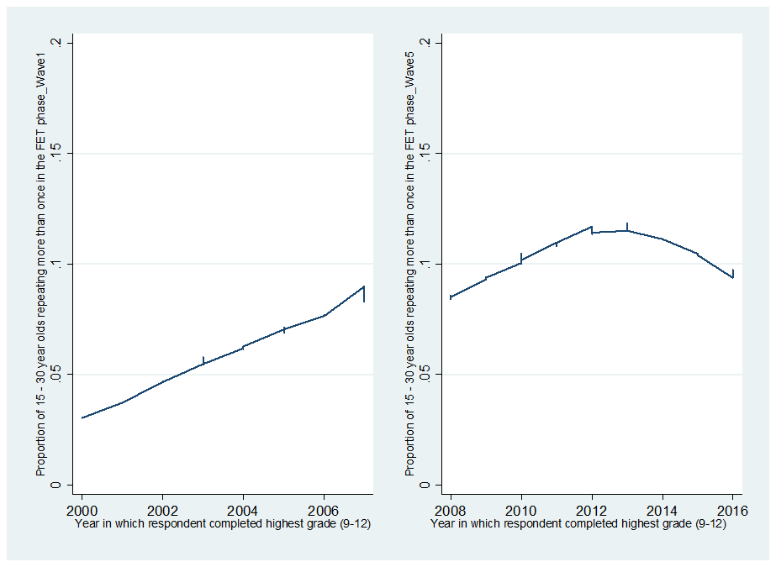
Proportion of 15-30-year-olds that repeated more than once in the FET phase by the year in which they completed their highest schooling grade
Notes:
The decline that we observe in the proportion of those repeating more than once in the FET phase could, therefore, be attributed to a system response to the policy signal to reduce repetition in this phase in 2013.

Slide 15
2. What did repetition patterns look like just-before and just-after the progression policy was endorsed in the FET phase?

Slide 16
Just-before and just-after cohorts
Just-before cohort | Progression policy | Just-after cohort
Group 1: Those who completed their highest schooling grade in and after 2009 and before 2013 (4-years). 15 to 30-year olds who are no longer in school. |  | Group 2: Those who completed their highest grade in and after 2013 and before 2017 (4-years). 15 to 30-year olds who are no longer in school.

Slide 17
Proportion of 15 to 30-year-olds repeating at least once just-before and just-after the endorsement of the policy in the FET phase

Slide 18
Proportion of 15 to 30-year-olds repeating more than once just-before and just-after the endorsement of the policy in the FET phase
Notes:
These differences, and those in the previous slide are significant at a 1% level.
We also ran a probit model and found that the group that respondents are in i.e. pre/post policy for the analysis, is significant at a 10% level for those who repeat more than once in the FET phase when additional demographic and school level characteristics are controlled for.
Post progression policy, the probability of repeating more than once in the FET phase is indeed less than it had been before the policy was introduced.
Note, we were not necessarily interested in the marginal effect of the covariates on the probability of repeating, but were more concerned whether respondents post-policy were more likely to repeat more than once.

Slide 19
What are the effects of the policy on retaining learners in school?
Group 1 (Just-before): Completed school in and after 2009 and before 2013
Group 2 (Just-after): Completed school in and after 2013 and before 2017
 | Repeated at least once |  | Repeated more than once |  | Repeated more than once in the FET phase
 | Group 1 | Group 2 | Group 1 | Group 2 | Group 1 | Group 2
Highest grade completed | 11 | 9 | 11 | 9 | 11 | 10
Difference is significant at a 1% level.

Slide 20
3. What are the in-school and out-of-school transitions before and after the introduction of the progression policy in the FET phase?
Notes:
We experienced the small sample size challenge when trying to look at these transitions, however, we managed to get a sense of what they look like by observing the two-year and four-year in-school and out-of-school transitions at the extreme ends of all five waves to observe these transitions before and after the policy was introduced in the FET phase.

Slide 21
Two-year in-school and out-of-school transitions

Slide 22
Two-year in-school and out-of-school transitions

Slide 23
Four-year in-school and out-of-school transitions

Slide 24
Conclusions, discussions and recommendations

Slide 25
Conclusion
The policy has had mixed effects:
Repeating grades more than once in the FET phase has dropped significantly in the post-policy phase,
But repeating at least once has been increasing since the policy was introduced.
The highest grade completed for the cohort who were affected immediately after the policy was introduced is lower than the pre-policy period.

Slide 26
Discussion
Repetition could be mistargeted:
This mistargeting may be due to inadequate evaluation and teacher bias.
Repetition could also be inconsistently applied across South African Schools.
Raises the question about the extent to which repetition is encouraged by principals to maintain enrolment totals.
Higher enrolment totals, more posts, and higher principal salary ranks

Slide 27
Recommendations
There is no causal evidence on the linkages between the policy and its intended effects on learner outcomes. Research is needed to evaluate the implementation of such policies with greater rigour, and to establish clear causal relationships before finalising the implementation of such policies at scale.
Policy-makers need to be aware of alternative policy options to help children catch-up and maintain pace with the curriculum.
Understand the costs of repetition so that informed resourcing decisions can be made.

Slide 28
Thank you!

