Slide 1
OPAL Quantitative Findings
Robin Shields, Swati Banerjee, Mohan Paudel, Gayathri Krishna, Ashik Singh

Slide 2
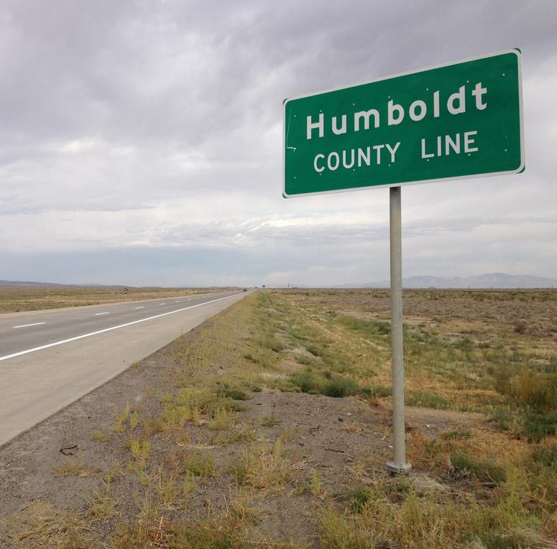
Accountability: Semantic Roots

Slide 3
Accountability
“The implicit or explicit expectation that one may be called on to justify one's beliefs, feelings, and actions to others...Accountability also usually implies that people who do not provide a satisfactory justification for their actions will suffer negative consequences” (Lerner and Tetlock, 1999, p. 255)

Slide 4
Accountability
“A broad and problematic term” (Kim, 2018)
“The concept has become increasingly ambiguous” (Dubnick, 2005)
“An ever-expanding concept” (Mulgan 2000)
“You know it when you see it” (Fox, 2007)

Slide 5
Principal-Agent Model
P
G

Slide 6
Principal-Agent Model
P
A
G
Accountability
G
“Given the utility maximizing nature of the individual, then the problem ... is how to ensure that the agent will seek to maximize the welfare of the principal, rather than their own” (Roberts, 2001, 1548)

Slide 7
Principal-Agent Model
P
A
G
G
Accountability
Accountability is defined mainly by outcomes
(The proof is in the pudding)

Slide 8
Accountability Experiences
Exit and Voice (Hirschman, 1970)
Dysfunctions and Unintended Consequences:
“Increasing efforts to improve performance through accountability tends to have the opposite effect. Rather than acting as a driver for desired levels of improved performance, accountability tends to be a ‘breaker’ by either slowing down or stopping the improvements.” (Dubnick, 2005, p. 396)
Limited dialog with rational choice/economics literature

Slide 9
Accountability and Private Schooling
Large literature on low-fee private schooling in South Asia
Private schools "providing higher quality education through greater accountability to parents than the government alternative” (Tooley, 2007).

Slide 10
The Research Question
Do different school types create different types of accountability that then influence students learning?
Accountability
School Type
(Public, Private, Mixed)
Learning
(Literacy & Numeracy)

Slide 11
The Sample
Kathmandu
30 Schools
981 students (4th grade)
395 parents
119 teachers
Mumbai
27 Schools
2621 Students (4th Grade)
990 parents
75 teachers

Slide 12
The Data
Student Assessment and Questionnaire
Parent home background questions
Teacher accountability questions
Teacher social background

Slide 13
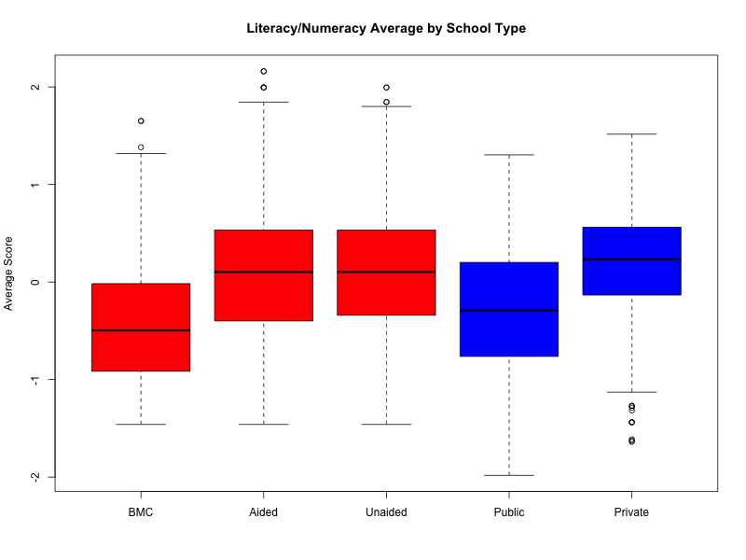
Learning Outcomes by School Type
Mumbai
Kathmandu

Slide 14
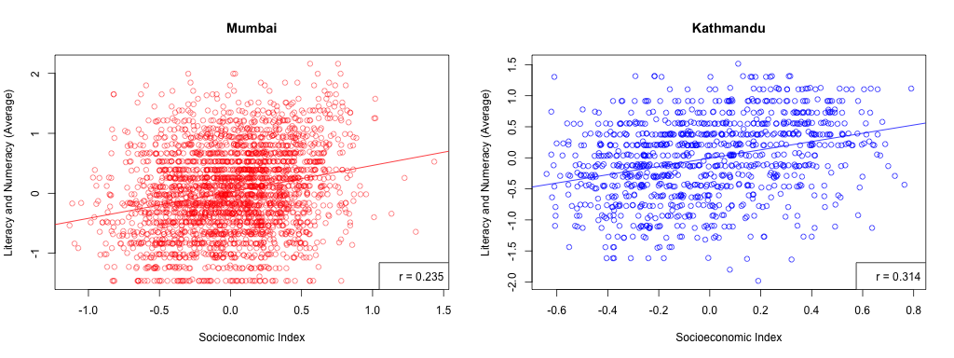
SES and Learning Outcomes

Slide 15
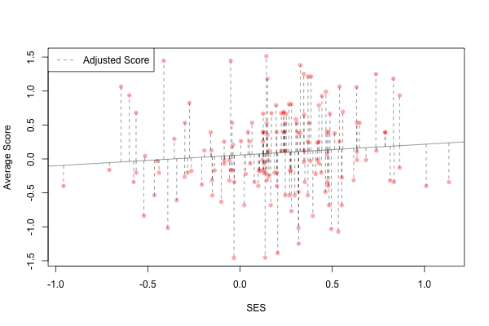
SES-Adjusted and Learning Outcomes

Slide 16
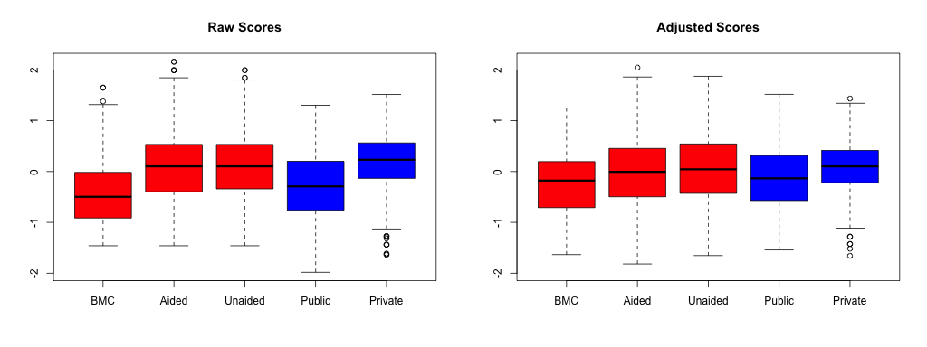
Raw vs. Adjusted Learning Outcomes

Slide 17
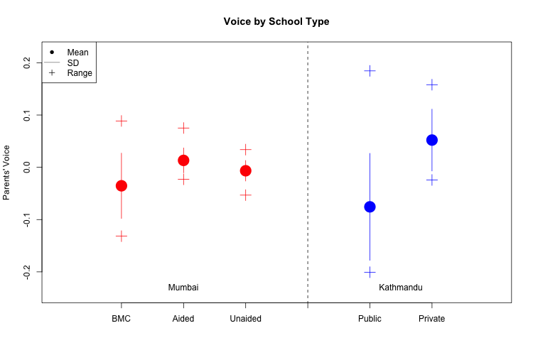
Exit (i.e. Choice) and Voice by School Type

Slide 18
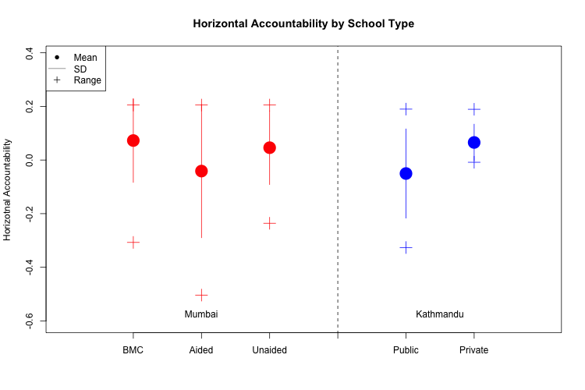
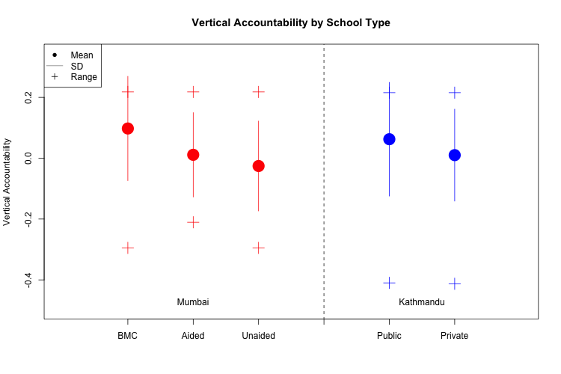
Horizontal and Vertical Accountability by School Type

Slide 19
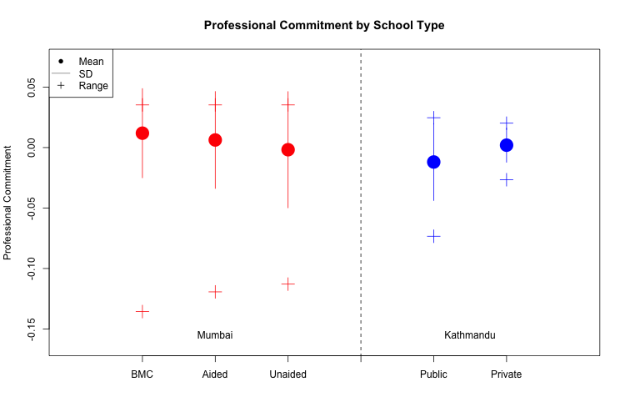
Professional Commitment by School Type

Slide 20
Accountability Summary
All five types of accountability differ significantly across school types (ANOVA, p < 0.05)
Exit and Voice: Higher in Private (Aided)
Vertical: Higher in Public
Horizontal and Professional Commitment: Mixed, differ by context

Slide 21
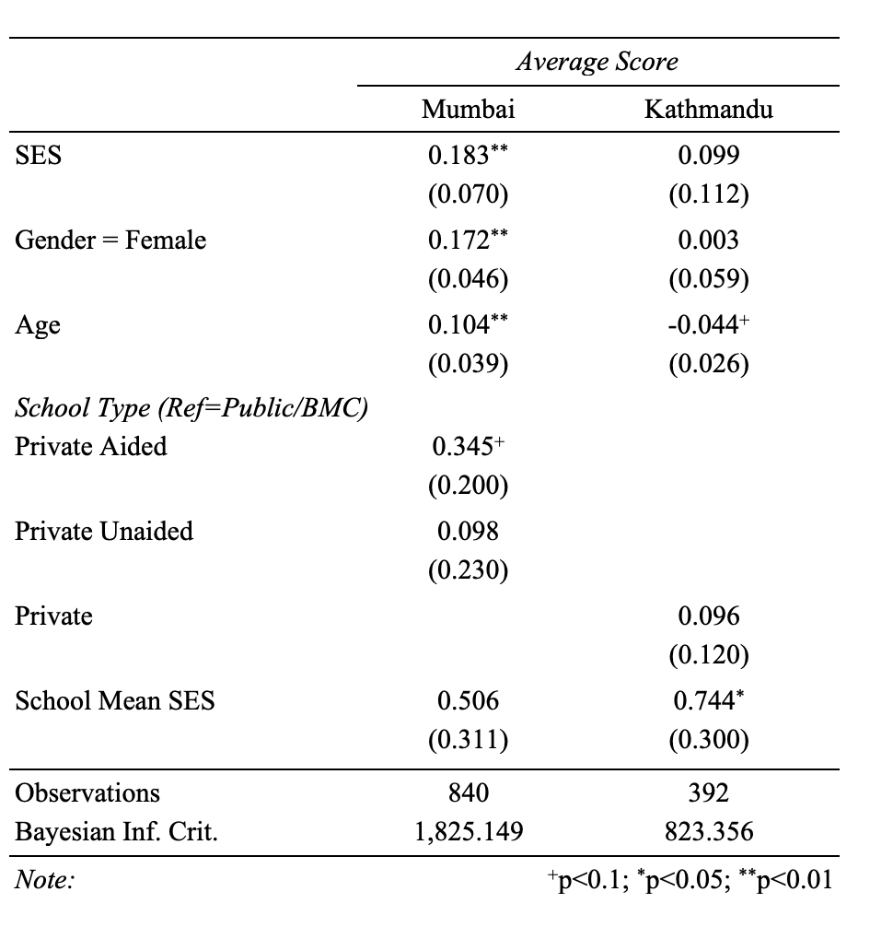
School Type and Learning Outcomes
Multilevel Regression Results
Some Control Variables Excluded

Slide 22
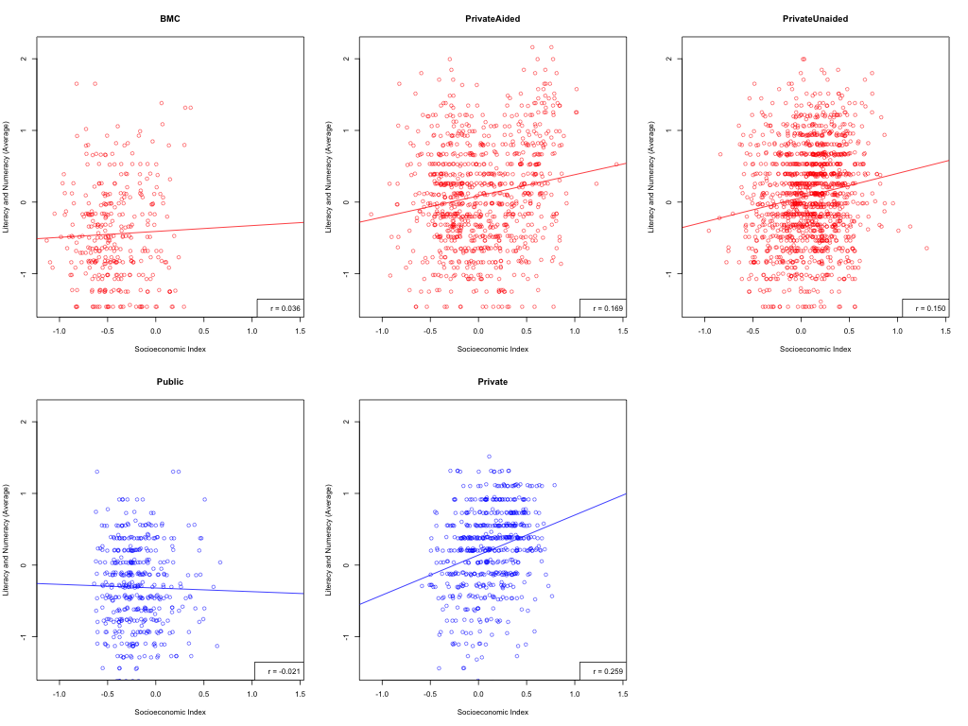
SES and Learning Outcomes by School Type

Slide 23
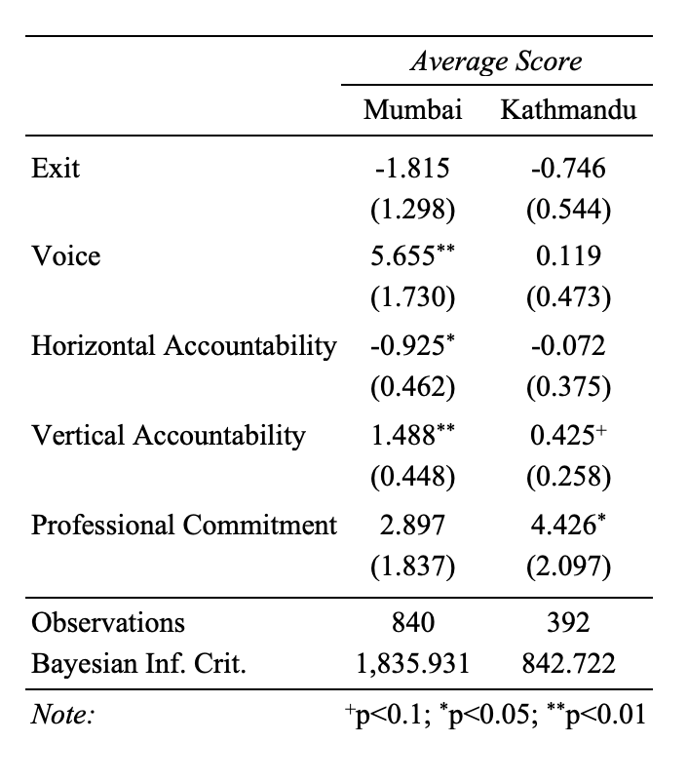
Accountability and Learning Outcomes
Multilevel Regression Results
Some Control Variables Excluded

Slide 24
The Research Question
Do different school types create different types of accountability (yes) that then influence students learning (no)?
Accountability
Yes
No
School Type
(Public, Private, Mixed)
Learning
(Literacy & Numeracy)

Slide 25
Discussion
There are differences in accountability across types of schooling
These differences do not seem reliably linked to learning
May be links within each context
School-specific improvements may be possible
Cultural capital, out-of-school activities not captured

Slide 26
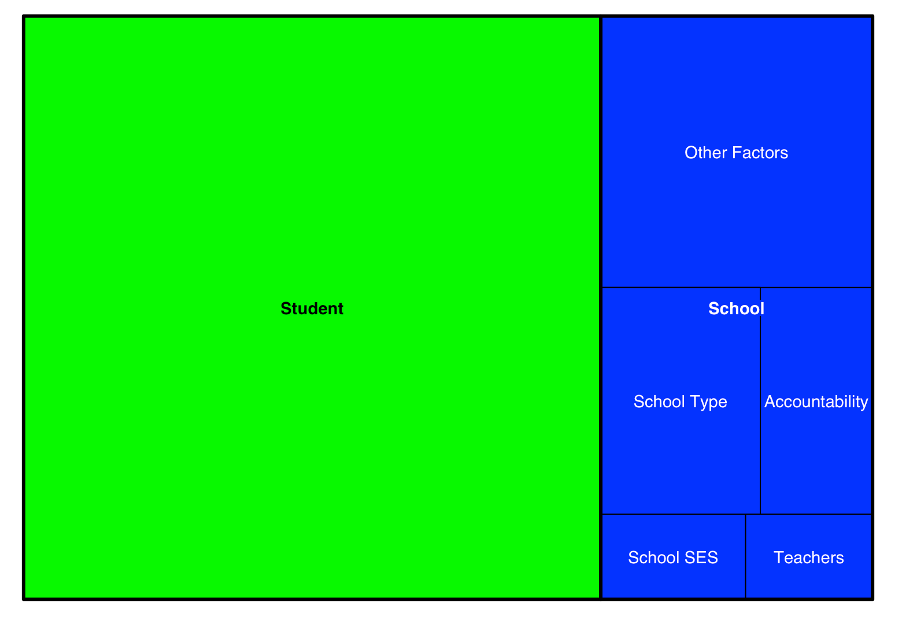
Concluding Thoughts
Thinking beyond schools in policy for learning outcomes

Slide 27
Appendices

Slide 28
Exit Items
Do you ever consider moving your child to another school?
If parents don't like the school, they should move their child to another one
Did you visit any schools when deciding where to send your child to school?

Slide 29
Voice Items
Have you attended a meeting at the school where a decision was made?
Have you spoken to the head teacher of the school?
Have you spoken to another parent about the school?
Have you talked about the school management with a member of the school management committee?
Have you spoken with a teacher about your child?

Slide 30
Vertical Accountability Items
Does the government make decisions that directly affect the daily activities of the school?
Does the headteacher make decisions that directly affect your teaching?
Does the school management committee make decisions that directly affect your teaching?

Slide 31
Horizontal Accountability Items
Been observed formally by another teacher?
Formally observed another teacher?
Participated in a decision that affects the rest of the school?
Talked to other teachers about how to improve your teaching?
Received recommendations from other teachers on how to improve your teaching?
Received formal feedback on your work?

Slide 32
Professional Commitment
Is it possible for teachers to miss some days of work, then make up the lost time when they return?
If teachers work hard, any child can do well in school
Attended any classes or workshops to improve your teaching?

