Slide 1
What do we know about system-wide instructional change to improve early grade learning?
Brahm Fleisch
RESEP Early Reading Workshop, 2019

Slide 2
Three questions
What is the problem?
What does the evidence show?
What do we know about system-wide instructional change?

Slide 3
What is the problem?
Unequal learning outcomes
Low levels of learning outcomes in the early grades

Slide 4
(Spaull, 2015)

Slide 5
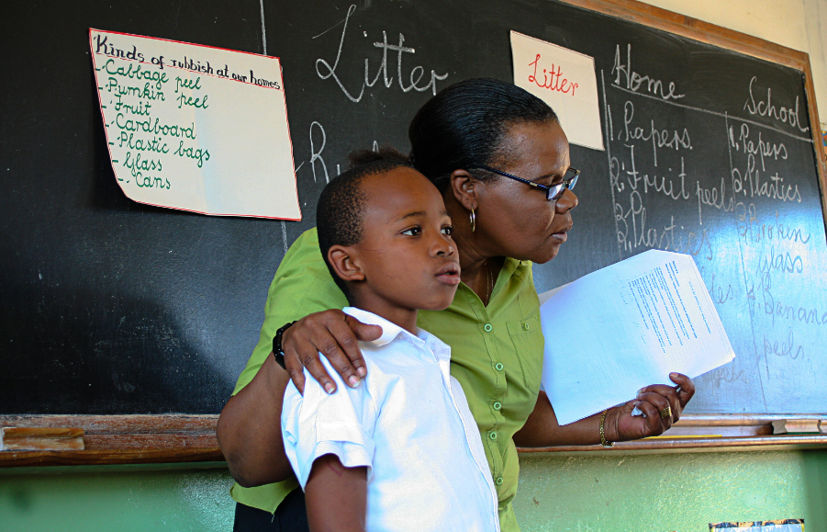
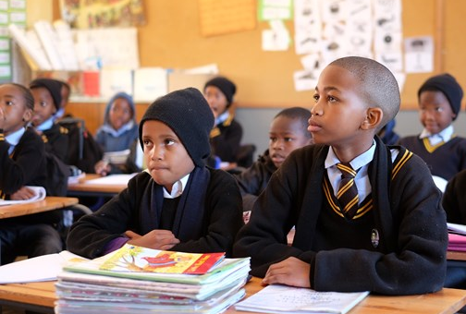
78%
of Grade 4 children in South Africa can not read for meaning in any language.
PIRLS Literacy 2016 (Howie et al., 2017)

Slide 6
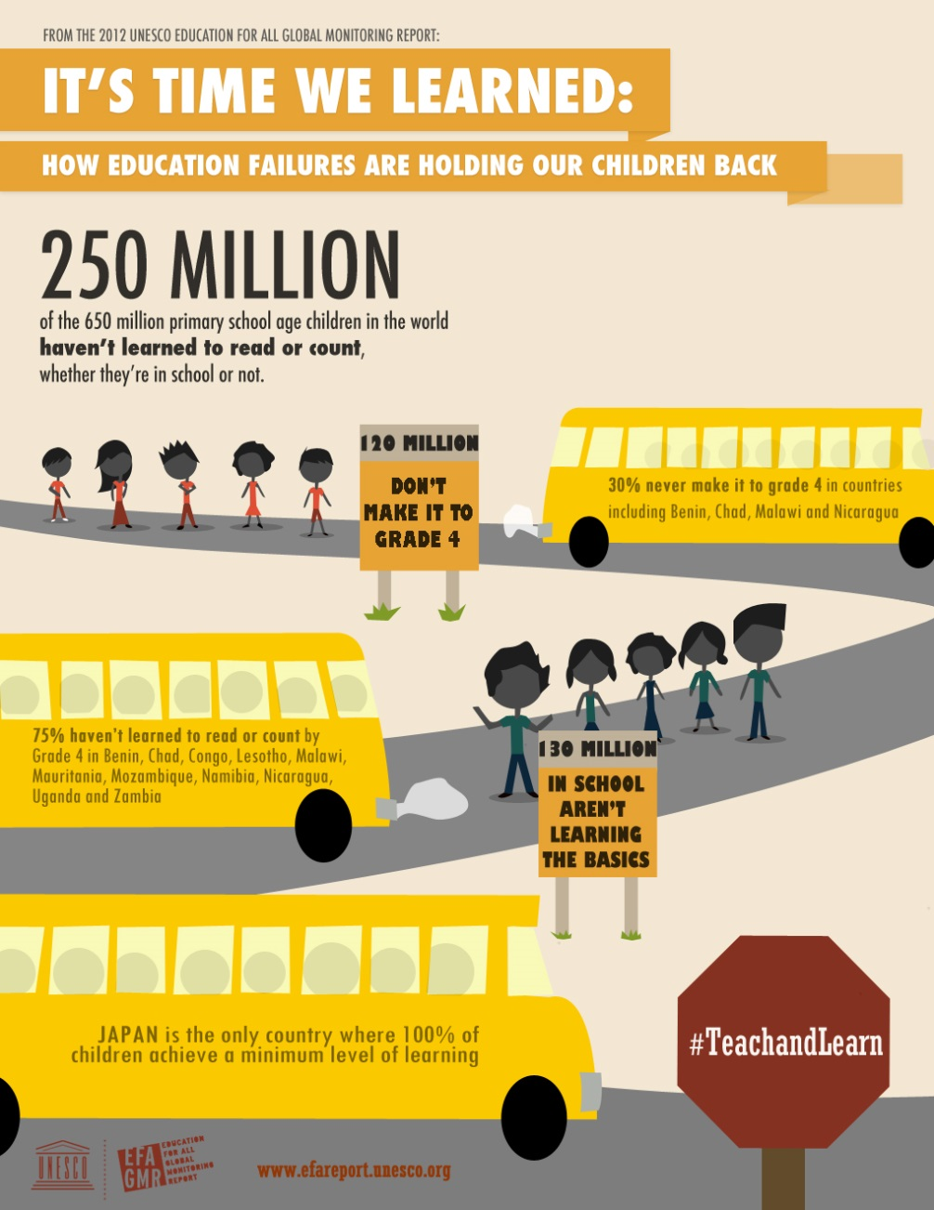
Around 250 million children in low-and middle-income countries cannot read, write or do basic maths. UNESCO

Slide 7
Cumulative backlogs in learning
(Spaull & Kotze, 2015)
Figure 10b: South African mathematics learning trajectories by national socioeconomic quintiles using a variable standard deviation for a year of learning (0.28 in grade 3 to 0.2 in grade 8 with interpolated values for in-between grades (Based on NSES 2007/8/9 for grades 3/4/5, SACMEQ 2007 for grade 6 and TIMSS 2011 for grade 9, including 95% confidence interval

Slide 8
What does the evidence show?

Slide 9
Name of Study | Research Method | Timeframe | Focus | Size
Gauteng Primary Language & Mathematics Strategy | Quasi-RDD, natural experiment | 2011-2014 | primary school literacy & mathematics | 1040 schools
Reading Catch-up Study | RCT | 2014 | Gr 4 remedial programme | 100 schools
Early Grade Reading Study | RCT, class observations case studies | 2015-2017 | Gr 1-3 Setswana literacy | 230 schools
Early Grade Reading Follow-up Study | RCT + | 2018 | Gr 3-4 Setswana literacy | 230 schools
Early Grade Reading Study II | RCT | 2017-2020 | Gr 3 English FAL literacy | 180 schools
Reading Support Project and Classroom Libraries | RCT | 2019-2021 | Gr 1-2 English and Setwsana literacy | +/-300 schools

Slide 10
Experimental research in early grade reading
GPLMS, 2011-2014
EGRS I, 2015-2018
EGRS II, 2017-2020
RCUP, 2014

Slide 11
Model 1
Instructional Practice
Learning Outcomes

Slide 12
Standardized Tests used as a Catalysis
Basic knowledge and skills in reading, writing, and mathematics, and the natural sciences
Narrowing of the curriculum, deemphasises on arts and other subjects
National Targets
Political identification of national numerical targets attached to the political cycle
External Assessment and Accountability
Provision of centrally procured and educative learning materials to all learners
Professional Development
Standardized Learning Materials
Focus on Literacy and Numeracy
Prescriptive Curriculum
Change strategies often triggered by international test results or national attention generated on the weaknesses of the education system
Sources of educational change are external innovations brought from the corporate world through legislation and national programs.
Tightly prescribed curriculum aligned to daily lessons with detailed scripting
This takes a variety of forms from conventional short-course, just-in-time training to site-based coaching.

Slide 13
Model 2
Lesson plans
Educational materials
Training & Coaching

Slide 14
GPLMS, 2011-2013
Initial literacy only, 2012 incorporated mathematics
Grades 1-7
1040 underperforming primary schools
~12 000 teachers
~700 000 learners
500 coaches
Funded out of the provincial budget
1. Measuring literacy and raising expectations
  1.1 Annual National Assessments
  1.2 Common Assessments
2. Strengthening the teaching of literacy & maths
  2.1 Lesson Plans
  2.2Provision of Resources:, e.g. HL Graded Readers & Workbooks
  Catch-Up Programme
  2.3 Training & Instructional Coaches
3. Improving programmes of learner support
  3.1 Homework Assistants
  3.2 Parent Support Programme Support
  3.2 Strengthening book collections in schools.
4. Improving the management of teaching and learning
4.1 District Officials
4.2 School Management Teams

Slide 15
)
GPLMS Grade 3 Numeracy 2008–2013 (restricted sample, Z-scores)
 | Specification 1 |  |  |  | Specification 2 |  |  | Specification 3
Year | 2008 | 2011 | 2012 | 2013 | 2011 | 2012 | 2013 | 2011 | 2012 | 2013
GPLMS | −.00852 | −0.165 | 0.631*** | 0.769*** | −0.134 | 0.725*** | 0.842*** | −0.0551 | 0.675*** | 0.909***
 | (0.0934) | (0.217) | (0.209) | (0.189) | (0.239) | (0.220) | (0.205) | (0.263) | (0.236) | (0.217)
Constant | 0.0879 | 0.0957 | −0.45** | −0.59*** | −0.015 | −0.65*** | −0.66*** | 0.141 | −0.360 | −1.121
 | (0.0779) | (0.181) | (0.174) | (0.158) | (0.242) | (0.244) | (0.212) | (0.767) | (0.781) | (0.797)
Obs | 82 | 82 | 82 | 82 | 82 | 82 | 82 | 82 | 82 | 82
R-squared | 0.000 | 0.007 | 0.102 | 0.171 | 0.035 | 0.250 | 0.301 | 0.103 | 0.307 | 0.357
Standard errors in parentheses. * p < 0.1. ** p < 0.05. ***p < 0.01

Slide 16
Reading Catch-up Programme, 2014
60% incorrect spelling of ‘bed’

Slide 17
Early Grade Reading Study, 2015-2017
Control group (80 schools) | “Training” Lesson plans, reading materials + central teacher training (50 schools) | “Coaching” Lesson plans, reading materials + on-site coaching (50 schools) | “Parent Involvement” (50 schools)
 | Training | Coaching | Parents
Per learner annual cost | $30.58 | $42.91 | $22.75
2015: Grade 1
2016: Grade 2
2017: Grade 3 (Interventions 1 and 2 only)
Notes:
Coaching most expensive but only about 30% more expensive than Training. Parent interventions, if effective, present a possible cost-effective solution.

Slide 18
EGRS I: Impact after 2 years

Slide 19
EGRS I Qual Studies
Partial enactment -- teachers’ lack reading instructional knowledge and had little ‘passion’ for reading.
Lesson plans, materials and coaching associated with teachers’ new use of micro and macro time.

Slide 20
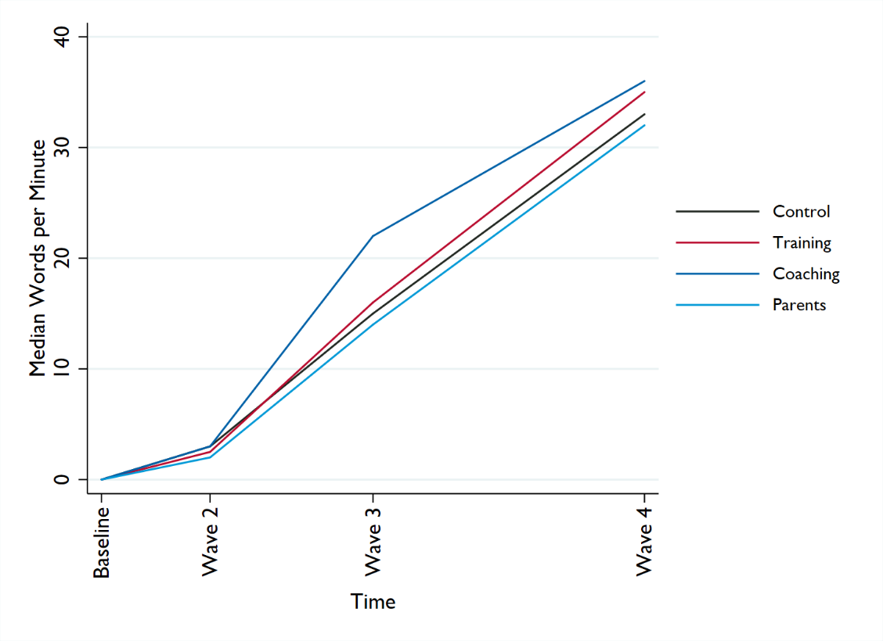
EGRS I Follow-up, 2018

Slide 21
Early Grade Reading Study II, 2017-2019

Slide 22
How does this compare to the international evidence from middle and low income countries?

Slide 23


Slide 24
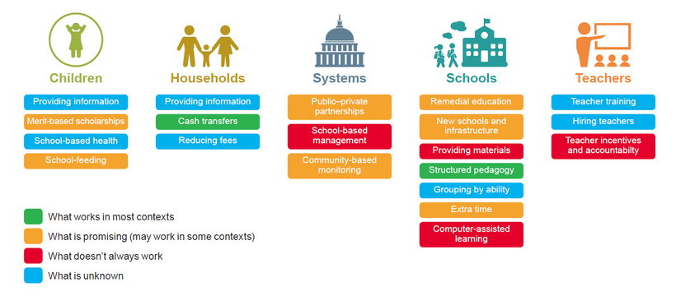

Slide 25
Pratham TaRL, 2017
State government ensured that 400 officials at sub-district level conducted their own daily “practice classes” for 20 days. (Pratham trained & monitored)
Officials then trained teachers and continuous on-site support, mentoring & monitoring
% Children | Baseline | Midline | Endline
Reading Gr 2 level | 39.4 | 57.1 | 75.4
subtraction borrowing (2 digit) | 72.6 | 86.8 | 95.2
division problems (3 digit by 1) | 38.3 | 53.7 | 75.6
4500 schools: 3 districts in Karnataka state in 2016-17

Slide 26
Tusome Class 2 Learning Outcomes
Notes:
These are the year on year comparisons in outcomes
We used the exact same tool in these randomly selected schools
The results are quite different
The key ones to look at are the percentage at the benchmark
Many more children are able to read, in one year, than could before
The zero score reductions are also notable
This far surpassed our expectations for one year

Slide 27
What do we know about system-wide instructional change?

Slide 28
Structured pedagogic models of system-wide improvement “work” in the early years of school learning.
The models have aligned multiple-components.
Early learning gains can be sustained into the middle years.
Learning gains are significant and educationally meaningful, and consistent with international evidence.
but . . .
The learning gaps remain large, and
We are far from reaching key learning targets/benchmarks.

Slide 29
Model 1
Instructional Practice
Learning Outcomes
Old
Instructional Practice at the right level
Learning Outcomes
New

Slide 30
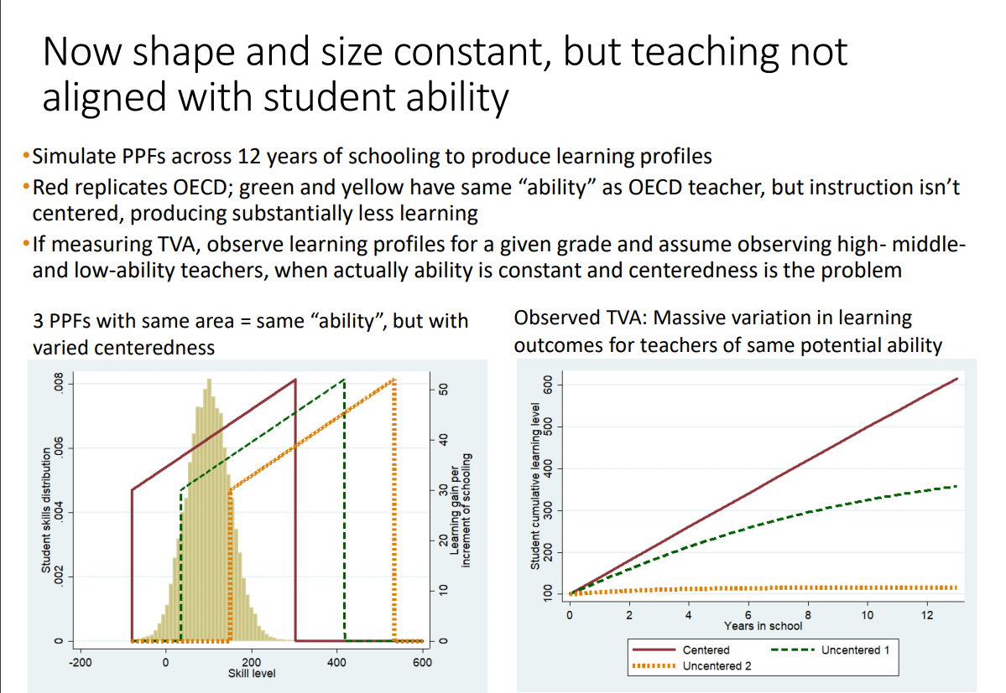
Kaffenberger & Pritchett, 2019

Slide 31
Model 2
Lesson plans
Educational materials
Training & Coaching

Slide 32
Model 3
Training
Understanding
Change
Old model
Understanding
Evaluating
Training
Trying
Change
New model

Slide 33
Model 4
Reading skills
Habits of reading
Reading for meaning

Slide 34
What we do not yet know
Do the change models transfer into other contexts, subjects and grades?
Can we scale-up system-wide effectively?
How long do the interventions need to be in place so they do not fade out?
What alternative curricula and pedagogies might be more effective?

Slide 35
Creating Pubic Value
Mark Moore
“Government should fix this problem” (Government)
This is unfair and unjust! There should be a law.” (Law)
“Everyone who knows anything knows this is the right thing to do.” (Professional Knowledge and Ideology)
“We just need better ideas” ( Social entrepreneurs and Philanthropy)
“This is so good people will want to buy it!” (Markets)
“The conditions are intolerable and unjust, we need to mobilise society as a whole to think and act differently.” (Social Movements)

