Slide 1
Building an evidence-base from randomised control trials Presentation of the findings of the impact evaluation of the Reading Catch-Up Programme
18 August 2015

Slide 2
The team includes Stephen Taylor, Volker Schoer and Thabo Mabogoane
Generous financial support from the Zenex Foundation
Wits University Human Research Ethics Committee
Mary Metcalfe, a big thank you for facilitating our discussions with the KwaZulu-Natal Department of Education
Top management of the KwaZulu-Natal Department of Education
Pinetown district staff
The teachers, both in the control and the treatment schools, for their ongoing commitment
Our partners at Class Act and the JET Education Services

Slide 3
Background
Research design
Findings
Discussion and Conclusion

Slide 4
Large-scale counterfactual studies of system-wide instructional programmes
PMRP comparison study (2010)
GPLMS RDD/natural experiment (2013, 2015)
RCUP Pinetown (2014)
EGRS I Setswana (2015-2017)
EGRS II English (2016-2018)
EGMS Multilingual (2016-2018)

Slide 8
Large proportion of schoolchildren in South Africa are one or more years below the acceptable achievement levels (Taylor, 2014; NEEDU, 2014; Spaull, forthcoming).
Spaull (forthcoming) schoolchildren that are academically behind in the Foundation Phase are likely to fall further behind as they progress up the school system.
How can education departments address systemic learning backlogs?
Intermediate Phase Catch-Up Programme, developed as a component of the Gauteng Primary Literacy and Mathematics Strategy in 2012.
The 11 week programme, reteaching Foundation Phase English FAL skills in underachieving primary schools.
Hellman’s (2012) interval evaluation showed that the programme was effective in helping the majority of learners in Grades 4 to 6 to gain basic literacy proficiency.

Slide 9
Catch-up programme distribution across the four levels, 2012
Source: Hellman (2012)

Slide 10
Background
Research design
Findings
Discussion and Conclusions

Slide 11
Research Site and Sampling Frame
A single language teacher for all Grade 4 classes in each school.
Only schools that performed below 55% on the FAL Language 2013 ANA are included.
Only schools with between 15 and 120 learners (based on the 2013 ANA) are included.
Only public ordinary schools are included.
An 80% power level, and a 5% significance level.
Testing restricted to a random sample within a single grade.
Study in the Pinetown District, Kwazulu-Natal Department of Education
40 Treatment Schools vs 60 Control Schools

Slide 12
Distribution of pretest scores

Slide 13
Spelling test component

Slide 14
Baseline performance by age of learners
Age | Mean reading score | Number of learners
8 | 27.09 | 11
9 | 21.80 | 1,072
10 | 17.41 | 832
11 | 13.56 | 324
12 | 10.69 | 97
13 | 9.59 | 46
14 and older | 17.29 | 148
Age not specified | 16.89 | 13
Average/Total | 18.41 | 2,543

Slide 15
Curriculum coverage
 | Phonics |  | Listening & speaking |  | Shared reading and oral comprehension
 | Total # lessons | Lessons complete | Total # lessons | Lessons completed | Total # lessons | Lessons completed
Average number of lessons completed | 21 | 14 | 13 | 9 | 19 | 12
Average percentage of lessons completed |  | 74% |  | 69% |  | 63%

Slide 16
Attrition between pretest and posttest
 | Present at endline | Not present at endline | Total
Control | 1,423 | 127 | 1,550
 | (91.81%) | (8.19%) | (100%)
Treatment | 1,043 | 70 | 1,113
 | (93.71%) | (6.29%) | (100%)
Total | 2,466 | 197 | 2,663
 | (92.6%) | (7.4%) | (100%)

Slide 17
Background
Research design
Findings
Discussion and Conclusion

Slide 18
Baseline performance by gender
Gender | Mean score
Boys | 14.89
Girls | 22.05
Average | 18.40

Slide 19
Pre and Post Test Mean scores

Slide 20
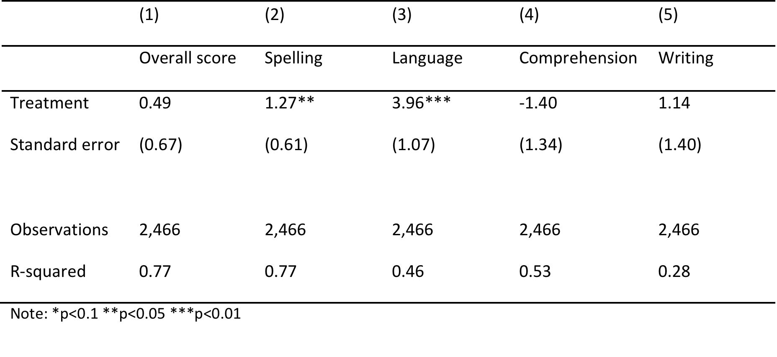
Main Regression Findings

Slide 21
Impact of coaches
 | Combined score | Spelling | Language
Coach A | 1.42 | 1.98** | 5.87***
 | (0.93) | (0.76) | (1.42)
Coach B | -0.42 | 0.56 | 2.09
 | (0.89) | (0.88) | (1.41)
N | 2,466 | 2,466 | 2,466
r2 | 0.7698 | 0.7692 | 0.4606
Note: *p<0.1 **p<0.05 ***p<0.01

Slide 22
ANA distributions

Slide 23
Annual National Assessment EFAL Grade 4
 | Model 1 | Model 2 | Model 3
Treatment | 3.35* | 3.83** | 3.49**
 | (1.93) | (1.88) | (1.72)
School mean Grade 4 2013 | No | Yes | Yes
School mean Grade 4 2012 | No | No | Yes
School mean RCUP baseline | No | No | No
School mean Grade 3 2013 | No | No | No
N | 6,419 | 6,419 | 6,419
r2 | 0.1731 | 0.1914 | 0.2072
Note: *p<0.1 **p<0.05 ***p<0.01

Slide 24
School A
School B
School C
School D

Slide 25
Average gains by decile of baseline scores

Slide 26
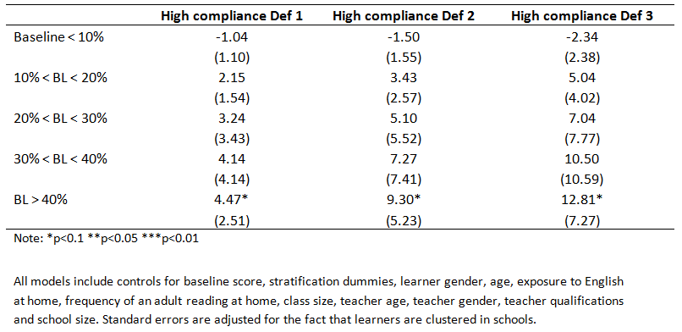
IV estimates of the TTE for differing baseline performance
(Outcome: Overall reading score; Compliance defined according to training attendance)

Slide 27
Background
Research design
Findings
Discussion and Conclusions

Slide 28
KEY FINDINGS
Study shows that RCUP impacts positively on spelling and language performance and impacts positively on the overall ANA EFAL Grade 4 scores.
the programme impact was greatest amongst initially well-performing learners with teachers who complied with the programme. Therefore, if learners have a fair learning platform and the teacher participates actively in the intervention, then the RCUP can have large benefits (up to 12 percentage points impact).
The quality of the coaching makes a difference in terms of learner performance.

Slide 29
One of the unexpected findings was the substantial gains made by the control schools. Why the large gains in the control group?
Developmental learning
Hawthorne effect
Unintended spillover effect
Floor effect

Slide 30
Other Findings
Grade 4 learners’ English-language proficiency is very weak. Most of the Grade 4 learners continue to be very weak spellers, with limited command of basic structures of the language, and poor comprehension and writing proficiency.
The gap between these learners’ literacy performance and the demands of the curriculum remains large.
Large performance gap between boys and girls. This gap is evident in both the pretest and the posttest, and is consistent across the study tests and the ANA results.

Slide 31
CONCLUSIONS
From a research perspective, the study shows that the Reading Catch-Up programme has ‘educationally meaningful’ impact for learners with a basic learning platform.
From a policy perspective, the results do not provide grounds for a scaling up warrant.
From a methodological perspective,
study demonstrates the enormous value of counterfactual research designs and importance of replication studies, and
the data collected for the study are likely to be the basis for a number of further secondary studies.

